Slide 1

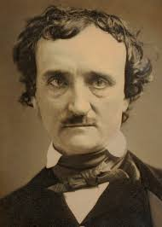
The Tell-Tale Heart
Do you know the author of this story?
By Edgar Allan Poe

Slide 2

Pre-Reading Discussion:
What do you already know about the story’s author?
What does the title reveal about the story?
What hypotheses about the story can you make based on this context?

Slide 3

Vocabulary

Slide 4
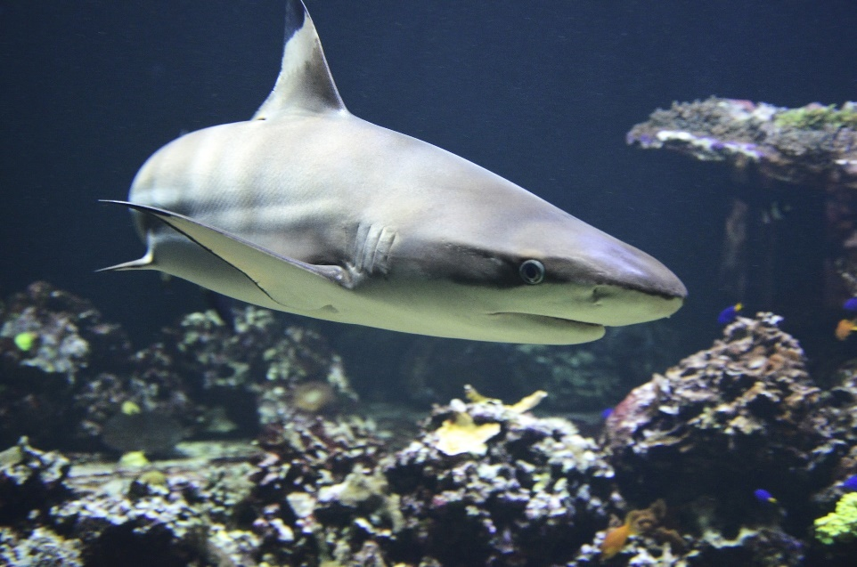
1. acute
adjective
sharp, keen, strong
  “Great whites sharks have an acute sense of smell.”

Slide 5
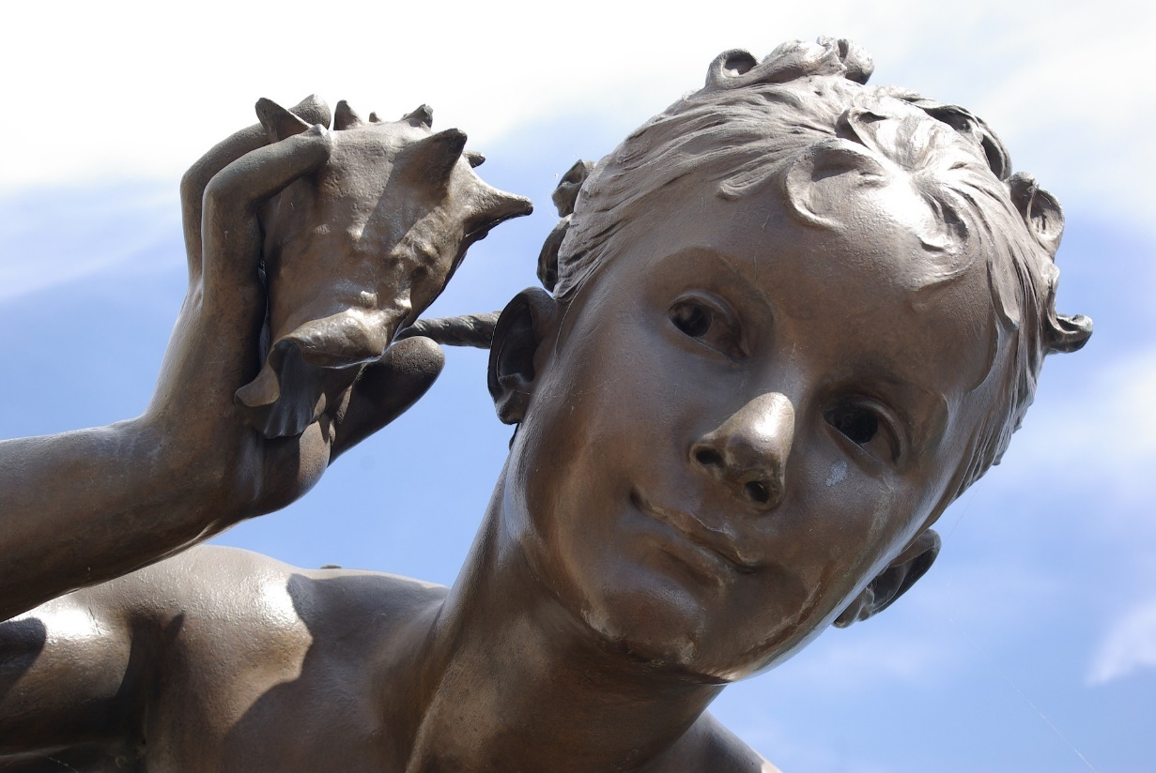
2. hearken
verb
listen
- “One must hearken to the sounds of nature.”

Slide 6
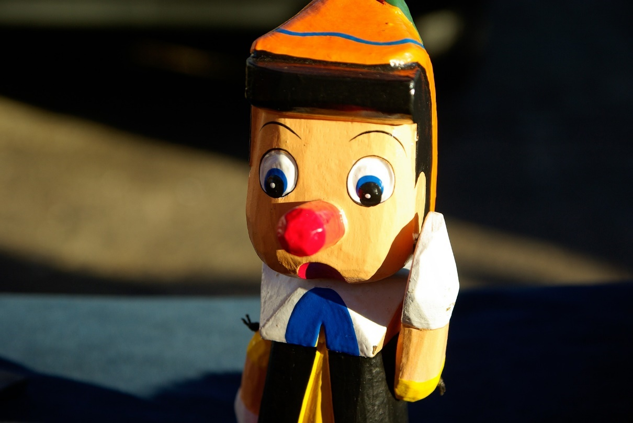
3. dissimulation
noun
lies, deceit
- “Your dissimulation shows on your face!”

Slide 7

4. cunning
adjective
clever, smart, sly, tricky
“Pirates are known for being cunning when running from the law.”

Slide 8
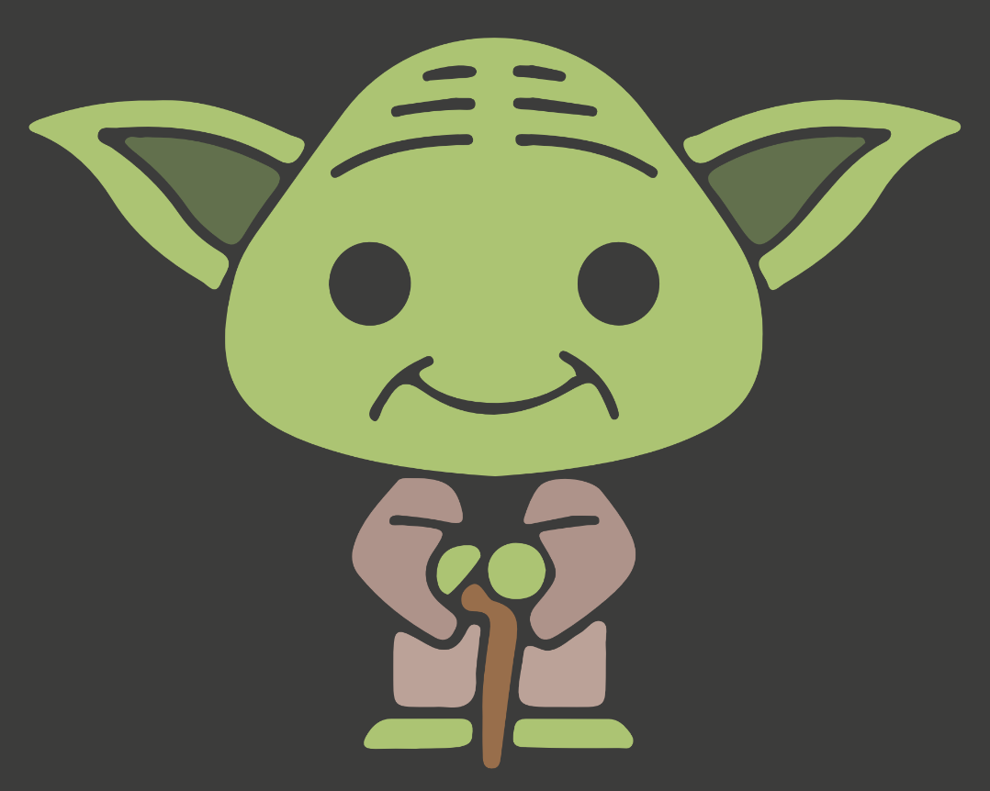
5. sagacity
noun
wisdom, forethought
“Yoda offers bits of sagacity to fellow Jedis.”

Slide 9
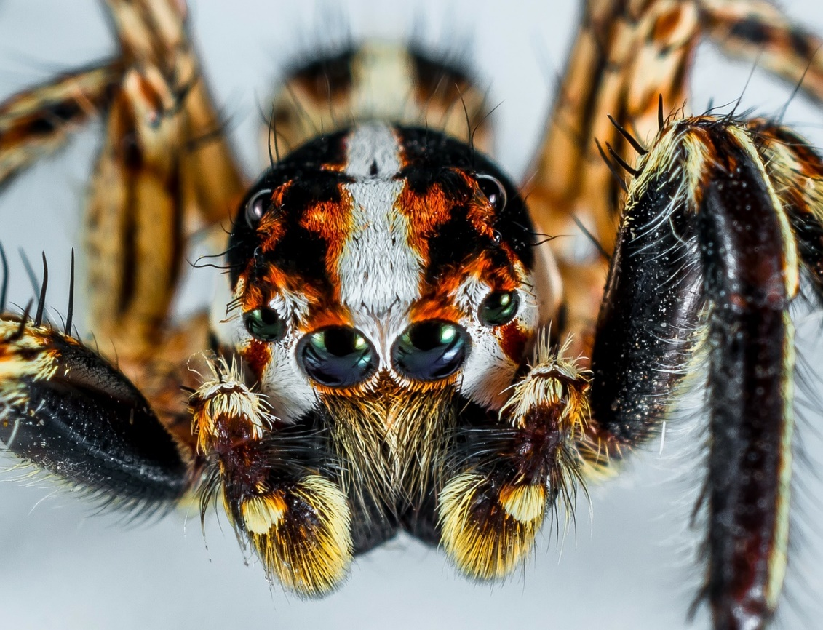
6. mortal
adjective
able to die, relating to life and death
“Spiders fear me with mortal terror.”

Slide 10

7. awe
noun
wonder, respect
- “A beautiful sunset can fill me with awe.”

Slide 11
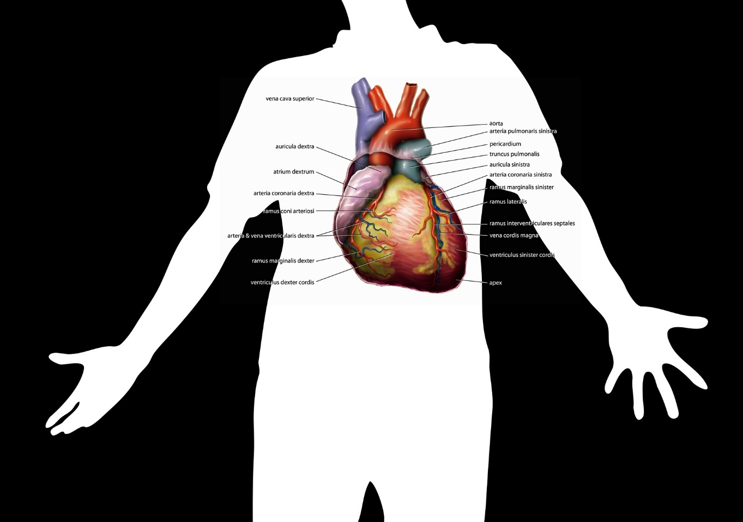
8. bosom
noun
chest, heart, breasts
- “I can feel my hear beat in my bosom.”

Slide 12
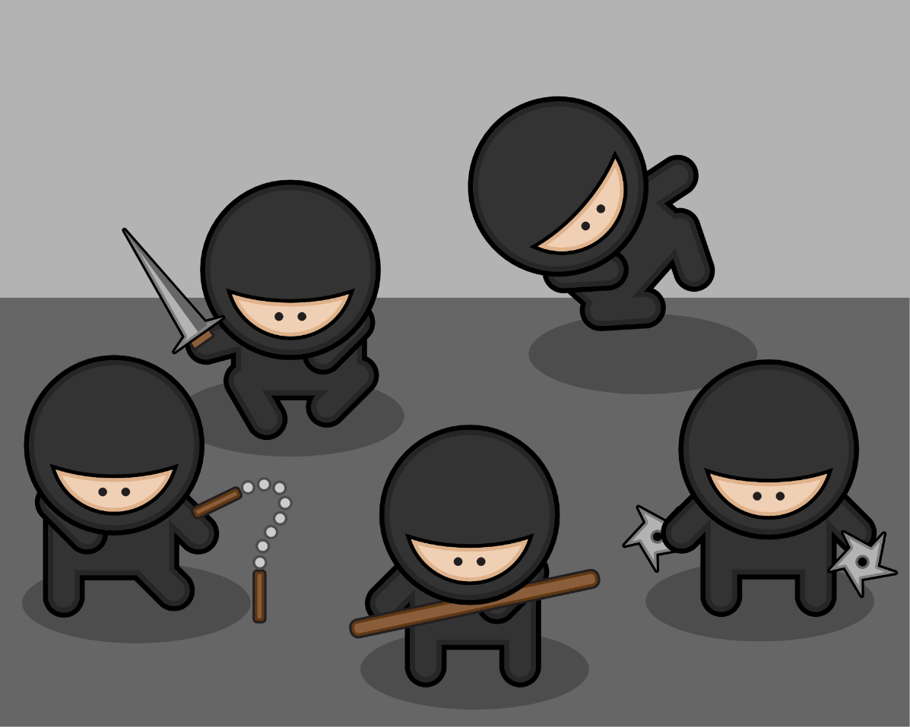
9. stealthily
adverb
sneakily, slowly, patiently
- “A ninja must move stealthily to avoid being caught.”

Slide 13

10. audacity
noun
nerve, boldness, courage
- “Where did you get the audacity to speak to me in that tone?”

Slide 14

11. ere
preposition
before
- “Cinderella must be home ere midnight!”

Slide 15
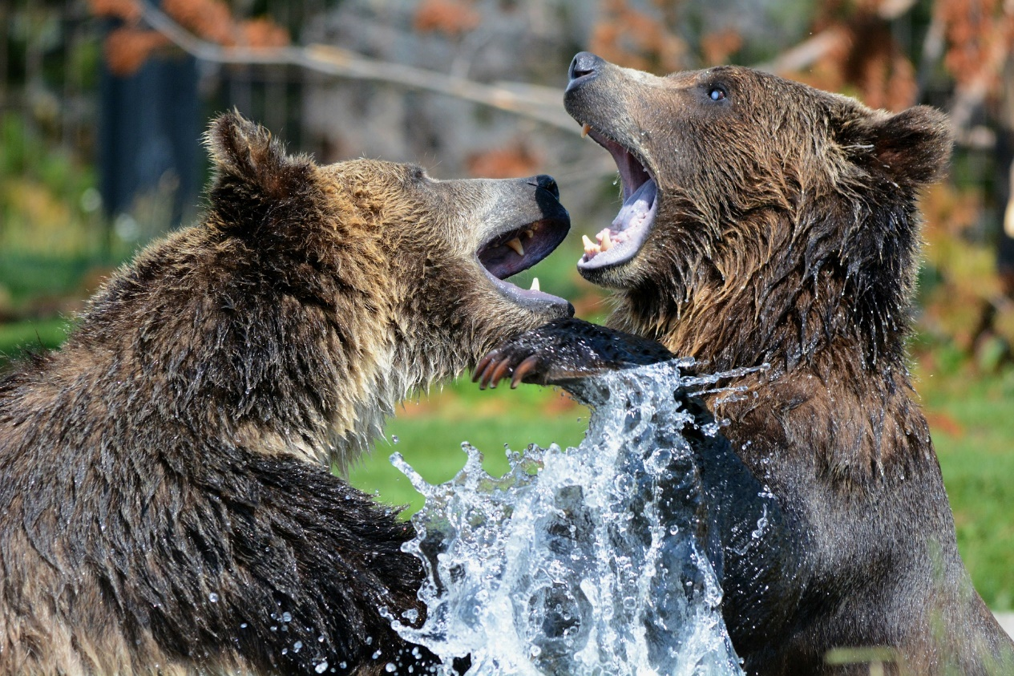
12. vehemently
adverb
strongly, furiously
- “The mother grizzly vehemently defended her cubs.”

Slide 16

13. trifles
noun
unimportant things
“Lady is not interested in your trifles.”

Slide 17
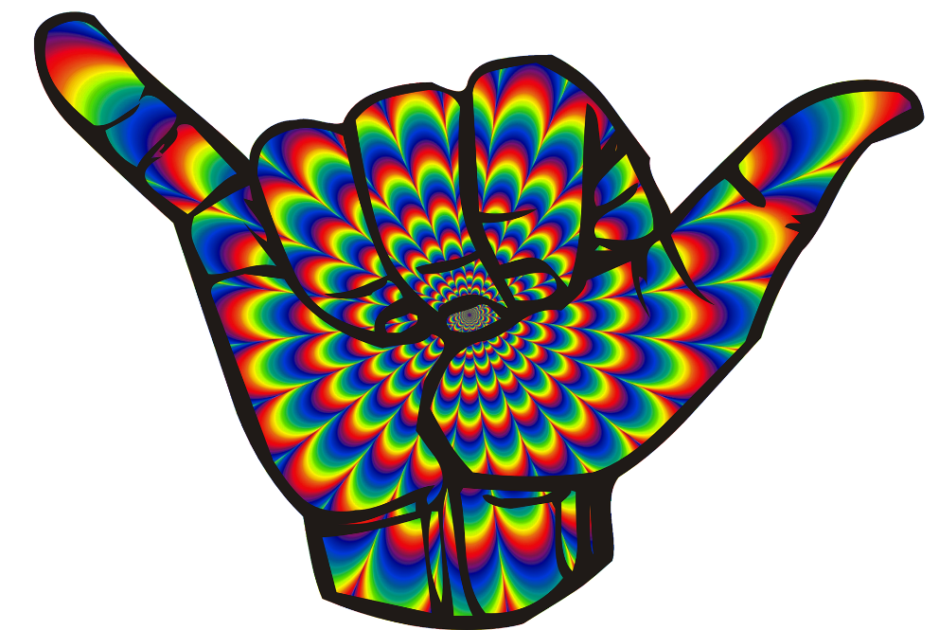

14. gesticulations
noun
movements that mean or signify something
- “Non-verbal communication requires physical gesticulations.”

Slide 18
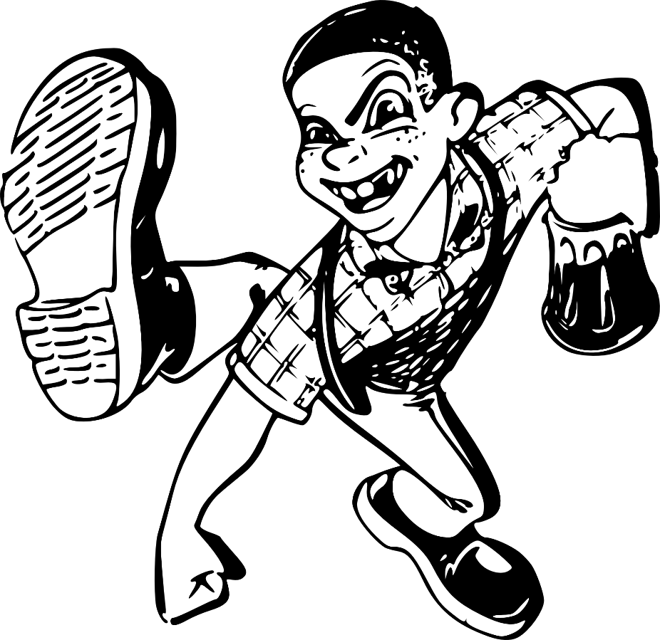
15. mockery
noun
ridicule, teasing
- “Bullies try to make a mockery of others.”

Slide 19
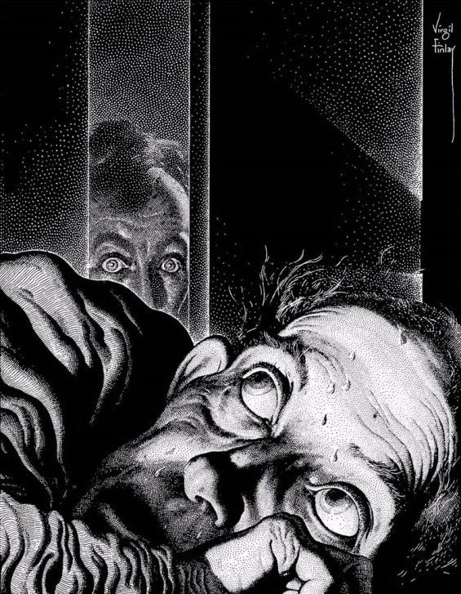
Discussion: Who is telling the story?
lines 1-29
In what person is the story told?
What is the point of view?
Why is this effective?

