Slide 1

For Heidi With blue hair
By Fleur Adcock

Slide 2


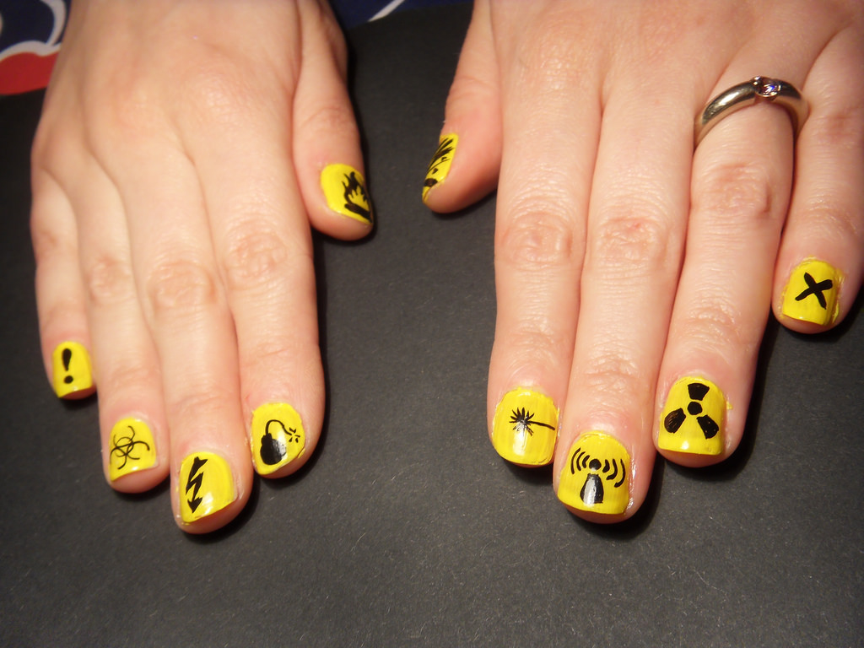

In your poetry journal:
Imagine if people had to wear warning labels, the the same as products or places.
                What would yours say?
                What colour would it be?
                What would the icon or image be?

Slide 3


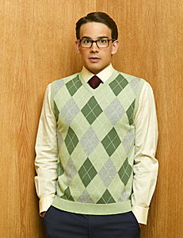
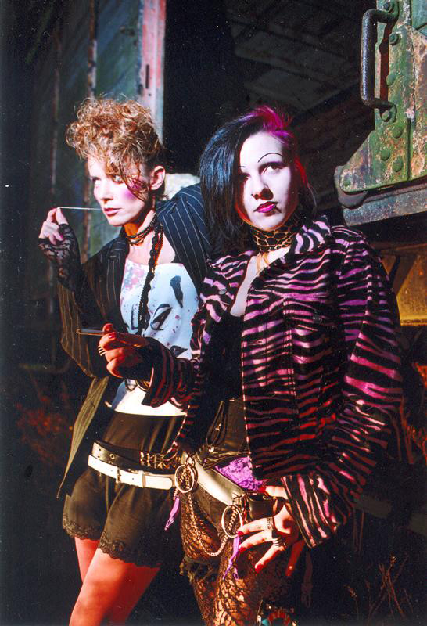
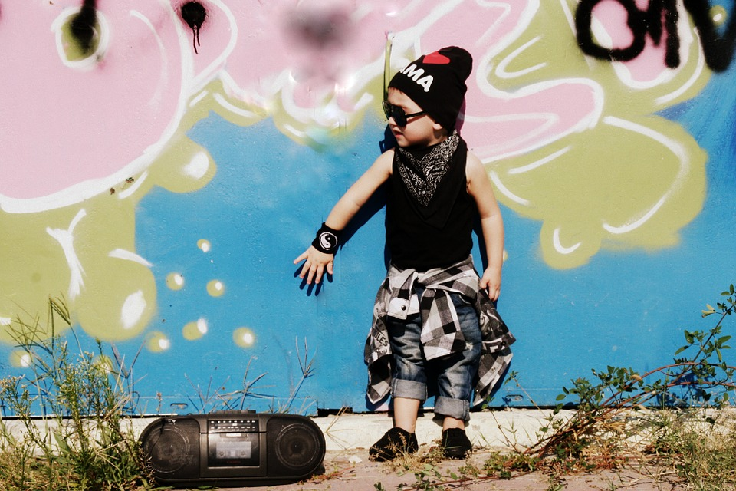

Discussion Question:
Can people really express themselves through their clothing and hair style?

Slide 4

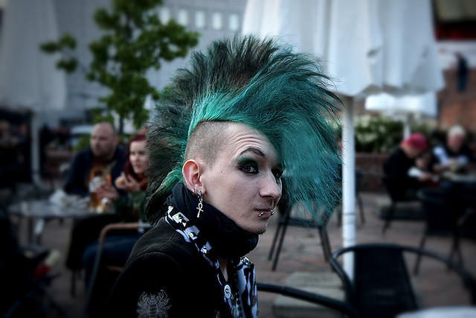
Why are we compelled to express ourselves to the public?

Slide 5
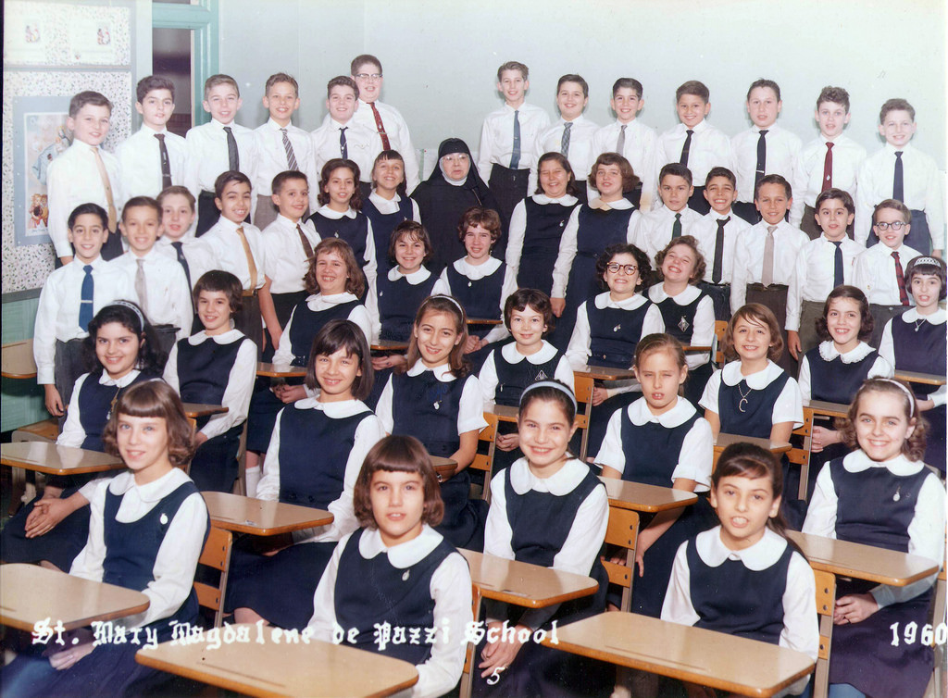
What is the point of school uniforms?
Think-pair-share:
What are the benefits of a school uniform?
Is obedience a virtue?
Is rebellion a virtue?

Slide 6
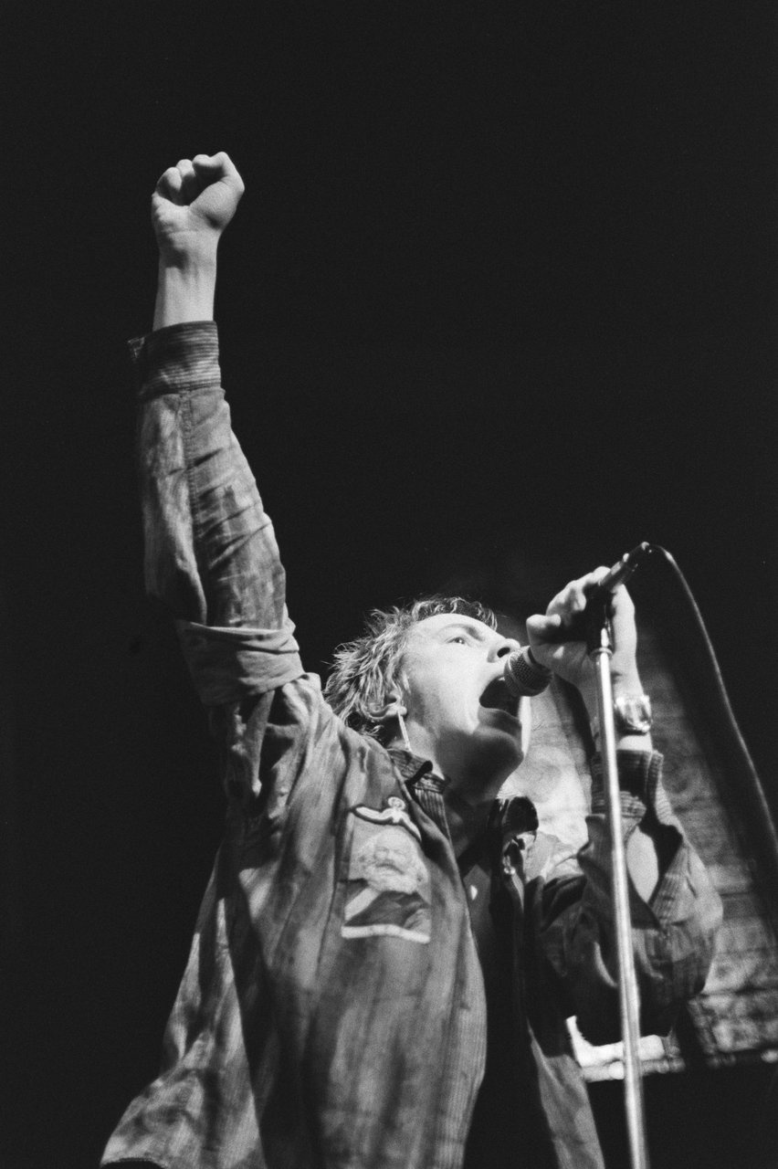
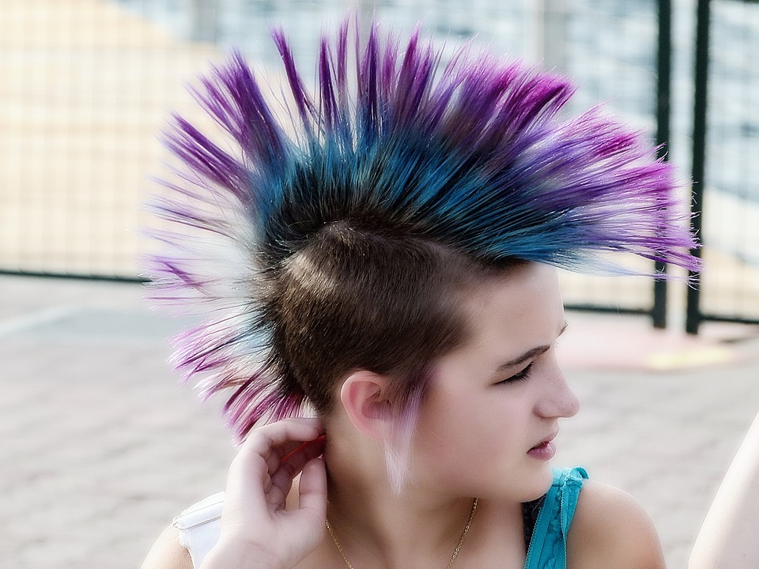

On your handout:
Make a list of the connotations that come to mind from the word punk:

Slide 7

Read the poem
Read the poem, ‘For Heidi With Blue Hair’ our loud with a partner switching speakers at each stanza
Answer the comprehension questions

Slide 8

Post reading Discussion:
What are the main themes in the poem?
death
loss
grief
rebellion
independence
family
obedience
authority
loyalty

Slide 9

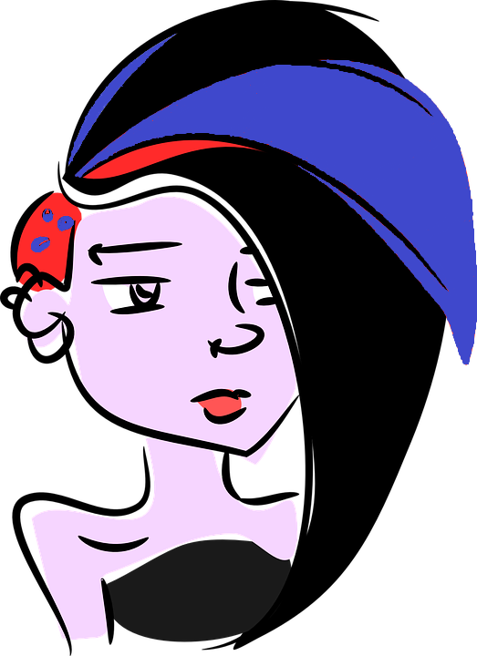
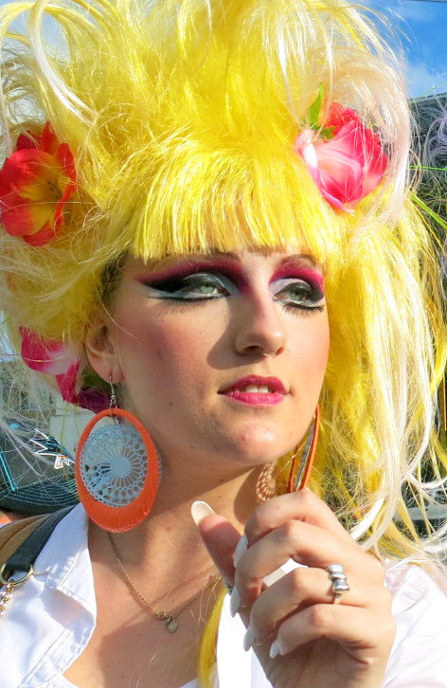
Literary devices
What literary device(s) did you identify in the poem?
Use the table from your handout to write 3 complete sentences articulating the effects each use of imagery has on the overall poem.
Hint: What do the uses of imagery reveal about Heidi? How do they help the reader develop empathy?

