Slide 1
One art
Elizabeth Bishop

Slide 2
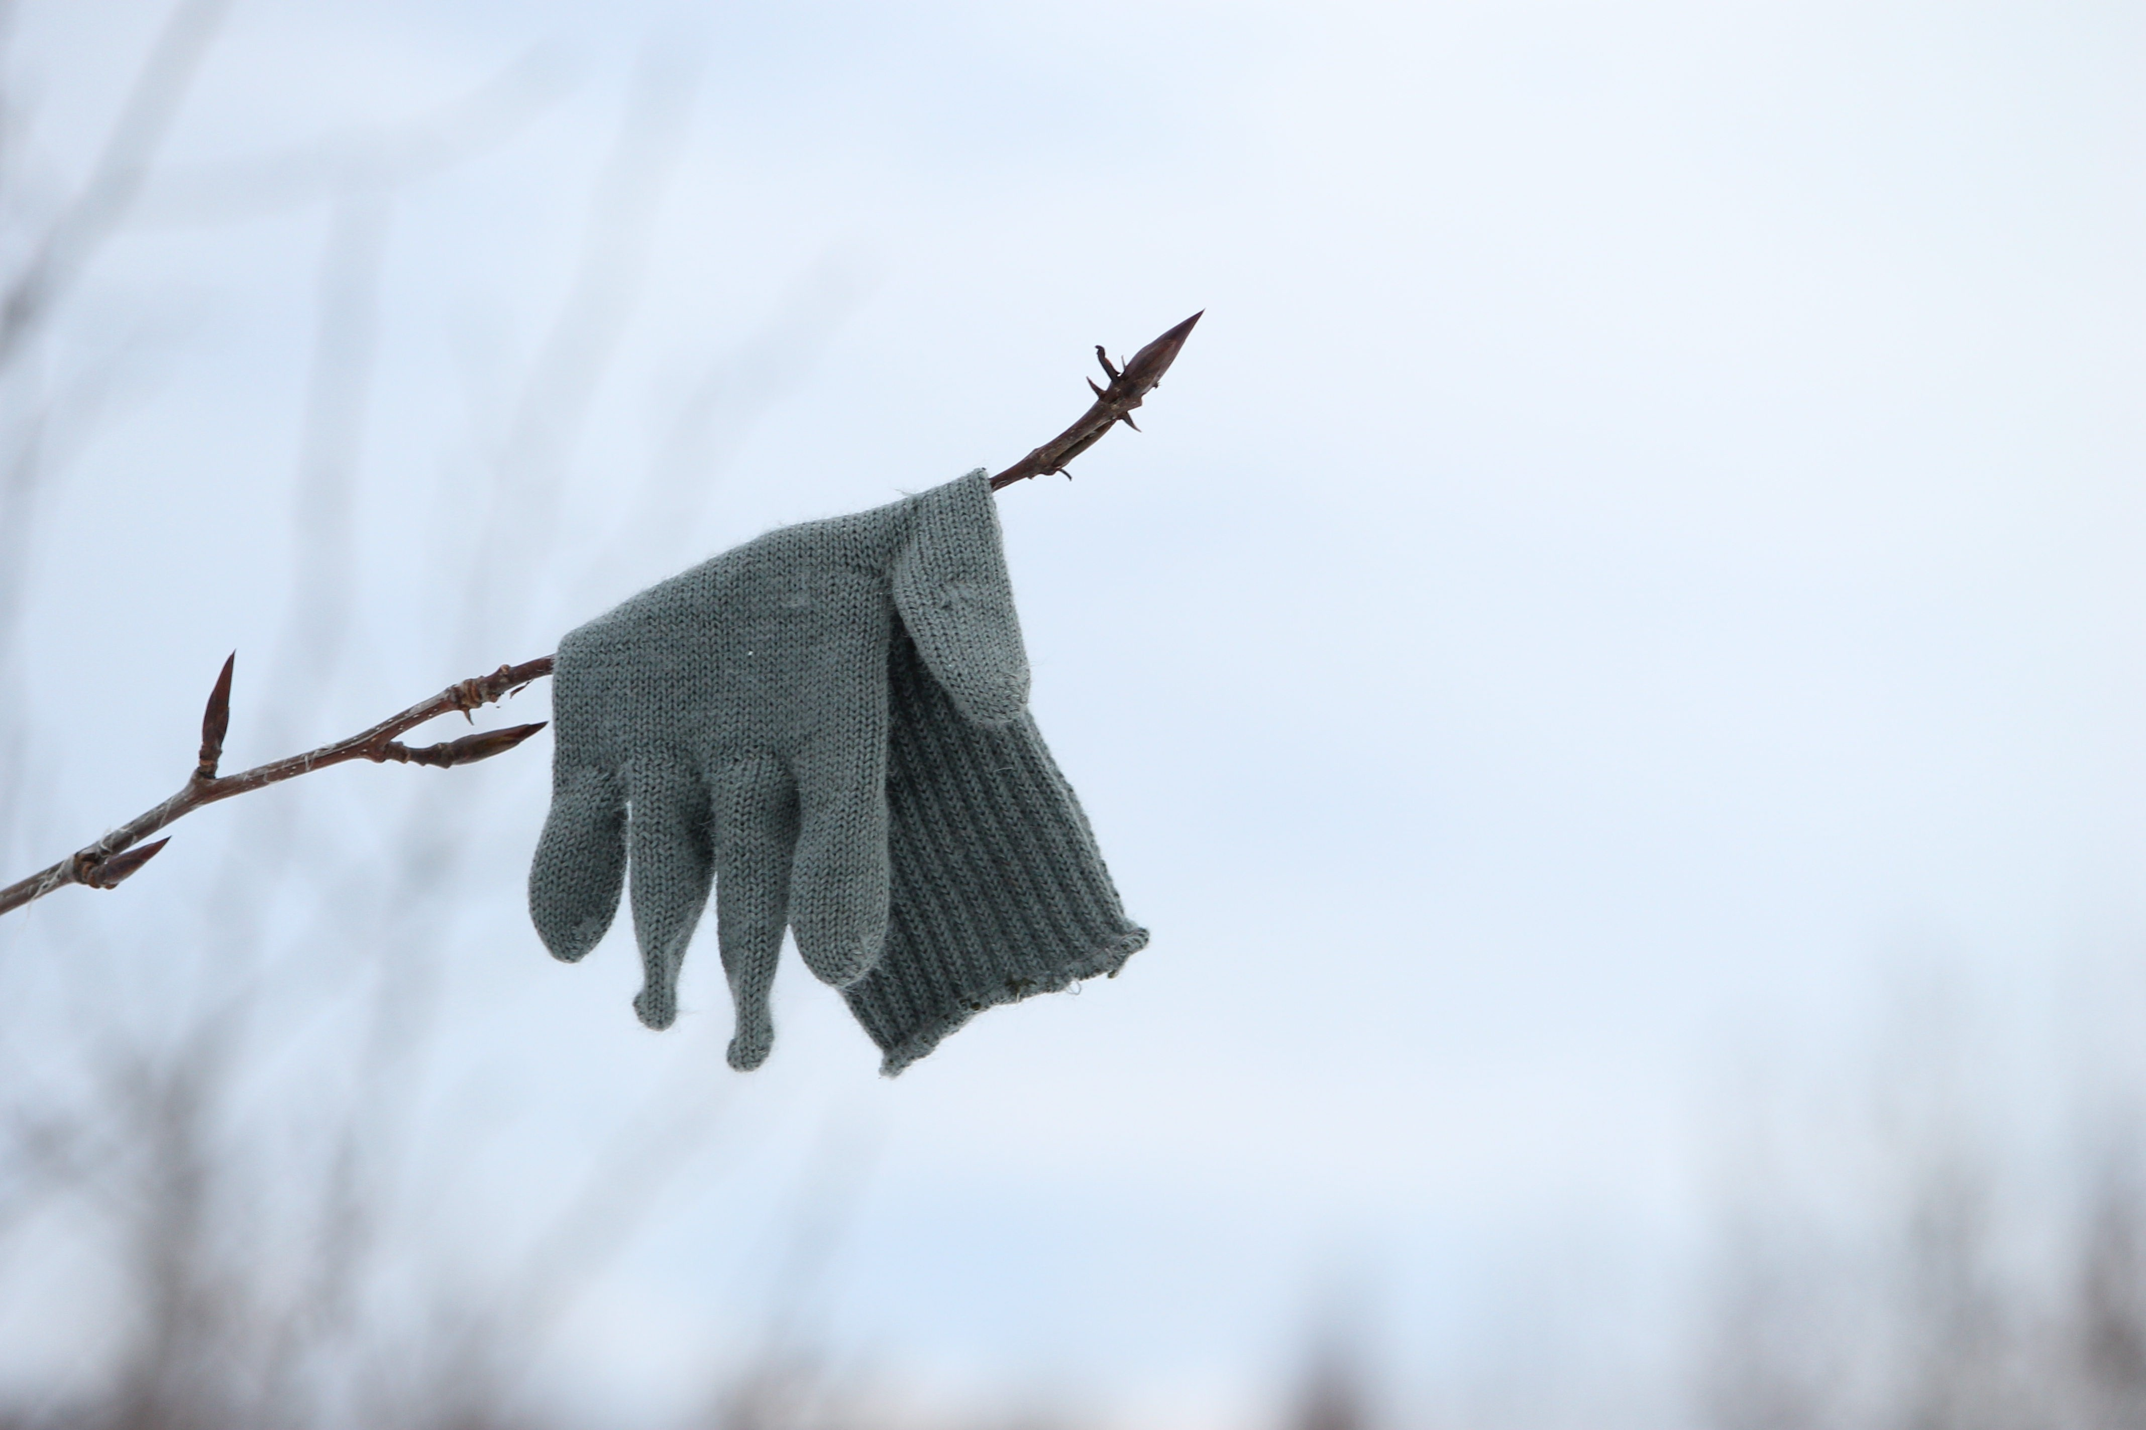
In your poetry journal:
QUICK WRITE
What was the last thing you lost? Describe it in detail.
How long before you noticed it was missing?
How did you feel?
Were you able to find it?

Slide 3
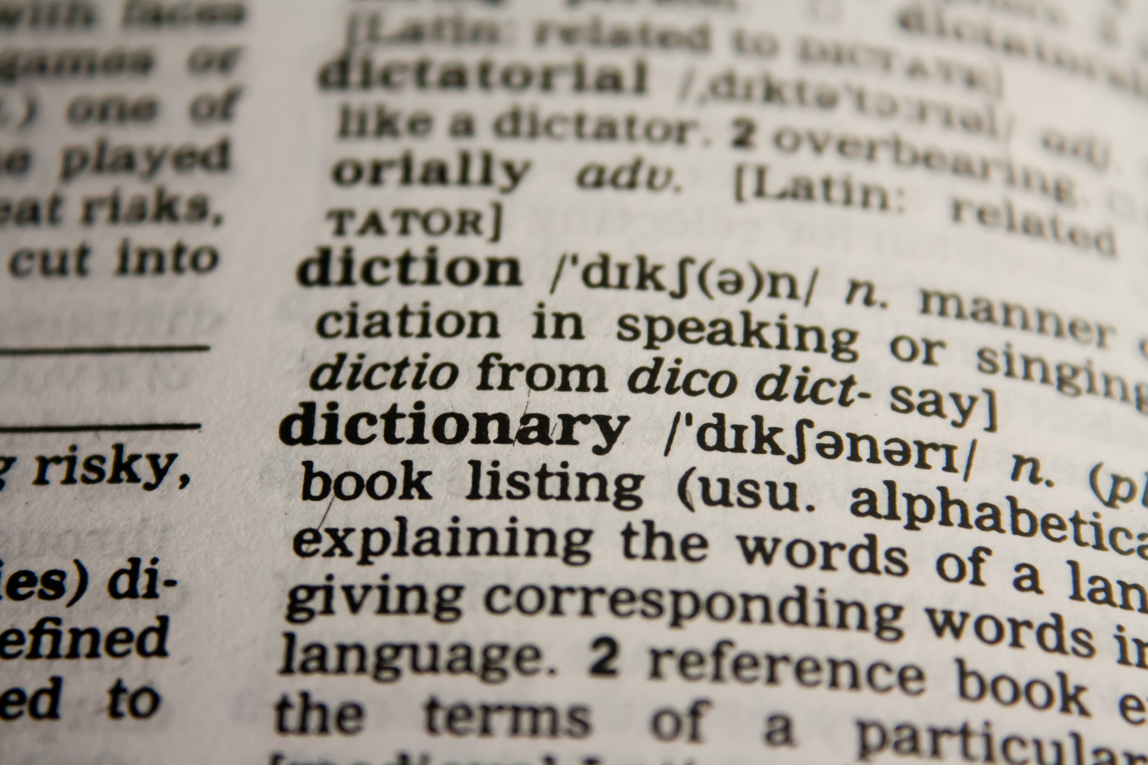
Key Vocabulary

Slide 4

1. intent
noun
determination, purpose
His intent is to reach the top of the stairs!

Slide 5
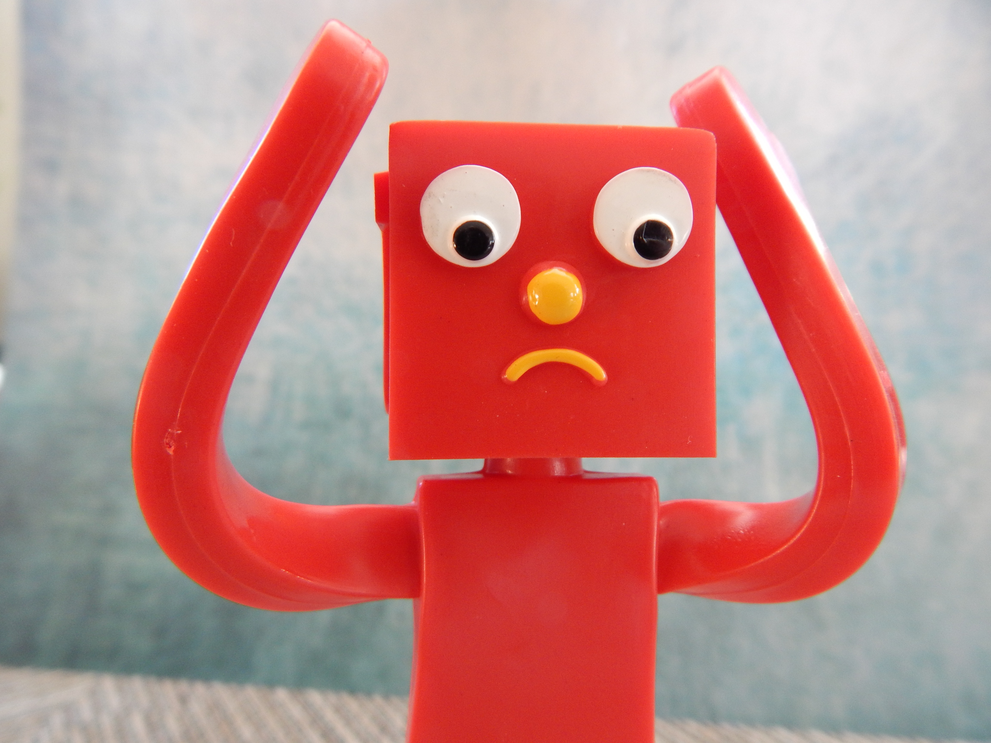
2. fluster
noun
confusion
Gumby is disorganized and leaves the house in a complete fluster every morning.

Slide 6
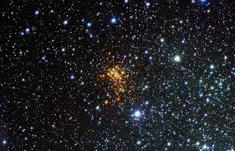
3. vast
adjective
very large, open and empty
Outer space is a vast expanse of unexplored mysteries.

Slide 7
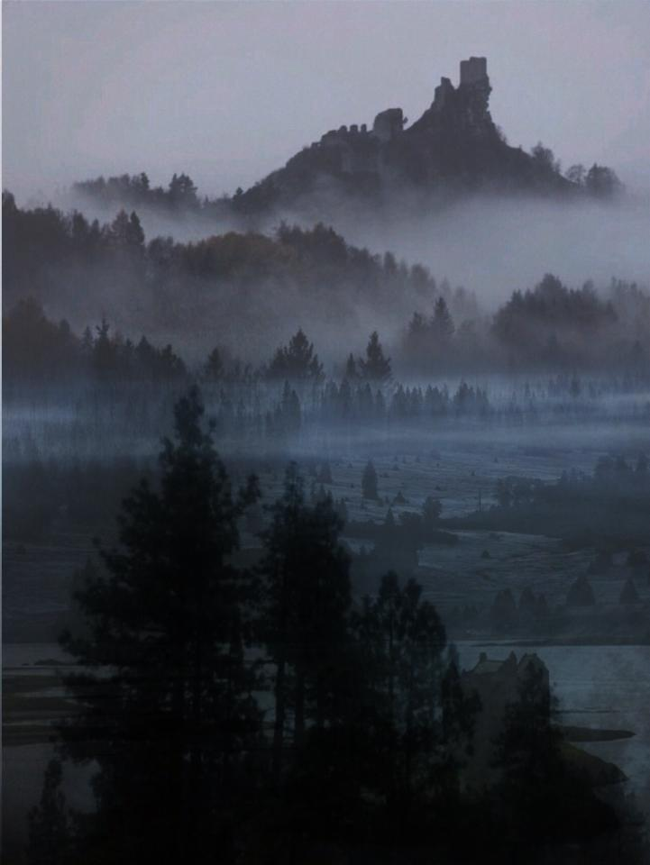
4. realm
noun
kingdom, world, land, dimension
My realm reaches as far as my eyes can see.

Slide 8

5. gesture
noun
movement of the body
Her gestures indicate everything is o.k.

Slide 9
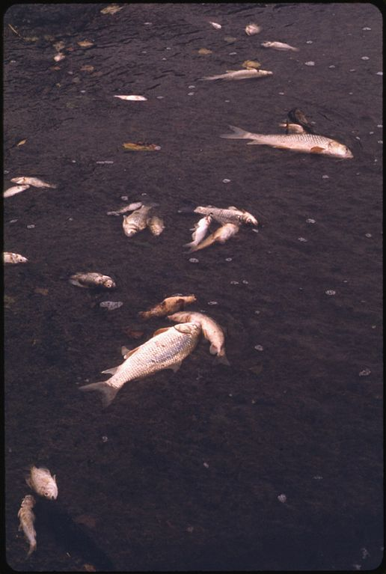
6. evident
adjective
obvious, easy to see
It is evident something is wrong with these fish.

Slide 10
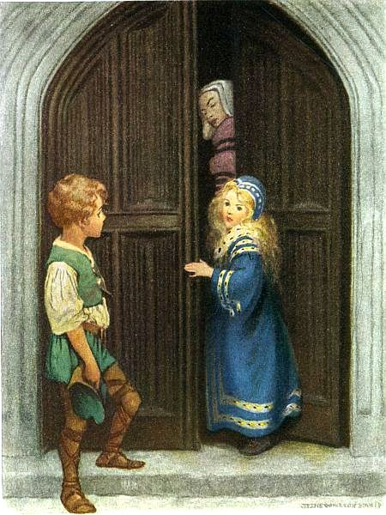
7. shan’t
contraction of shall not
“No, I shan’t come out and play today.”

Slide 11
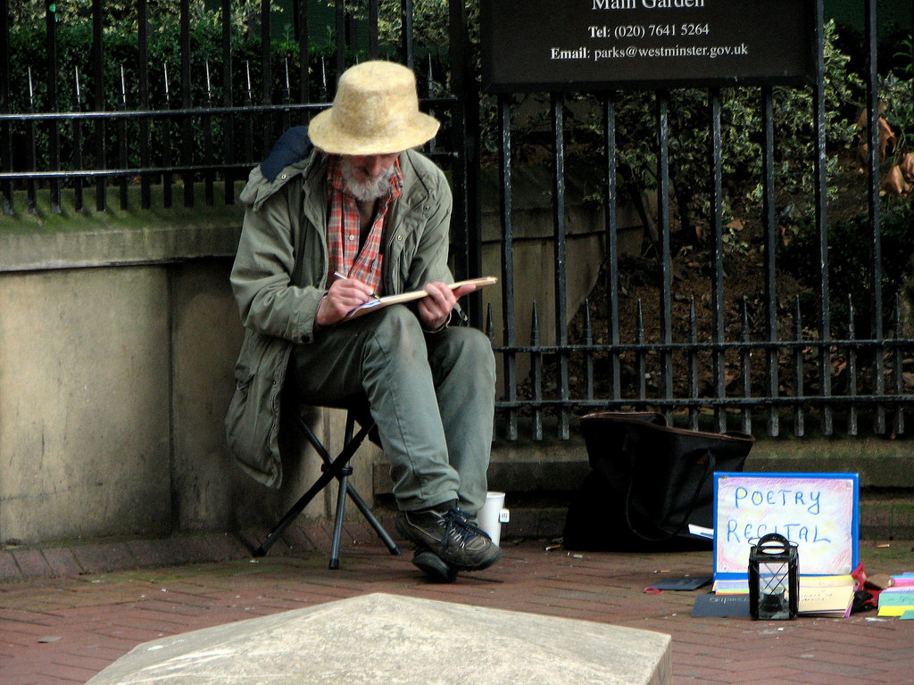
Poetry Challenge!
Compose a short 3 line rhyming poem (tercet) about what you lost.
Challenge:
How many tercets can you rhyme with your object?
Extra Challenge:
How many of the the vocabulary words can you incorporate?

Slide 12
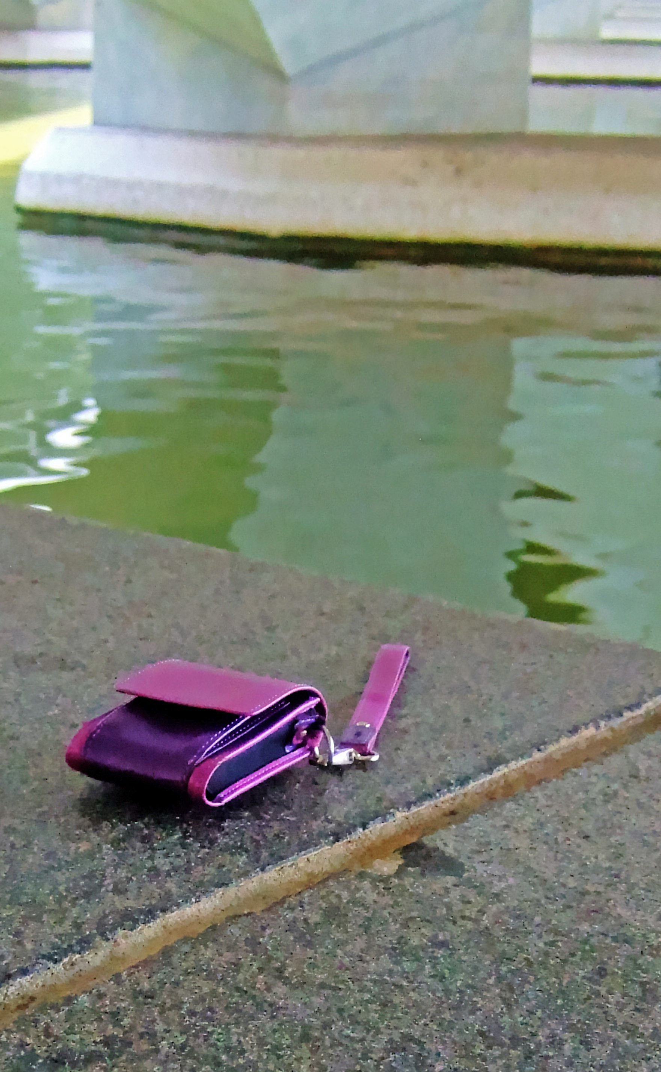
One Art
Pre-reading Essential Questions:
Think-pair-share
Are there things in life we cannot avoid losing?
What kinds of things?
Are there things we want to lose?

Slide 13
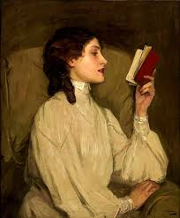
Read the poem aloud with your partner:
Switch speaker with each stanza.
What do you notice about the poem’s rhyme and rhythm?

Slide 14

Poetic Structure
What do you notice about the rhyme, rhythm or structure of the poem?
VILLANELLE:
19 line poem
6 stanzas
5 tercets (3 lines)
1 quatrain (4 lines)
2 rhymes throughout the poem
This is not an easy structure!
(How many tercets were you able to rhyme?)

Slide 15
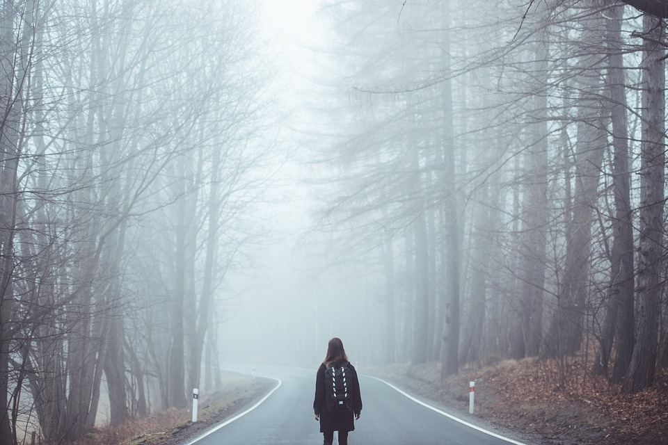
Tone and Theme
How does the repetition and rhythm of the poem affect the tone?
What themes are present in the poem?
loss
love
sadness
honesty (is the poet honest with herself?)
acceptance (or defeat?)

Slide 16

WRITING PROMPT:
Two paragraphs
How does the repeated line in the poem change meaning as the poem progresses?
Use at least two pieces of textual evidence in your analysis.

