Slide 1
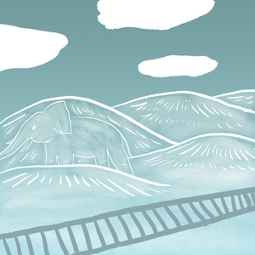
Hills Like White Elephants
Text, Context and Subtext

Slide 2

In this lesson:
You will learn to distinguish between text, context and subtext
Determine what context is relevant in order to interpret a text
Read Ernest Hemingway’s short story, Hills Like White Elephants, and draw inferences as to the subtext

Slide 3

text: the words on the page, the literal meaning of the words
You should be able to answer these questions after reading
What kind of text is Hills Like White Elephants?
Who are the main characters in the story?
What is the setting of the story?
How much times passes in the story?
What happens in the story?

Slide 4
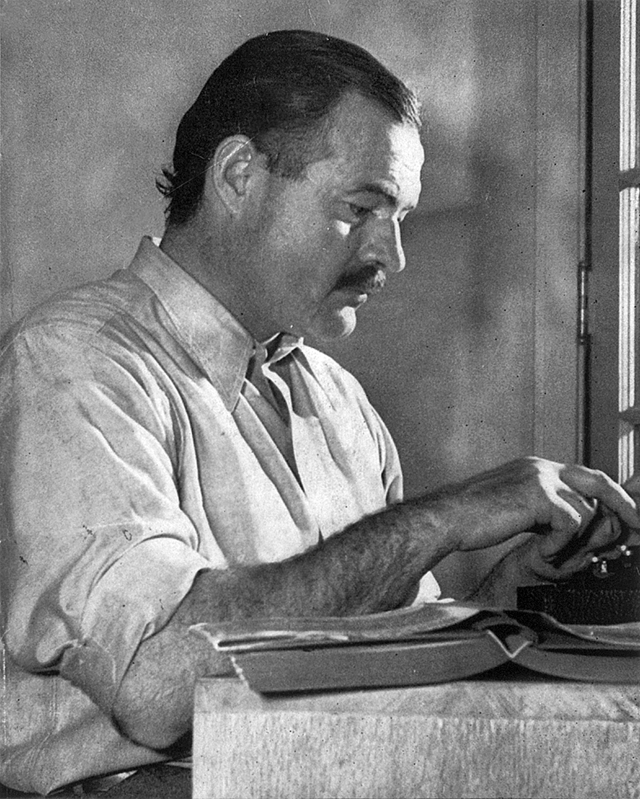
context: any relevant background information that could provide more meaning or insight to the text
What information below do you think might be relevant to interpreting the story?
Author: Ernest Hemingway
Date of Publication: 1927
It was part of a larger collection of short stories entitled Men Without Women.
Many high school students are required to read this story.
“White elephant” is an idiom that refers to a possession that is troublesome and unwanted.

Slide 5

subtext: the deeper meaning below the surface of the words
Ernest Hemingway coined the term Iceberg Theory to describe this style of writing
What do you think that means?

Slide 6
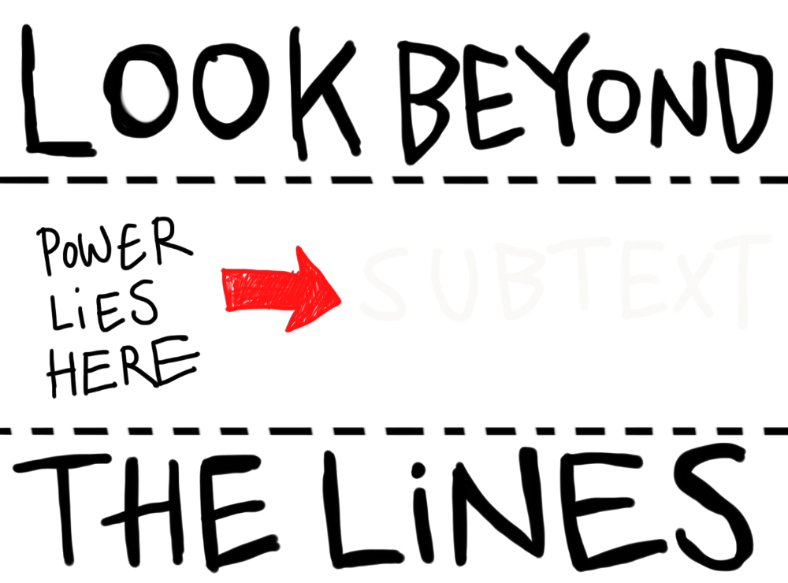
Omission: What is left out
What is omitted from a text can be just as important as the text itself.
Your job, as a sophisticated reader, is to draw inferences based on what is in the text and what is omitted.

Slide 7
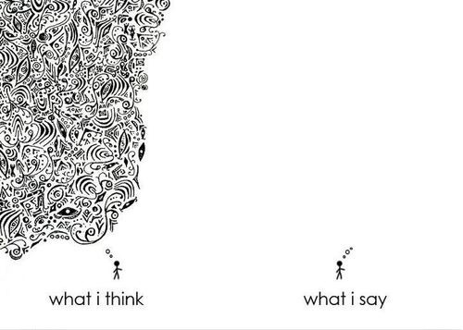
Dialogue
Most of this story is dialogue.
However, the characters say very little about what they are actually thinking and feeling.

Slide 8
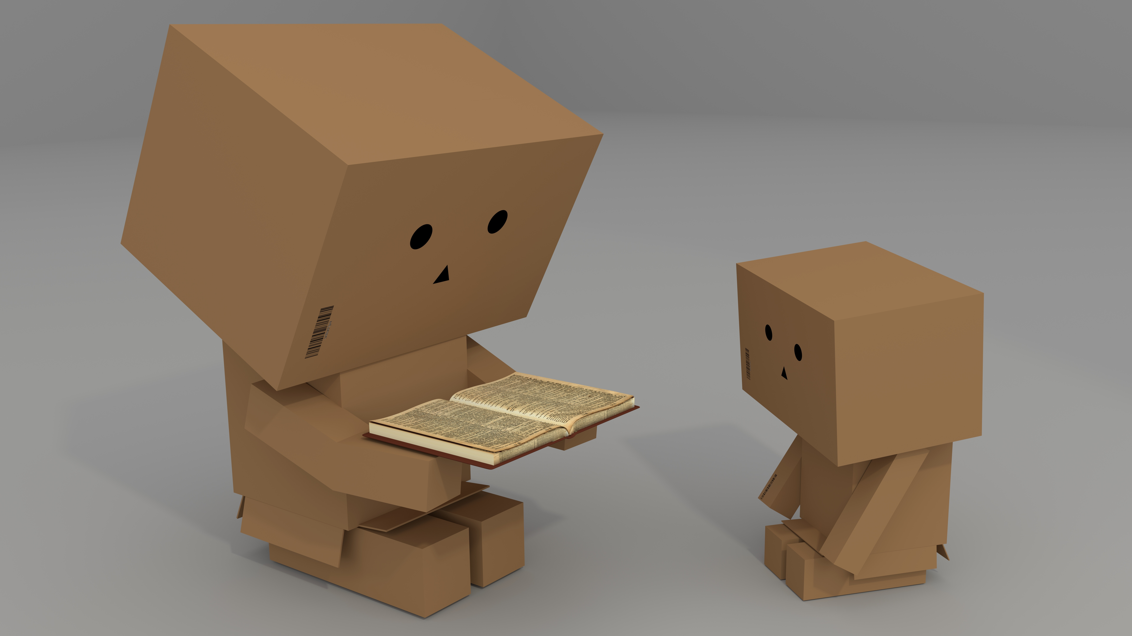
Let’s read!

Slide 9
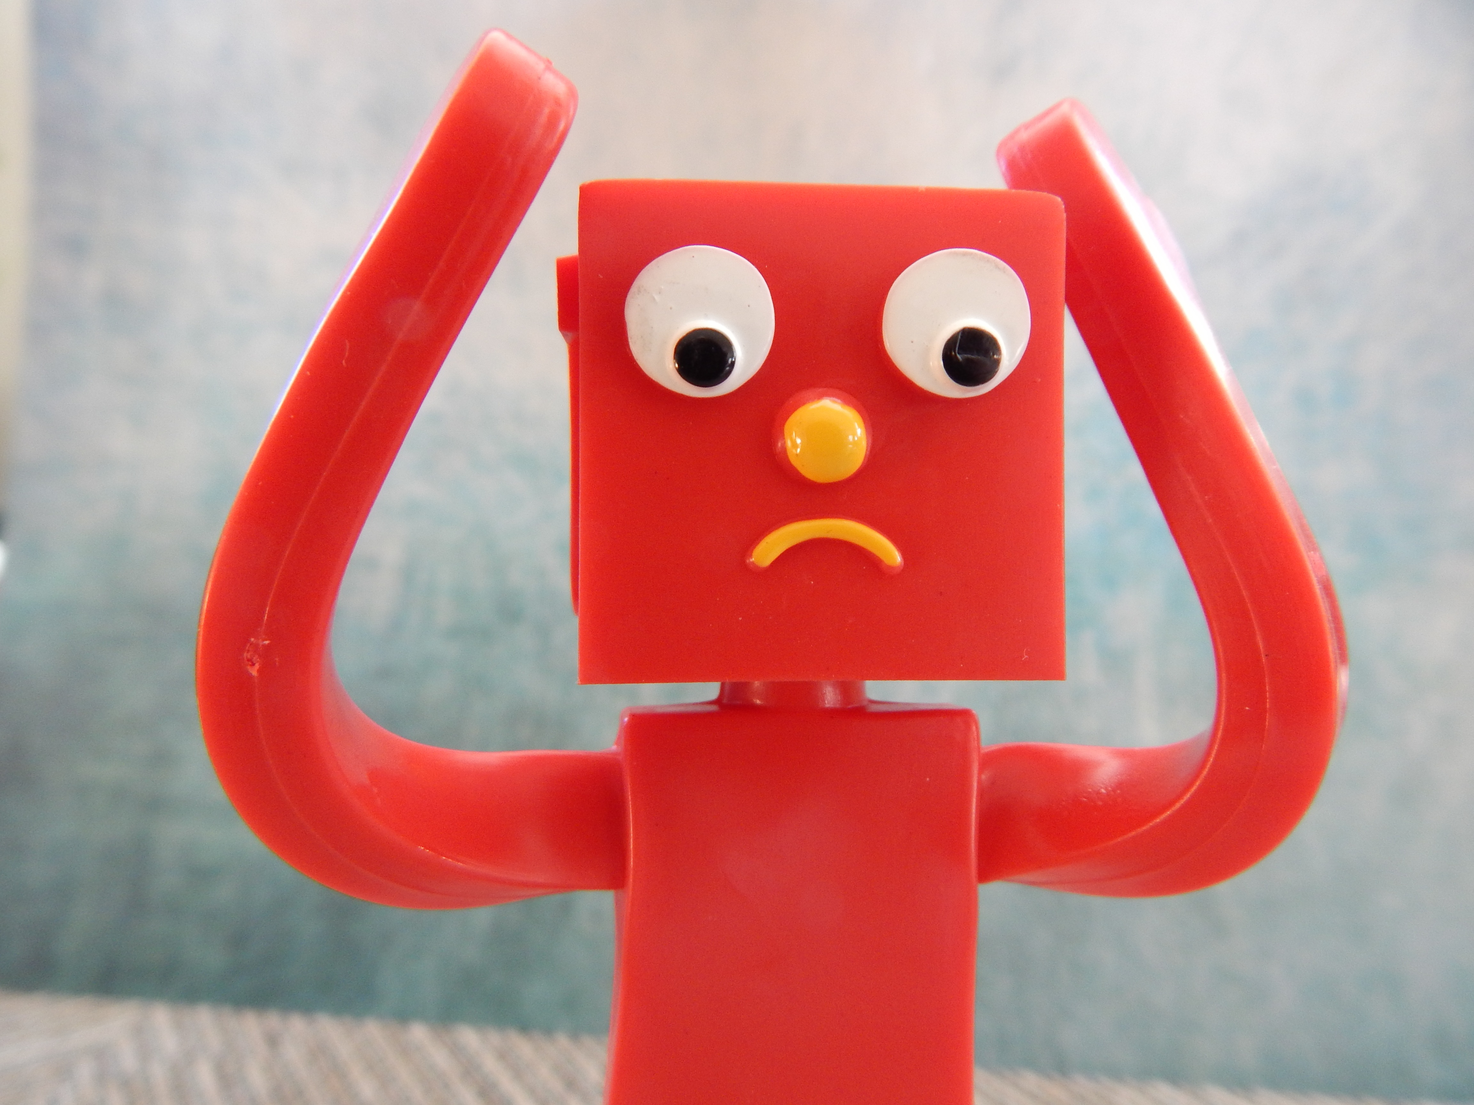
Post-Reading
Can you answer these questions?
What kind of text is Hills Like White Elephants?
Who are the main characters in the story?
What is the setting of the story?
How much times passes in the story?
What happens in the story?
Do the answers to these questions help you understand what the story is really about?

Slide 10
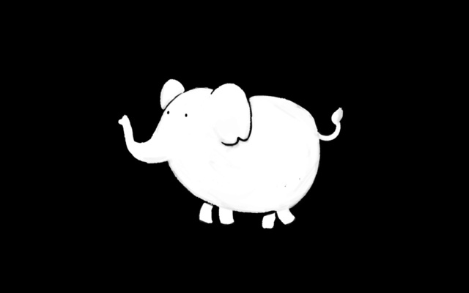
What is the “white elephant”?
What is the “white elephant” in the story?
Re-read lines 55-115
What does the operation refer to?
What other clues in the text support this?

Slide 11
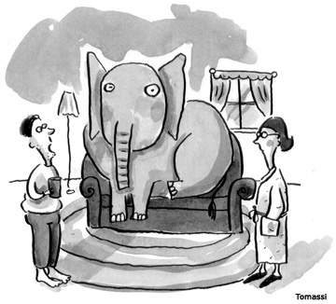
“the elephant in the room”
Another elephant-themed idiom is “an elephant in the room.”
Why doesn’t the couple want to talk about the issue directly?

Slide 12
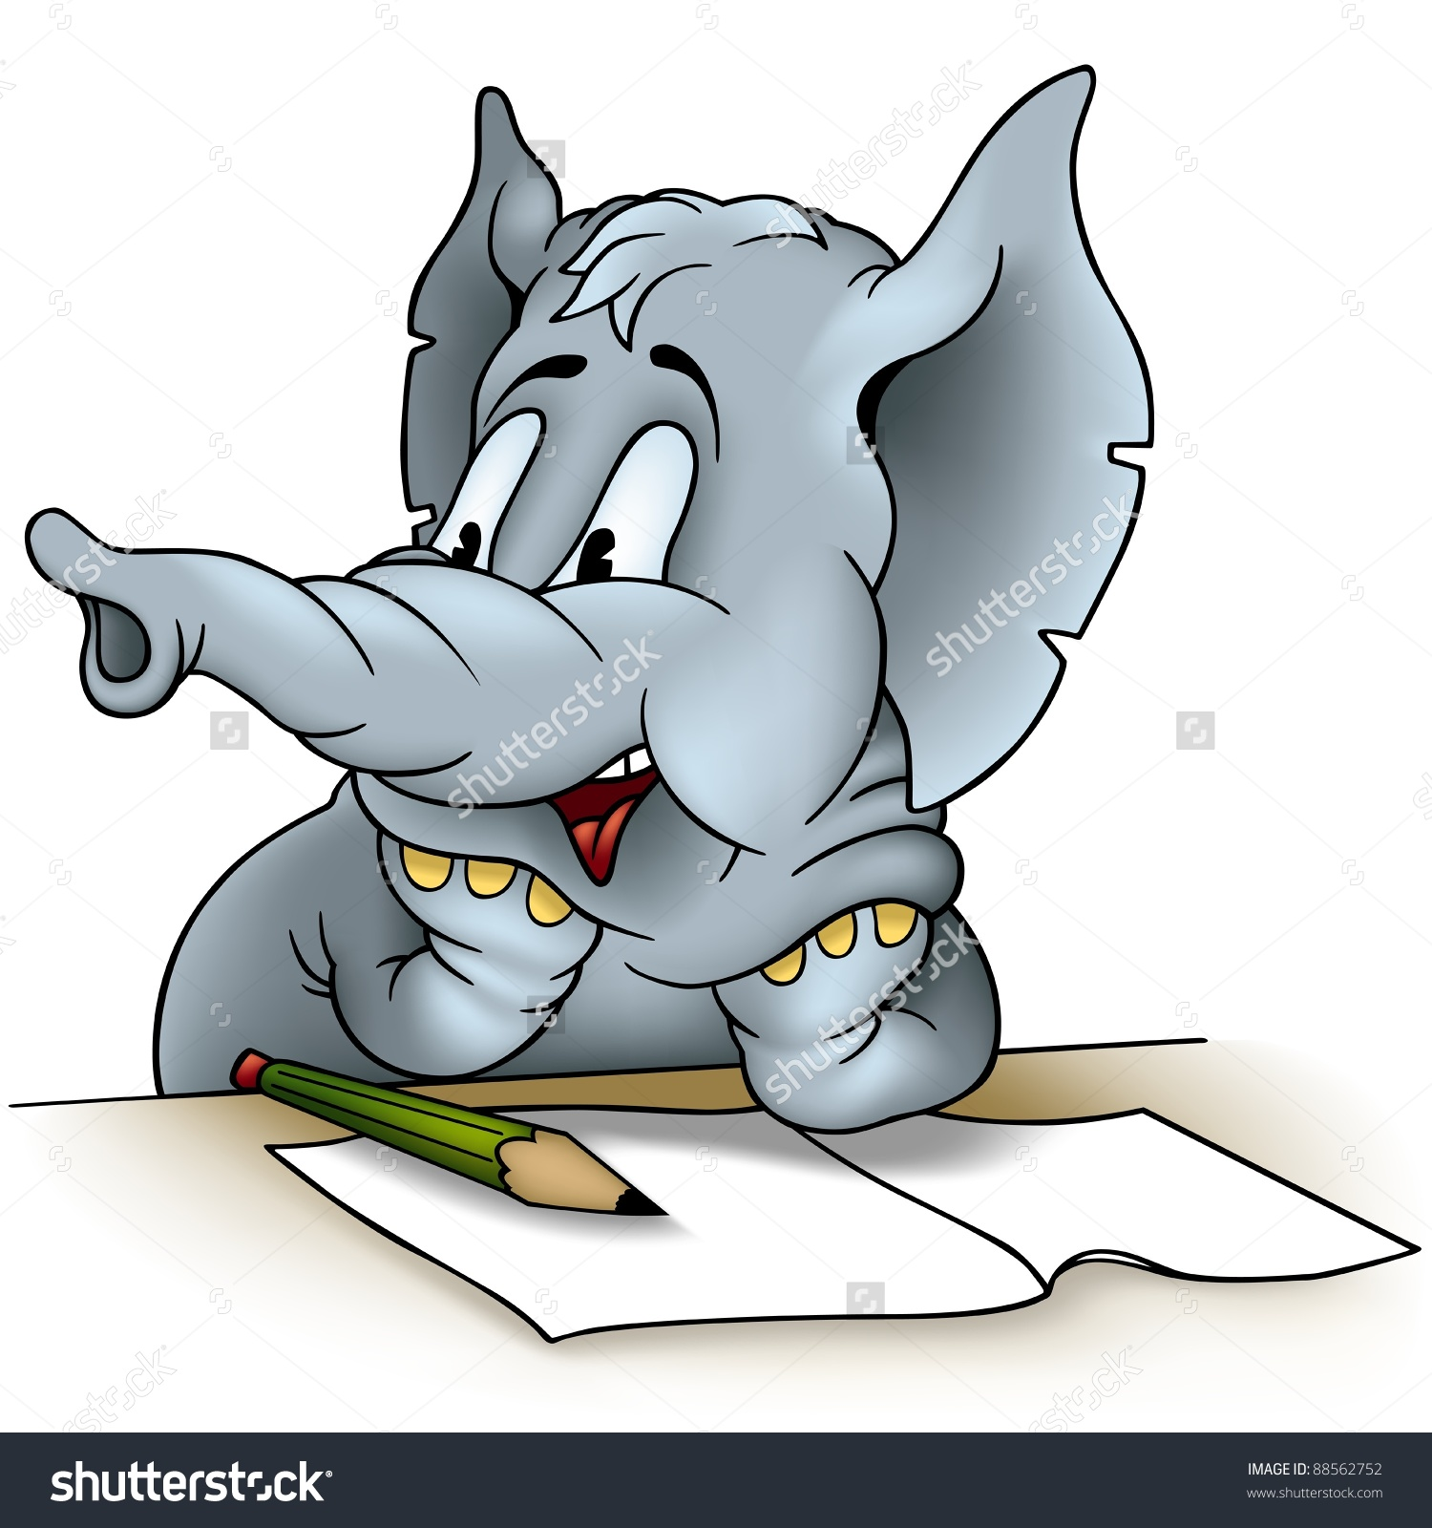
Writing Response: Choose a prompt and respond in one paragraph
A. Would your attitude to the story change if the genders of the characters were reversed? How would the story be different if Jig wanted the abortion and the man wanted to keep it?
B. How does the setting contribute to the overall mood of the text? What is the effect of setting the story in a train station? What could it represent?
C. Is the story still relevant today? Does the year it was published add to the controversy or do people feel the same way today?

