Slide 1
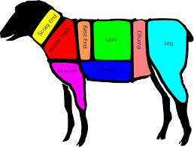
lamb to the slaughter
By Roald Dahl

Slide 2
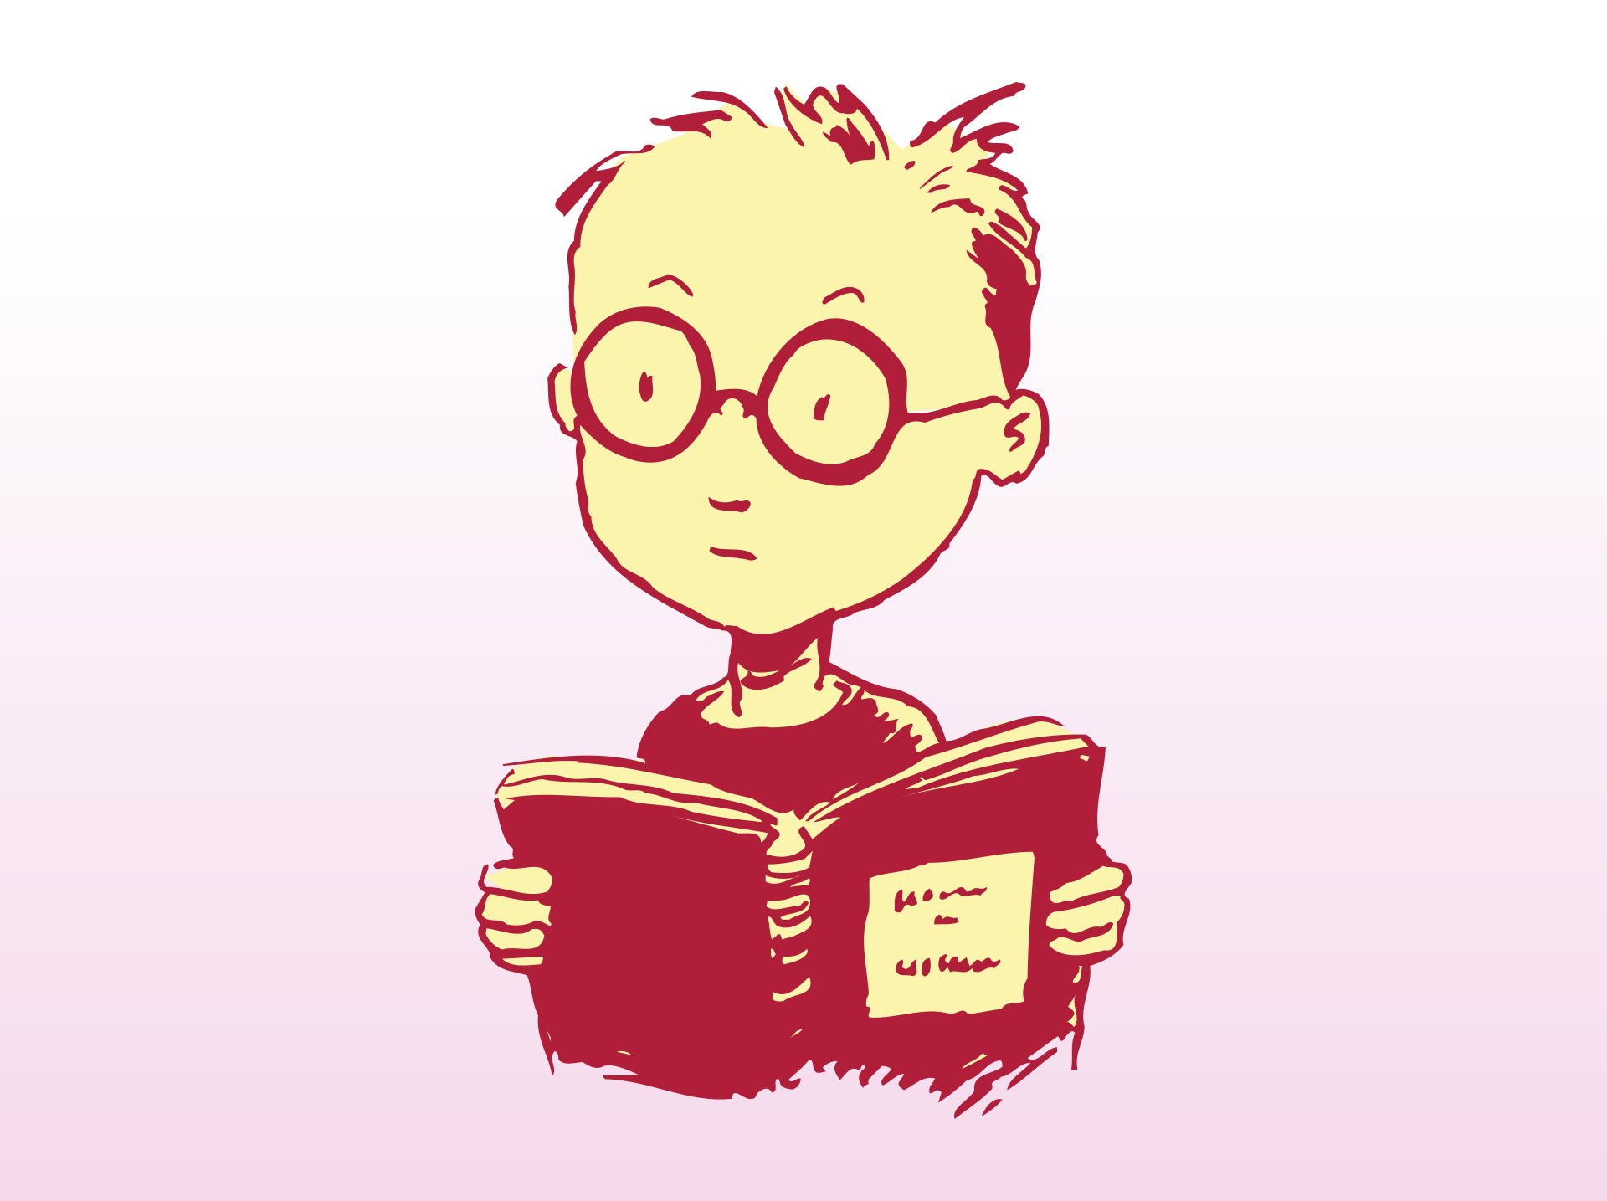
While reading this story, we will:
Distinguish between character and characterization
Draw inferences of characterization based on textual description
Use clues from texts to generate hypotheses
Use story as a model text for plot twist
Learn new vocabulary!

Slide 3
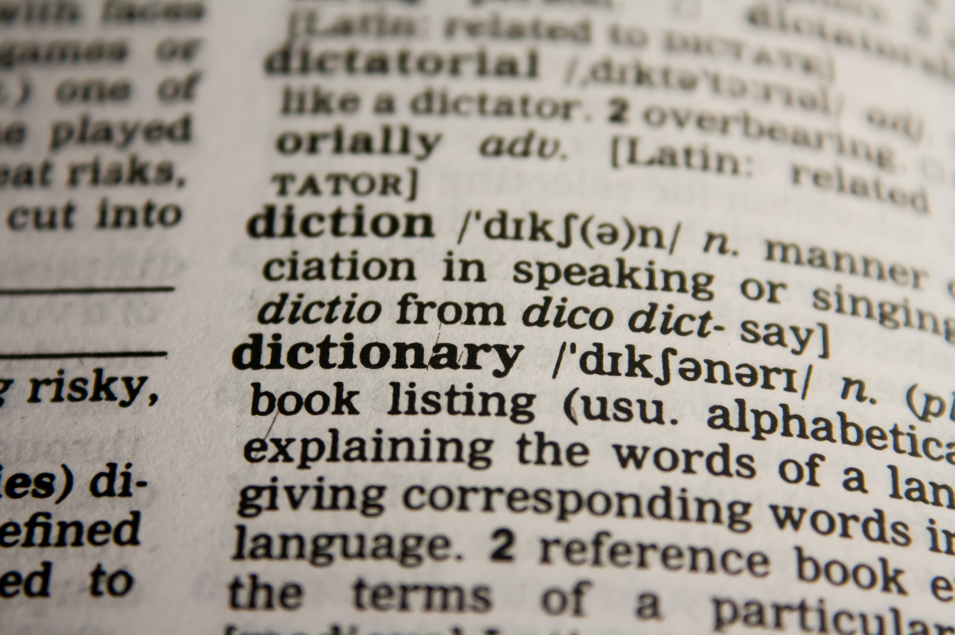
Pre-Reading
In pairs, use the Reading for Vocabulary handout and scan the text for unfamiliar words.
Keep this handout with you and we read the story together.

Slide 4
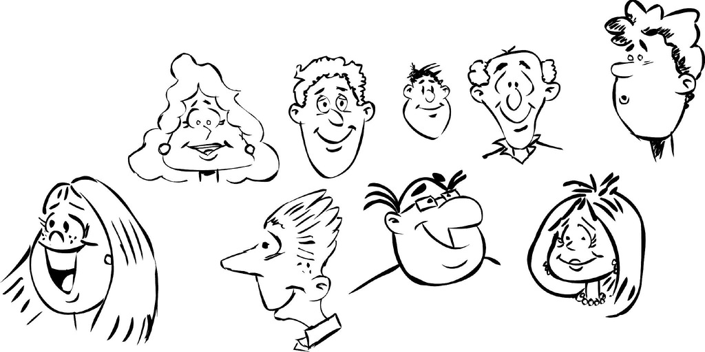
What is the difference between character and characterization?
Character:
A human or animal that participates in the action of a story
Characterization:
The way a character is described and developed throughout the story

Slide 5
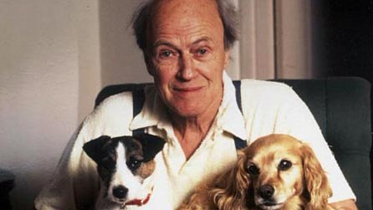
What do you already know about the author?
Based on this, what do you anticipate in the story you’re about to read?

Slide 6
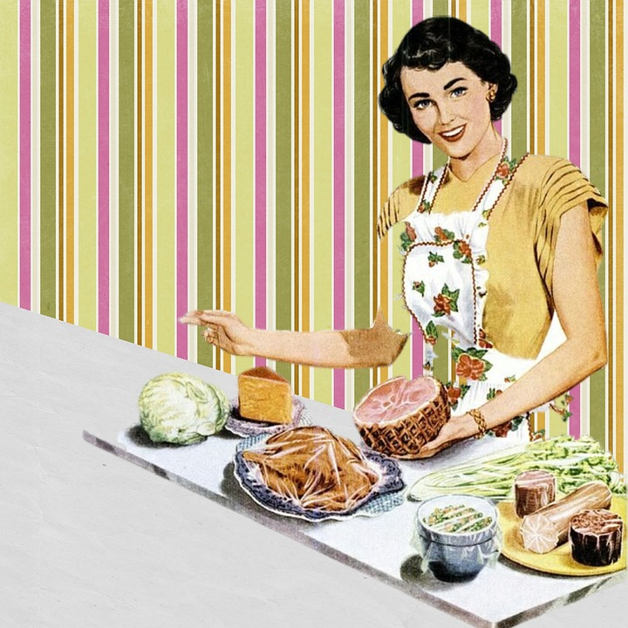
Read up to line 38
What can you infer about Mary Maloney from this description?
There is a wide agreement that good authors show and not tell.
Identify a sentence from line 1-38 and explain how the description is showing and not telling.

Slide 7
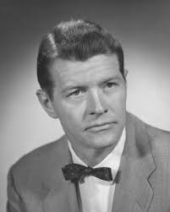
What about Patrick?
What is the characterization of Patrick? Provide textual evidence.
How does Dahl convey to the reader, in only a few lines, that Patrick is acting differently than most evenings?

Slide 8

Show and not tell
“He lifted his glass and drained it in one swallow although there was still half of it, at least half of it left. She wasn't really watching him, but she knew what he had done because she heard the ice cubes falling back against the bottom of the empty glass when he lowered his arm. He paused a moment, leaning forward in the chair, then he got up and went slowly over to fetch himself another.”
What does Dahl show and not tell?
How does he do it?

Slide 9

Continue reading until line 135
What would you do in Mary’s position?
What kind of plan would you make?

Slide 10
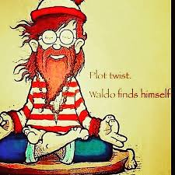
Finish reading the story
Plot twist!
What happens to the murder weapon? How does Dahl assure his readers understand the irony of this event? Cite the evidence from the story that foreshadows this event.
Notice how the lighting changes during the course of the text. Cite evidence to show how the lighting has changed. How does this change in imagery reflect the changing character of Mary? Cite textual evidence to support your opinion.

