Slide 1
Gothic Horror

Slide 2
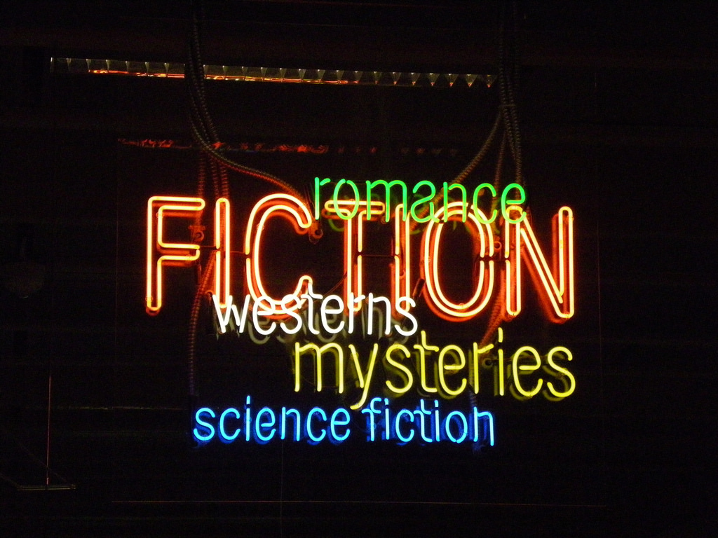
With a partner:
List all the literary genres you have heard of in the form of a mind map:

Slide 3
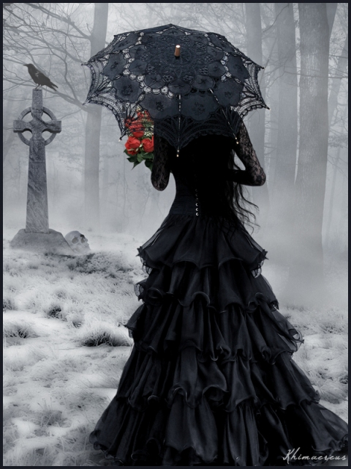
What can you guess about this genre?
spooky
the term ‘Gothic’ refers to the time period (middle 1700’s to early 1900’s)
often elements of fantasy or science fiction
Settings are usually spooky and dark
Characters often include monsters
Combines love, death and horror

Slide 4
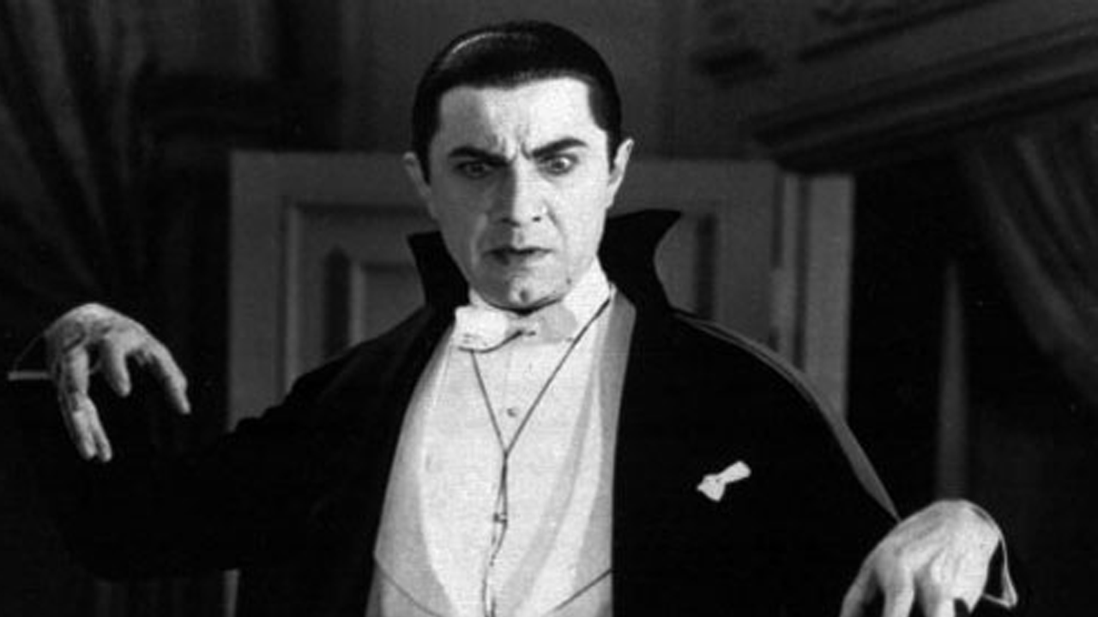
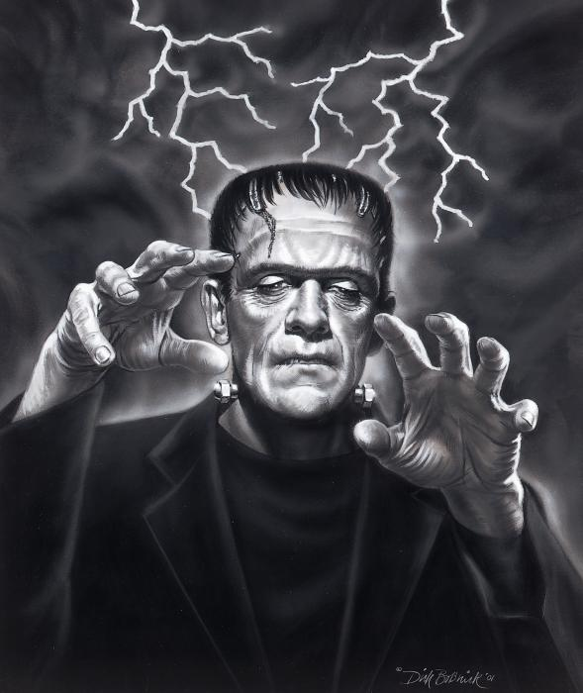
What famous Gothic novels have you heard of?
Dracula
Frankenstein
Dr. Jekyll and Mr. Hyde
The Phantom of the Oprah
Wuthering Heights

Slide 5
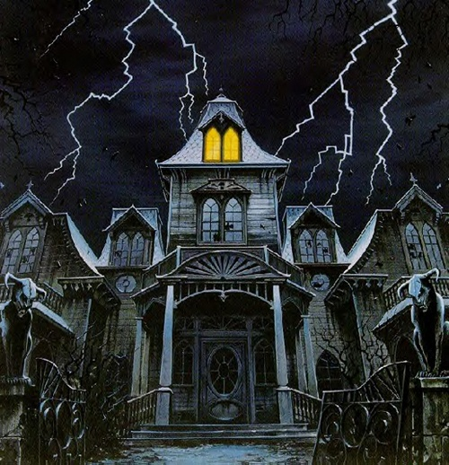
Use a thesaurus to generate words for this Gothic setting

Slide 6
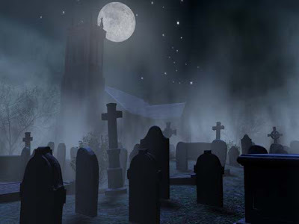
Use a thesaurus to generate words for this Gothic setting

Slide 7
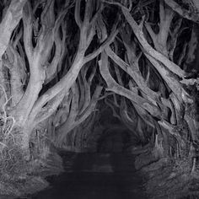
Use a thesaurus to generate words for this Gothic setting

Slide 8
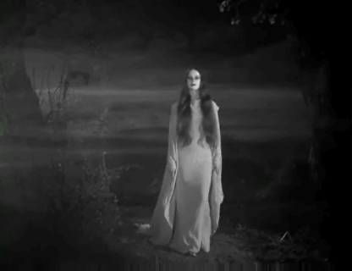
Writing Gothic Horror
Gothic horror writing relies more on spooky suspense than it does on gore, blood and violence.

Slide 9
Stand – Up Sit –Down Review
1. Name one famous Gothic Novel.
2. What other genre could Frankenstein also be considered?
3. Name a common Gothic Horror setting.
4. Gothic Horror involves death and this other common literary theme.
5. What centuries was Gothic Horror most popular?
6. Name one distinction between Gothic Horror and modern horror films.

Slide 10
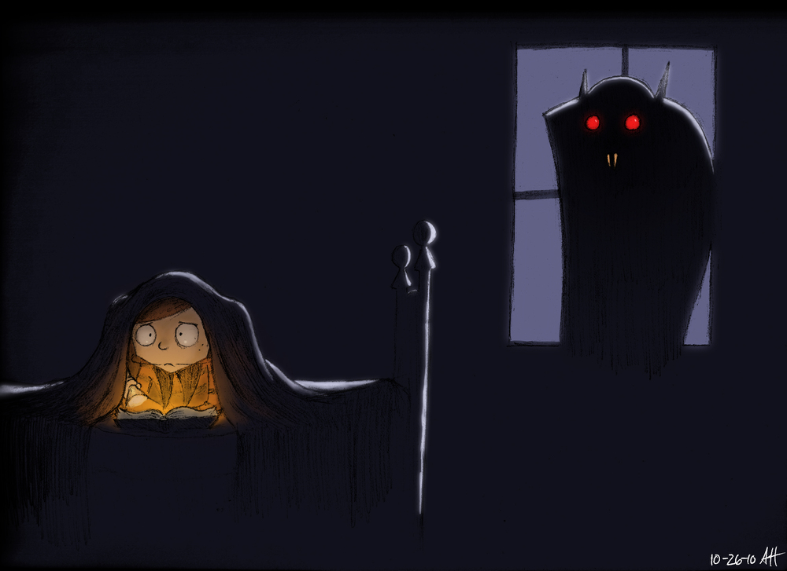
Learning Objectives
To understand the elements and purpose of descriptive writing
To understand how writers create tone
To generate examples of imagery in our own writing

Slide 11
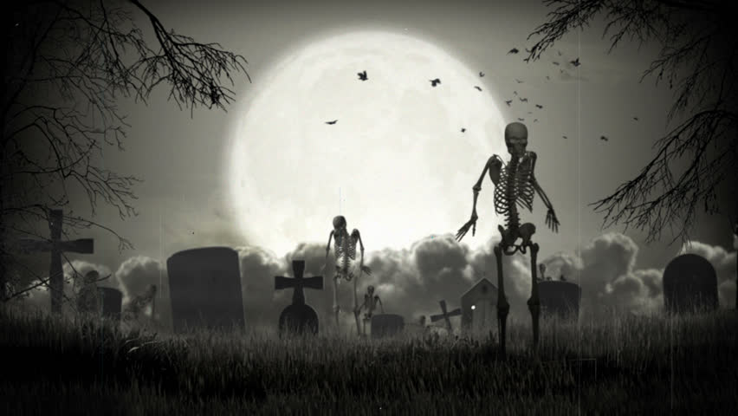
Descriptive Writing
L.O. Understand the elements and purpose of descriptive writing
Which sentence is more descriptive?
A. The moon shone over the graveyard.
B. The pale moon cast an ominous luster over the graves of long-forgotten souls.

Slide 12
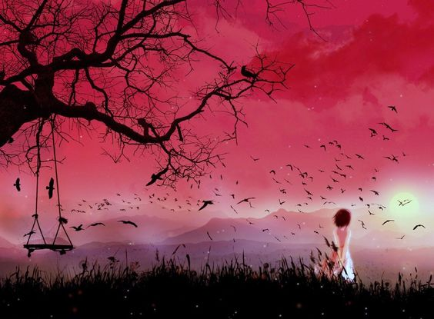
Descriptive Writing
L.O. Understand the elements and purpose of descriptive writing
The goal of descriptive writing is to paint a picture with words.
Effective descriptive writers show and not tell.

Slide 13
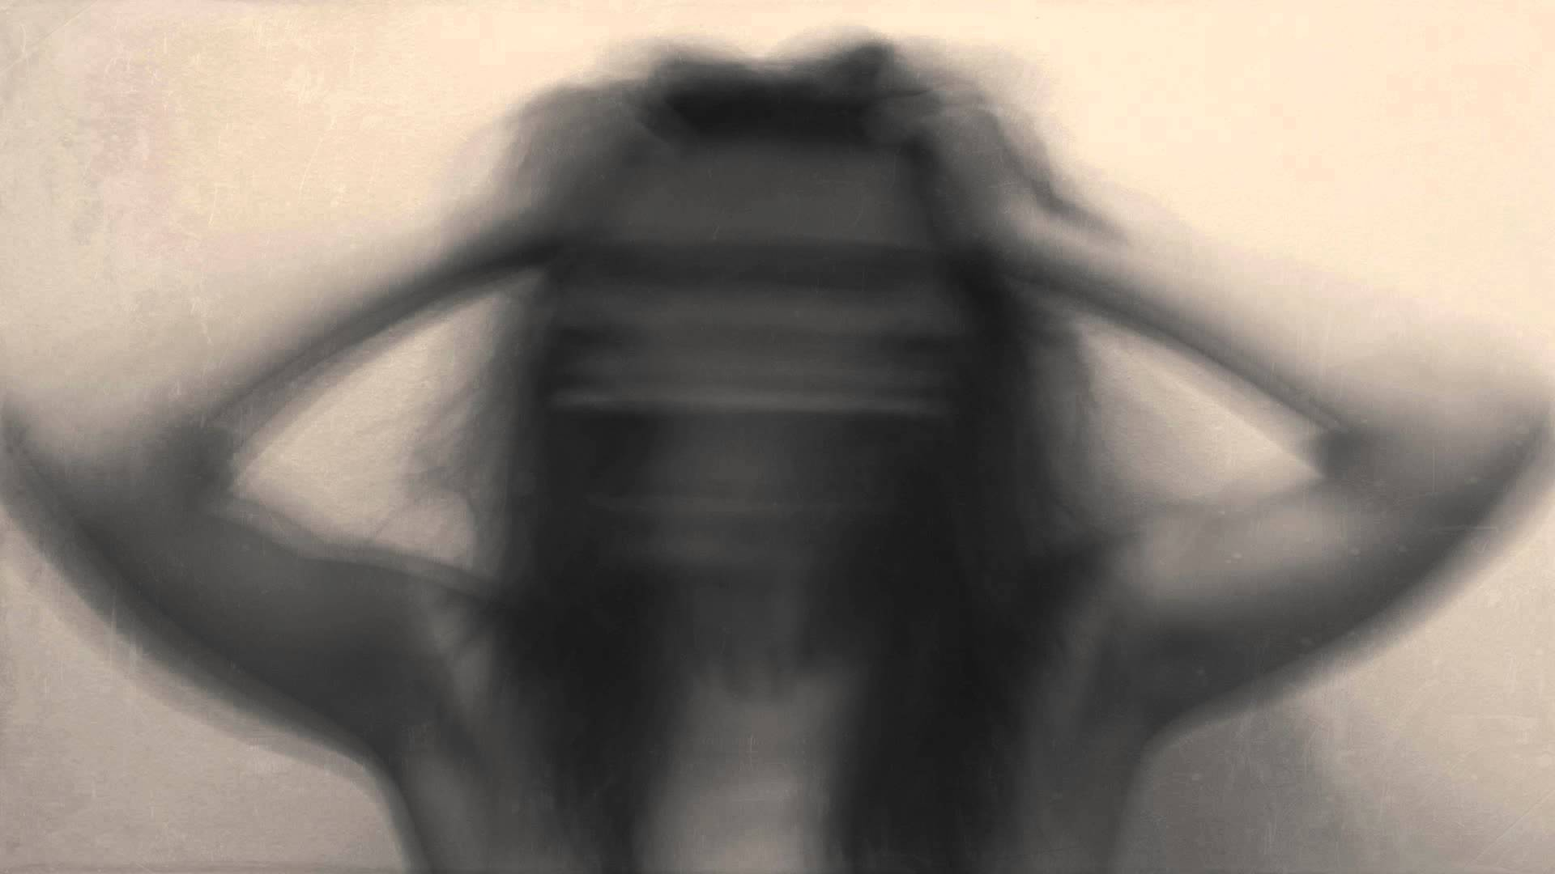
Descriptive Writing
L.O. Understand the elements and purpose of descriptive writing
Which sentence is more descriptive?
A. The woman screamed in horror.
B. A blood-curdling shriek echoed throughout the desolate chamber.

Slide 14

Descriptive Writing
L.O. Understand the elements and purpose of descriptive writing
Which sentence is more descriptive?
A. She tasted blood in her mouth.
B. The metallic tang of crimson gore oozed out of her gaping mouth.

Slide 15
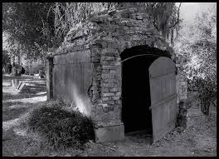
Descriptive Writing
L.O. Understand the elements and purpose of descriptive writing
Which sentence is more descriptive?
A. The putrid stench of rotting corpse engulfed the tomb.
B. It smelled bad.

Slide 16
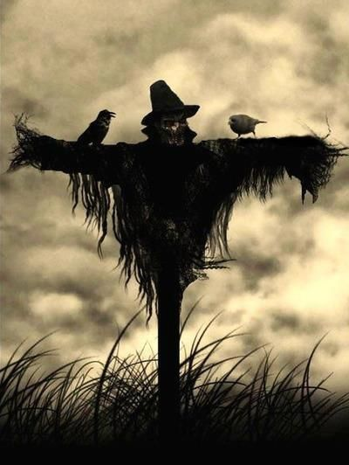
Descriptive Writing
L.O. Understand the elements and purpose of descriptive writing
Which sentence is more descriptive?
A. She was sure the slight bristles on her neck were only breaths of wind.
B. She felt the wind against her skin.

Slide 17
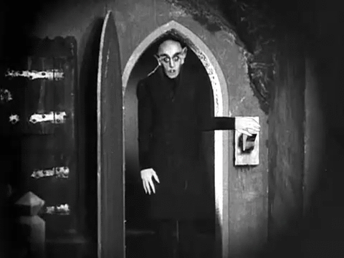
What kind of tone do all these sentences create?
L.O. Understand how writers create tone
How is the tone created?
Descriptive adjectives
putrid vs bad
Specific, relevant nouns and verbs
  ooze
  gore
  shriek
  echo

Slide 18
Sight
L.O. Generating our own examples of imagery
The pale moon cast an ominous luster over the graves of long-forgotten souls.
The ________ ________ ________ an _________ _______ over the ________ of ________ _________.
adjective
noun
synonym for showed
adjective
noun
noun
adjective
noun

Slide 19
Sound
L.O. Generating our own examples of imagery
A blood-curdling shriek echoed throughout the desolate chamber.
A __________ _________ __________ throughout the ____________ __________.
adjective
noun
PT verb conveying noise
adjective
noun

Slide 20
Taste
L.O. Understand the elements of descriptive writing
The metallic tang of crimson gore oozed out of her gaping mouth.
The ________ _________ of _________ ________ _____ out of ________ ________ __________.
adjective for flavour
noun
adjective
noun
PT verb
pronoun
adjective
noun

Slide 21
Smell
L.O. Understand the elements of descriptive writing
The putrid stench of rotting corpse engulfed the tomb.
The ________ ________ of ______ ______ _______the_______.
adjective for smell
synonym for smell
adjective
noun
PT verb
noun

Slide 22
Touch
L.O. Understand the elements of descriptive writing
She was sure the slight bristles on her neck were only breaths of wind.
_______ was sure the _____ ______ on ______ _______ were only _______ of ________.
pronoun
adjective
noun
pronoun
noun
noun
noun

Slide 23
What do all these sentences have in common?
L.O. Understand how writers create tone
1. The pale moon cast an ominous luster over the graves of long-forgotten souls.
________________
2. A blood-curdling shriek echoed throughout the desolate chamber.
_____________________
3. The metallic tang of crimson gore oozed out of her gaping mouth.
_____________________
4. The putrid stench of rotting corpse engulfed the tomb.
_____________________
5. She was sure the slight bristles on her neck were only breaths of wind.
_______________________________________

Slide 24
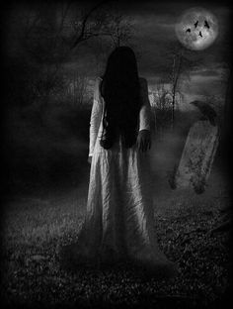
Imagery
L.O. Understand how writers create tone
Imagery: Literary device that engages the 5 sentences

Slide 25

Imagery
Imagery: Literary device that engages the 5 senses
Under each flap of your foldable, write one sentence using imagery for each of the five sentences.

