Slide 1
To Build a Fire
Jack London

Slide 2
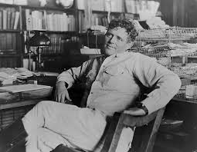
Jack London
Call of the Wild
White Fang
The Sea-wolf

Slide 3
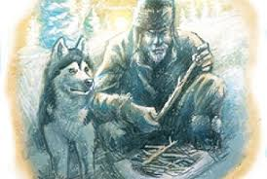
Published 1902
While reading this story, we will analyze:
Theme
Character development
Narration and perspective

Slide 4
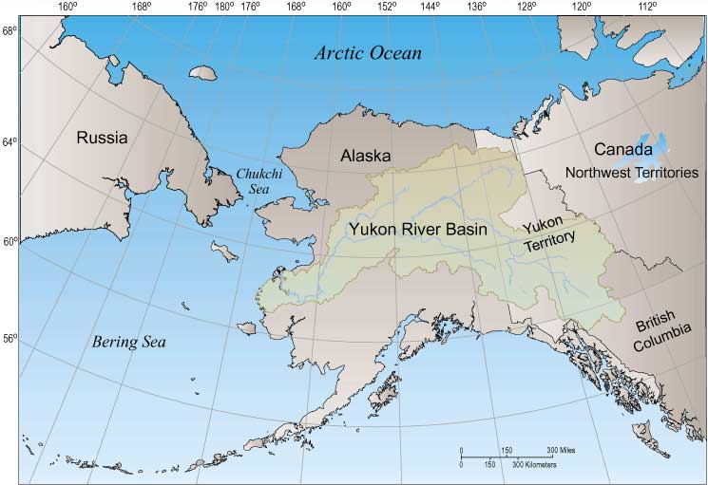
Yukon Territory
What can you infer about the climate of the region?
Very cold during winter
Months of darkness or sunshine
Very remote from civilization

Slide 5
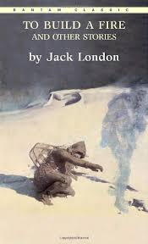
Expedition to the Yukon
What will you bring?
You can only bring what you can carry.
You will be gone at least 30 days.

Slide 6
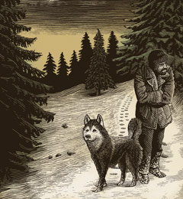
Paragraphs 1: Characterization
What do we know about the character already?
What might this foreshadow?

Slide 7
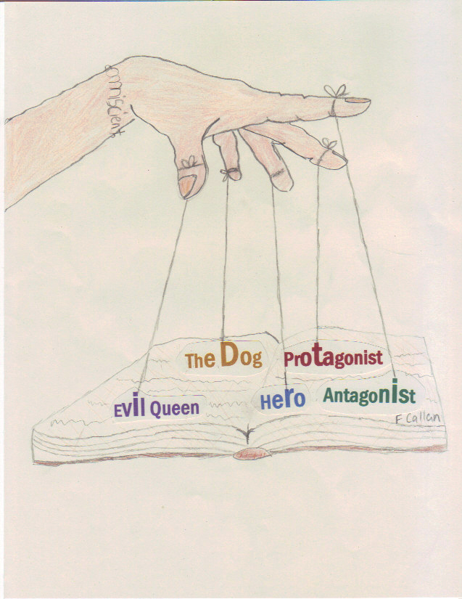
Narration and Perspective
How do we know what we know about the character?
What is the perspective?

Slide 8

3rd person narrations:
Third person limited: A removed narrator that knows or present only a limited amount of information to the reader based an certain character(s) point of view
Third person omniscient: Removed narrator that knows everything that is happening, has happened and will happen to all the characters

Slide 9
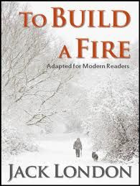
What is the difference between the dog and the man?
What is the effect of juxtaposing these two characters together?
What might it add to the theme?
Why might London have chosen this title?

Slide 10
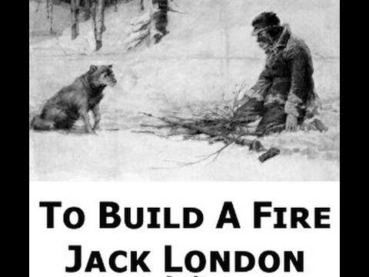
Two paragraph Mini-essay
How does the third person narration enable London to relate the struggle between man and nature, knowledge and instinct.

