Slide 1
The Sniper
By Liam O’Flaherty

Slide 2

Vocabulary

Slide 3
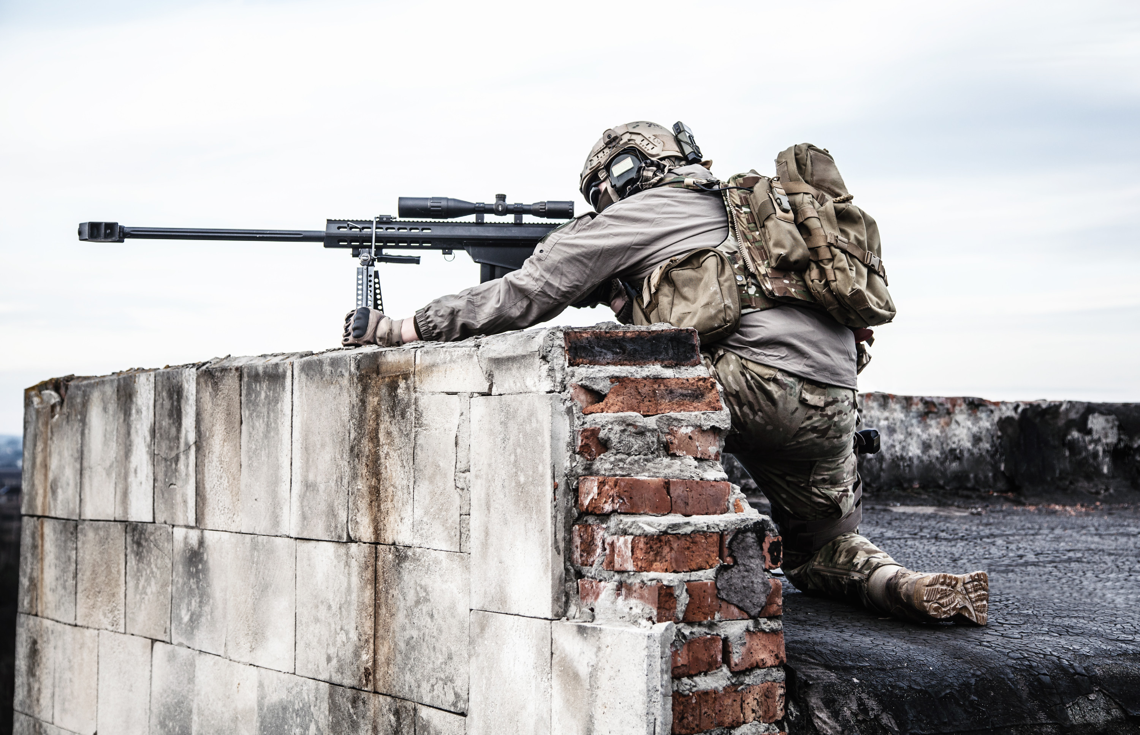
1. sniper
noun
person who hides and shoots a target from a distance

Slide 4
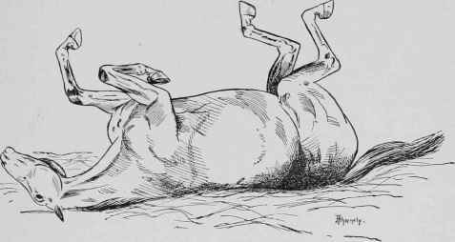
2. spasmodically
adverb
moving about quickly and involuntarily

Slide 5
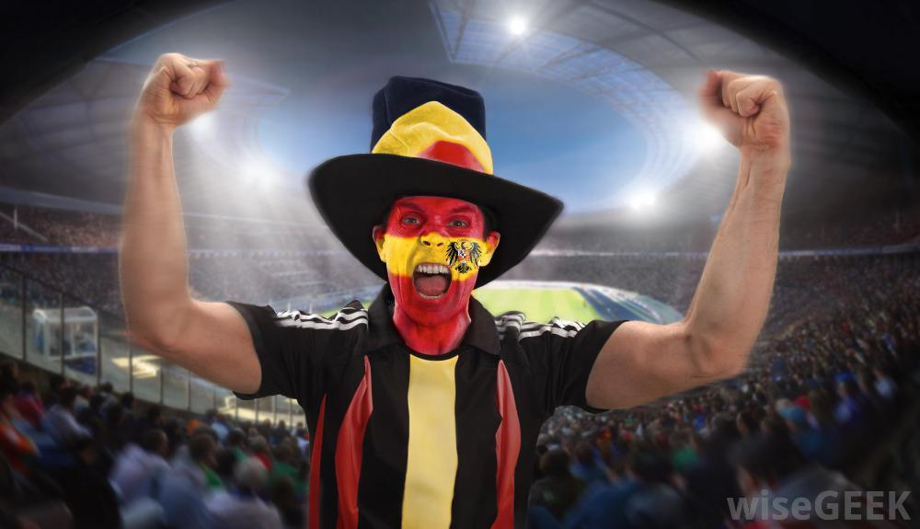
3. fanatic
noun or adjective
someone who is too enthusiastic or excited about something

Slide 6
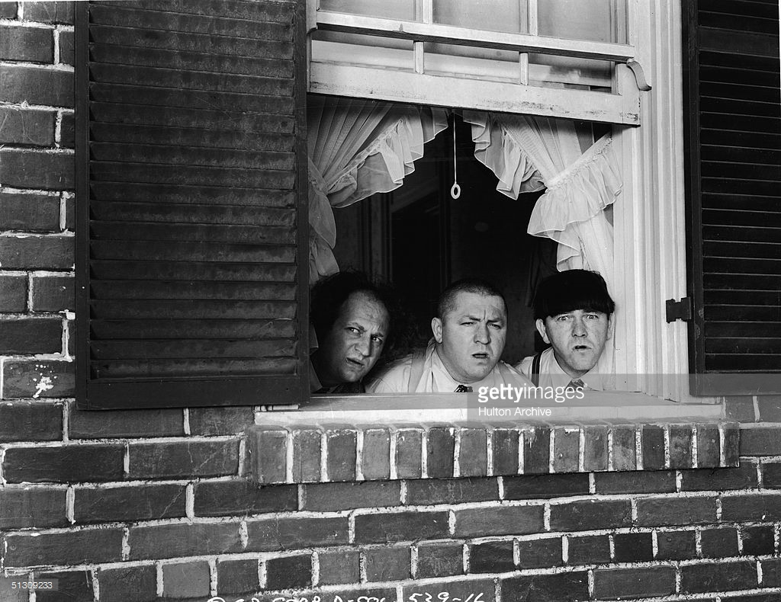
4. peer
verb
look out for something, sometimes secretly

Slide 7
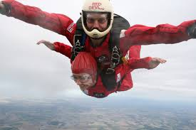
5. sensation
noun
a physical feeling, or an emotion strong enough to be felt physically

Slide 8
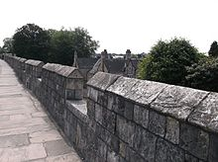
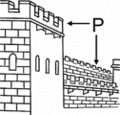
6. parapet
noun
wall on the roof of a building

Slide 9
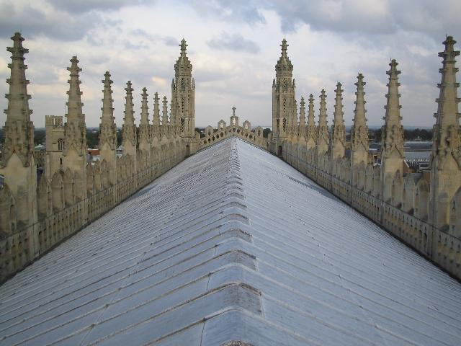
7. turret
noun
tower on the top of a building

Slide 10
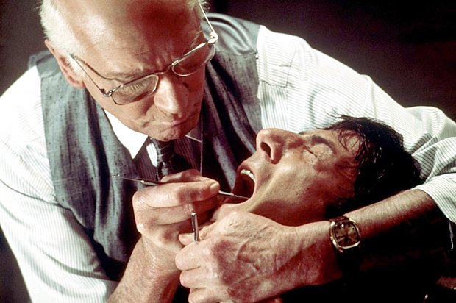
8. agony
noun
terrible physical pain

Slide 11
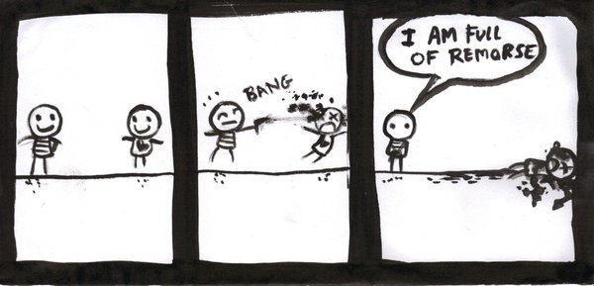
9. remorse
noun
feeling of regret or guilt

Slide 12
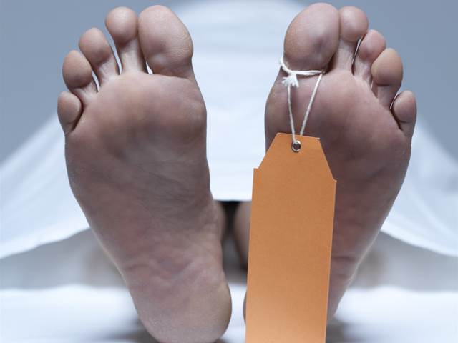
10. corpse
noun
dead body

Slide 13
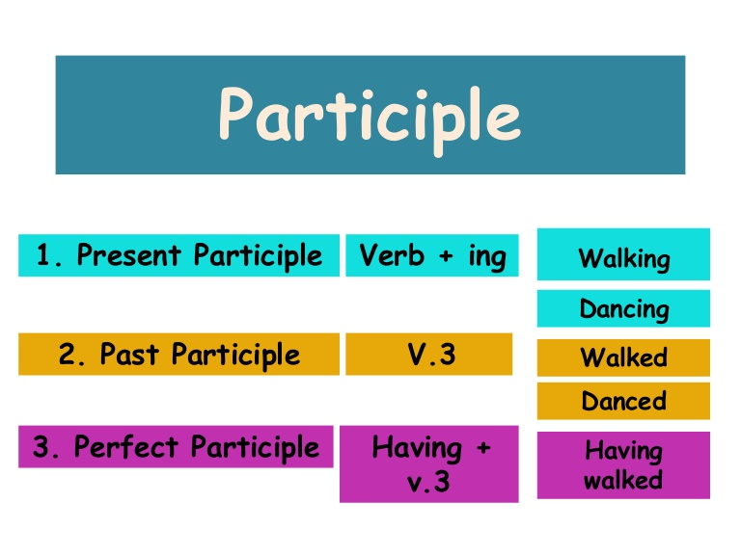
Language Focus: Participles
In the language section of your notebook:
Participle:
  Form of a verb that can be used as an adjective or a noun

Slide 14
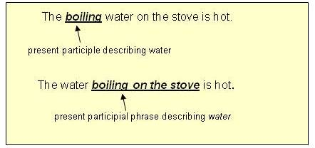
Present Participle
-ing form of a verb
Participles can be used as verbs in verb phrases
Can be used to describe

Slide 15
Try to write sentences using participles:
Used as a verb phrase:
  Tracy is killing a duck.
Used as an adjective:
  She flashed a glistening set of braces.

Slide 16
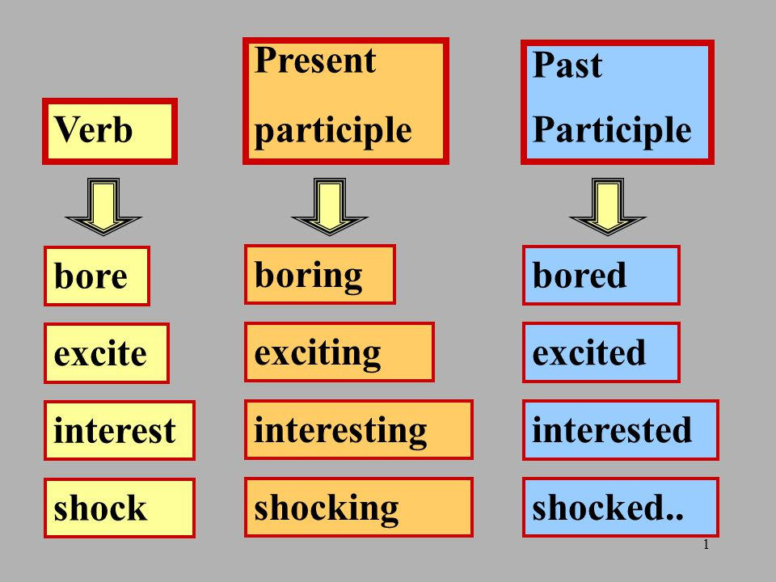
Present and Past Participles
The penguins waddle down the ice, the penguins formed a line.
Relaxing in the pool, her feet dangling over her floating raft, Jessica bathed in the sun.
Shocked and flabbergasted by the insult, Angela punched the dirty old man right in the face.

Slide 17
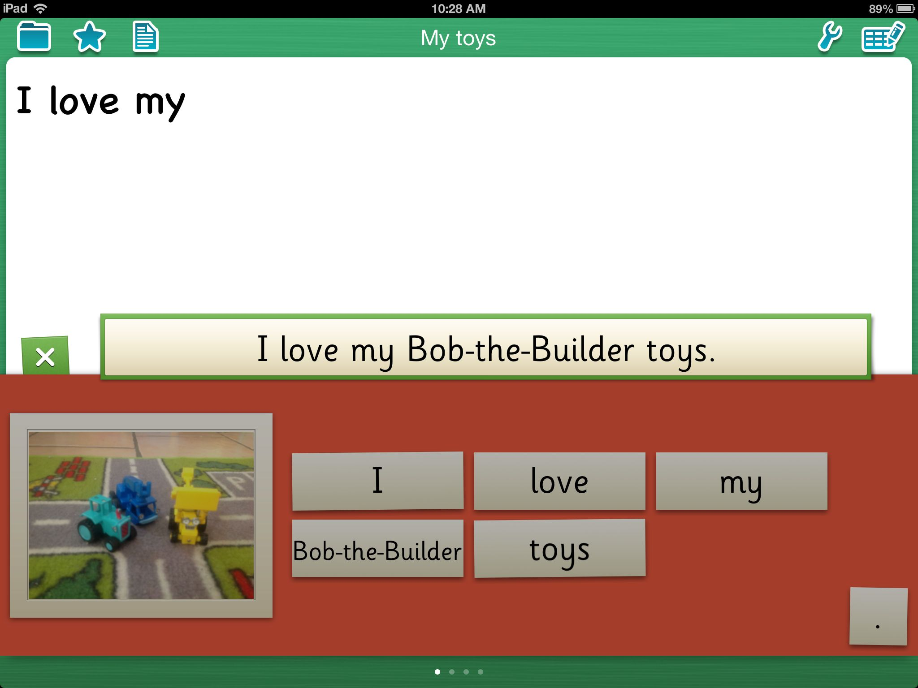
What are mentor sentences?
Model sentences are accurate, interesting, and creative examples of effective language.
How do they work?

Slide 18
Mentor Sentences
It had been raining for seven years.
preposition
________ had been ____________ for ____________ ____________.
subject
present participle
adjective
helping verbs
noun
We take a good example of a sentence and use it as a model to write our own.
We take out the fun, interesting words and replace them with our own.

Slide 19
Mentor Sentences
He was eating a sandwich hungrily.
Try your own:
_______________ was _________________ a ____________________
_________________.
subject
present participle
noun
adverb

Slide 20
Mentor Sentences
On a rooftop near O'Connell Bridge, a Republican sniper lay watching.
Try your own:
On a __________________ near ________________, a _________________
____________ ____________________ _______________________.
noun
proper noun
adjective
noun
verb
present participial

Slide 21
The woman darted toward the side street.
What do you notice about this sentence?
The ___________ ___________ ___________ the
__________ ___________.
noun
past tense verb
preposition
adjective
noun

Slide 22
Mentor Sentences
Dublin lay enveloped in darkness but for the dim light of the moon that shone through fleecy clouds, casting a pale light as of approaching dawn over the streets and the dark waters of the Liffey.
Try your own:
___________________ lay ________________ in ____________________, ___________________ a ___________________.
subject
past participle
noun
present participle
noun

Slide 23
Mentor Sentence
The armored car had retired speedily over the bridge, with the machine gunner's head hanging lifeless over the turret.
Try your own:
The ___________________ ____________________ had _______________
_________________ over the _________________, with the _____________
_______________ __________________ over the ___________________.
past participle
noun
verb
adverb
noun
noun
present participle
adverb
noun

Slide 24

Write you own flash fiction!
Write your own short story in NO MORE than 10 sentences.
Use a variety of sentence lengths.
Determine when to use short sentences and when to use long ones.

Slide 25

Sentence Lengths
What are the different effects of using short sentences, compared to longer ones?
Match the sentence length to its appropriate use:
  short
  longer
  description
  action

