Slide 1

Creative Writing
Getting started

Slide 2

Hook
Something interesting to grab the readers’ attention
Examples:
flashback
flash forward
dialogue
onomatopoeia
action

Slide 3
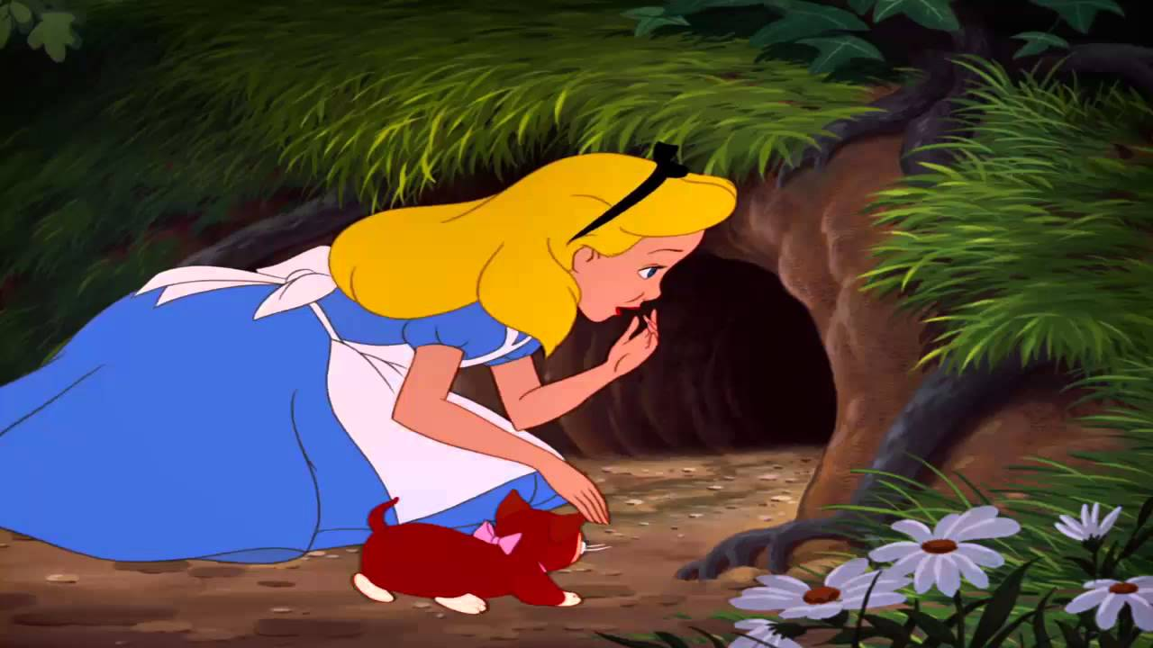
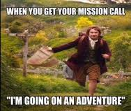
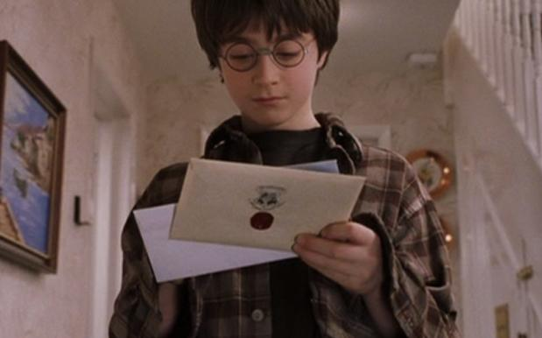
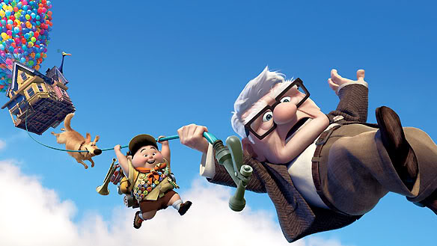
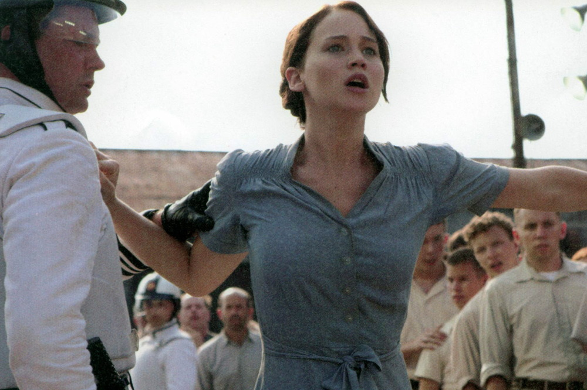
Call to Adventure
Something that forces the protagonist out of their comfort zone
What event compels the protagonist into action?

Slide 4
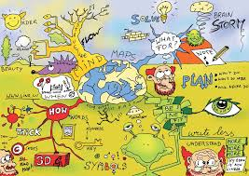
Mind Mapping
Use different bubbles for each character, setting, or themes to get started

Slide 5
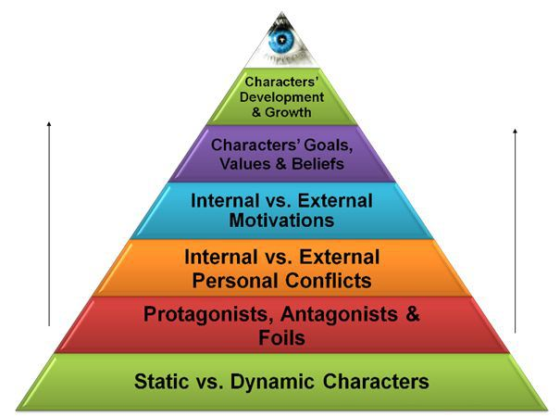
Character Development

Slide 6
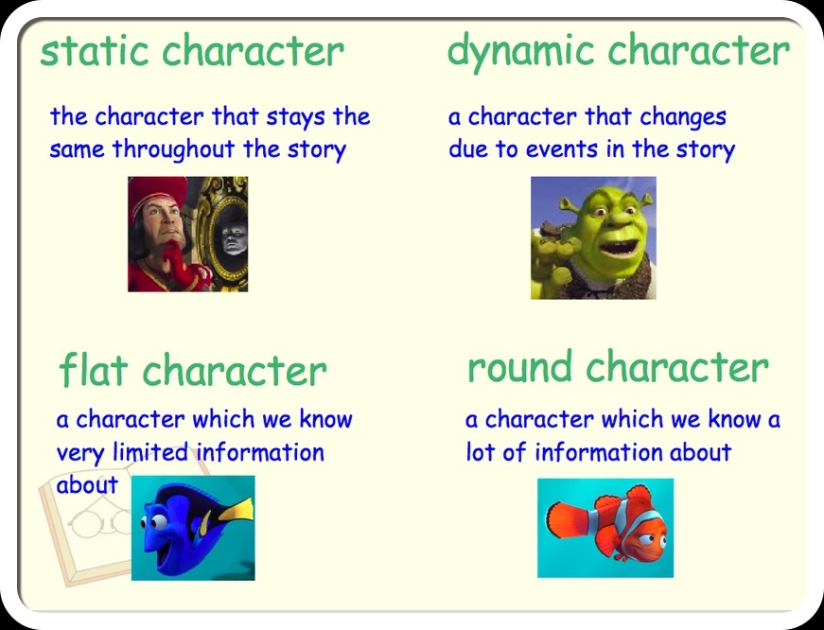
Kinds of characters
Characters drive plot, NOT the other way around.

Slide 7

Above all, characters need to be believable.
Characters drive the plot forward

Slide 8


Character Development
Head: How intelligent is he or she?
Eyes: How does he or she see the world?
Shoulders: What burdens does he or she carry?
Mouth: What does their voice sound like?
Do they speak in slang or with an accent?
Arms: What are their strengths?
Legs: What do they rely on? What keeps them standing?
Heart: What do they care most about? What do they want most of all?
Achilles Heel: What is his or her biggest weakness?
Feet: What are their roots? Where do they come from? What culture?

Slide 9
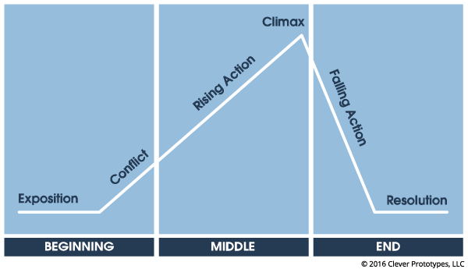
Plot Outlining
Outline the main events of the story first and fill in the details later

Slide 10
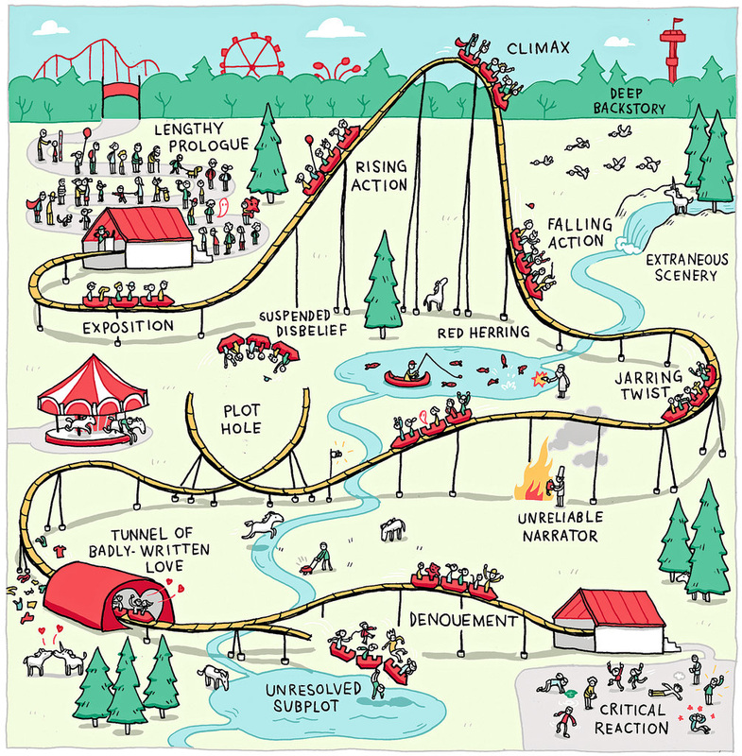

Slide 11
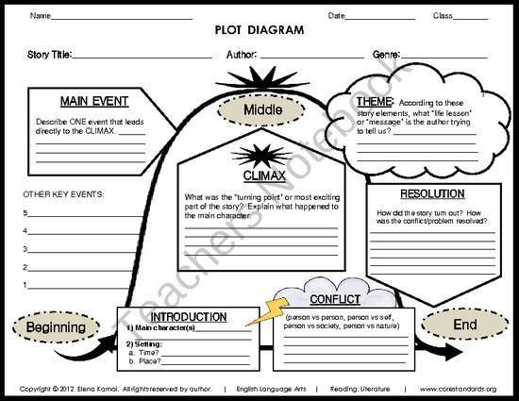

Slide 12
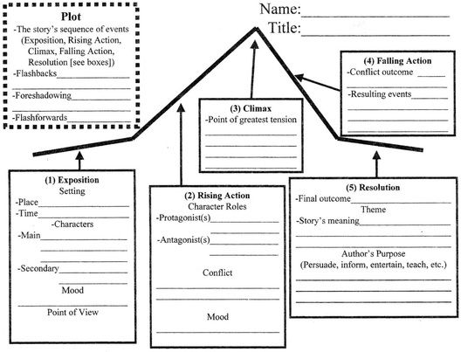

Slide 13

Free Writing
Just start writing and see what happens!
(Don’t think of free writing and brainstorming as your first draft)

Slide 14

How to start
Dialogue
Describe a setting in detail
Get inspired by a picture

Slide 15
Famous first lines of literature
Call me Ishmael. —Herman Melville, Moby-Dick (1851)
A screaming comes across the sky. —Thomas Pynchon, Gravity's Rainbow (1973)
It was a bright cold day in April, and the clocks were striking thirteen. —George Orwell, 1984 (1949)
I am an invisible man. —Ralph Ellison, Invisible Man (1952)

Slide 16
And MOre
They shoot the white girl first. —Toni Morrison, Paradise (1998)
Ships at a distance have every man's wish on board. —Zora Neale Hurston, Their Eyes Were Watching God (1937)
This is the saddest story I have ever heard. —Ford Madox Ford, The Good Soldier (1915)
It was a pleasure to burn. —Ray Bradbury, Fahrenheit 451 (1953)
You better not never tell nobody but God. —Alice Walker, The Color Purple (1982)

