Slide 1




Expanding a sentence with semi-colons commas, parentheses and dashes

Slide 2
How to use a semicolon

Slide 3
Quick Review: CLAUSES
A clause contains a subject and a verb.
How many clauses are in the following sentences?
1. I really really really really really want a puppy!
2. If you’ve ever been Paris, you’ll know what I’m talking about when I say it’s the most romantic city in the world.

Slide 4
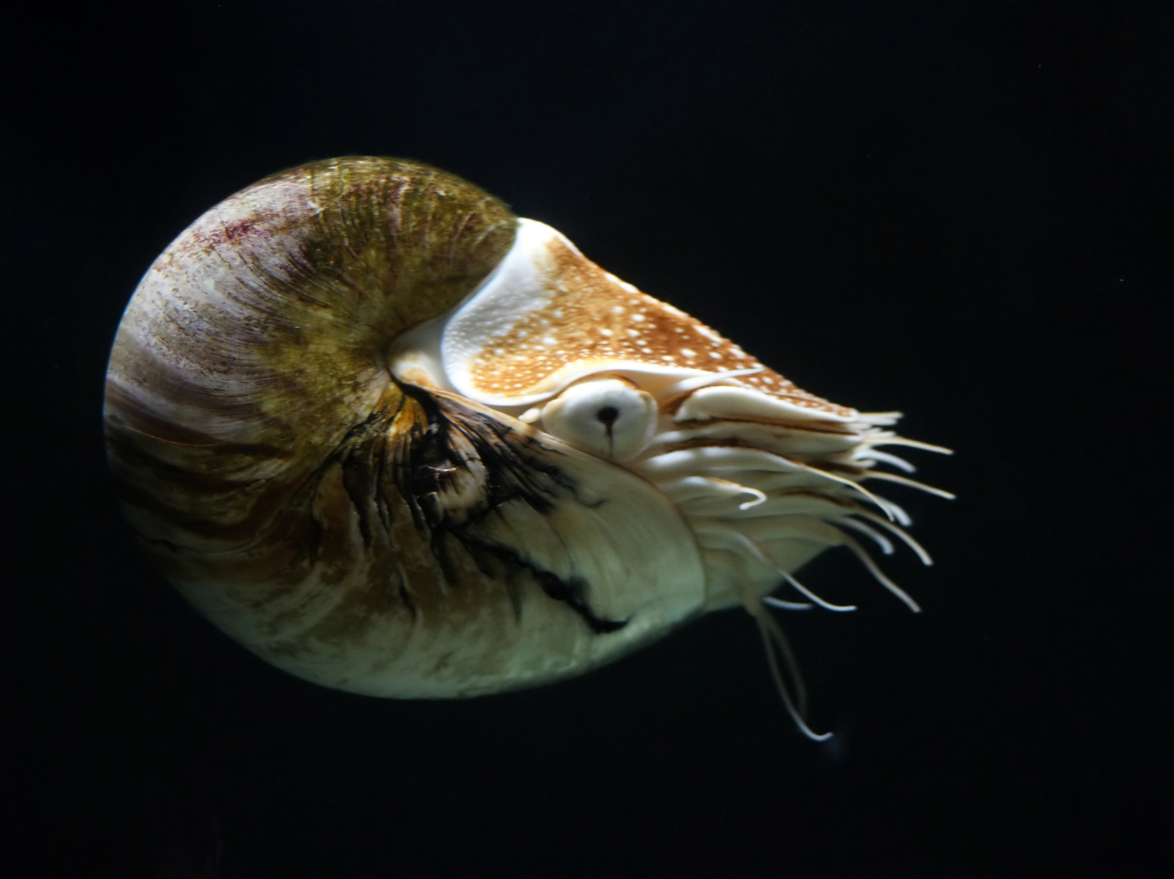
A semicolon separates two independent clauses that are related.
This week we’re studying cephalopods; next week we’re studying nidarians.
I like to watch individual sports; my dad prefers to watch team sports.
Mrs Lovitz has started a tutoring club; many teachers are borrowing this idea.
Think of a semicolon as stronger than a comma, but not quite a full stop.

Slide 5
You may also need semicolons to separate items in list when items contain several words
In order to complete the experiment, you will need: 5 magnets with labeled poles; 5 cylindrical beakers; iron shavings or very small nails; and distilled water.
The invite list to my birthday party includes Emily and her boyfriend; Danielle and the foreign exchange student staying with her; the McDavis twins; and everyone in my form group.

Slide 6
Write 5 compound sentences separated by a semicolon.
Added challenge: Use some of the following vocabulary words
  *melancholy *obsolete *ponder *gullible
  *arid *detrimental *ignorant *stealthy
  *plausible *cope

Slide 7
Expanding a sentence with commas, parentheses and dashes

Slide 8
Use a comma for non-restrictive elements:
The Inuit, sometimes referred to as Eskimos, are a resourceful tribe of native North Americans.
The Artic, a harsh and desolate climate, is home to polar bears, an aggressive and predatory species, as well as narwhals and seals.

Slide 9
Parentheses add information that is not essential to the main point
My sister (the most annoying person in the world) is on her way home college.
Queen Elizabeth I (1533-1603) was the last monarch of the Tudor Dynasty.
By using apple sauce as a substitute for eggs (I forgot them off my shopping list), I learned I could never be a vegan.

Slide 10
Dashes can be used in place of parentheses
My favourite basketball team is the Bulls – I was born in Chicago - and I am saving up for season tickets.
I know I’m going to pass Chinese – I’ve been speaking it since I was 6 – so I don’t even bother to study.
I haven’t spoken to Marie since I stole her boyfriend – a choice I’ve regretted ever since.
The only difference between brackets and dashes is that you can use only one dash.

Slide 11
Write 5 sentences containing non-restrictive elements
Added challenge: Use some the vocabulary words you were unable to use last time
  *melancholy *obsolete *ponder *gullible
  *arid *detrimental *ignorant *stealthy
  *plausible *cope

