Slide 1
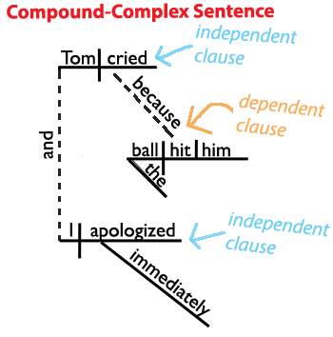
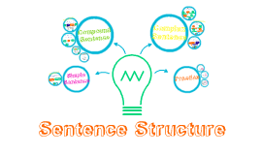
Simple, Compound, and Complex Sentences

Slide 2

What part of speech is required in EVERY sentence in the English language?
However, not all verbs look like an action.

Slide 3

The following are all verbs:
have
has
had
having
must
shall
will
am
is
are
was
were
be
being
been
might
may
can
should
could
would

Slide 4
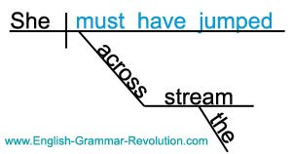
To express yourself, you often need more than one verb.
The verb that refers to the action is the main verb.
The verbs that refer to tense or condition are helping verbs.

Slide 5
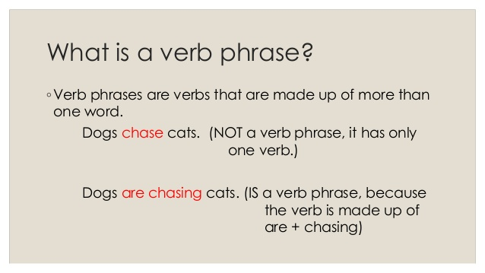

Slide 6
What are the main verbs and helping verbs in the following sentences?
I have never visited France.
helping
main
Sandra is lurking under the stairs.
helping
main
By next month, Alisha and Tom will have been dating for a year.
helping
helping
helping
main
You are not going to lead this discussion.
helping
helping
main

Slide 7
Subject: The who or the what that is doing the verb.
Where is the subject?
The black rhino is an endangered species.
___________________
subject
My sister cannot sit still.
______________
subject
subject= who or what is doing the verb
Eventually, all the fresh water will run out.
__________________________
subject
In the movie theatre, a strange man is lurking behind the curtains.
_____________________
subject

Slide 8
Clause
Contains a subject and a verb
How many clauses in the following sentences?
I eat pizza.
I eat pizza and it’s delicious!
I eat pizza and tacos.
Because pizza is delicious, I eat it all the time.
Whenever I eat pizza, I feel amazing, so I eat it every day.

Slide 9
Simple, compound and complex sentences
I eat pizza.
simple sentence
I eat pizza every day.
simple sentence
I eat pizza, and I love it!
compound sentence
I eat pizza, but I only eat it on Friday.
compound sentence
I eat pizza because it’s my favourite.
complex sentence
Since pizza is the bomb, I eat it all the time.
complex sentence

Slide 10
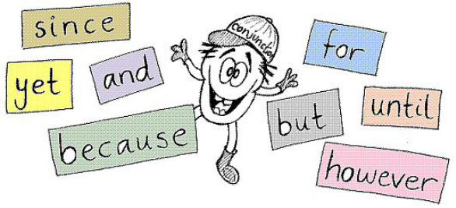
How do you know the difference?
CONJUNCTIONS!

Slide 11
Complex Sentences
Are made of one independent clause and one dependent clause.
Subordinating conjunctions
if
because
unless
although
since
until
while
Can stand alone as a complete sentence
Depends on the other clause for meaning
You may be afraid if you read Dracula.
If you read Dracula, you may be afraid.

Slide 12
Complex Sentences:
The dependent clause begins with the conjunction.
If your sentence begins with a dependent clause, you need a comma.
Dracula drinks blood because he needs it to survive.
independent
dependent
Because he needs it to survive, Dracula drinks blood.
dependent
independent
Don’t go out at night if you’re afraid of vampires.
independent
dependent
If you’re afraid of vampires, don’t go out at night.
dependent
independent
You’re not safe against vampires unless you carry garlic.
independent
dependent
Unless you carry garlic, you’re not safe against vampires.
dependent
independent

Slide 13
Compound- Complex Sentences
Made up of two or more independent clause AND one or more dependent clauses
My friend and I went to the movie that I had been wanting to see, and then we got milkshakes afterward.
independent
dependent
How many clauses?
independent

Slide 14
Compound- Complex Sentences
Before they were friends, Isabelle and Erica knew Angie, but they didn’t realize that they had met until they were in the same class.
When a dependent clause occurs between two independent clauses and applies only to the second, the dependent clause should be set off with commas.
Before they were friends, Isabelle and Erica knew Angie, but they didn’t realize that they had met until they were in the same class.
dependent
independent
dependent
independent
How many clauses?

Slide 15
What do you notice about the punctuation in compound-complex sentences?
If we want this business to work, you need to find suppliers and I need to find buyers.
When a sentence begins with a dependent clause that applies to two independent clauses that follow, insert a comma after the dependent clause, but do not insert a comma between the independent clauses.
The prime minister’s plan seemed quickly and sloppily put together, and when they saw it, the opposition party immediately attacked it.
When a dependent clause occurs between two independent clauses and applies only to the second, the dependent clause should be set off with commas.

