Slide 1
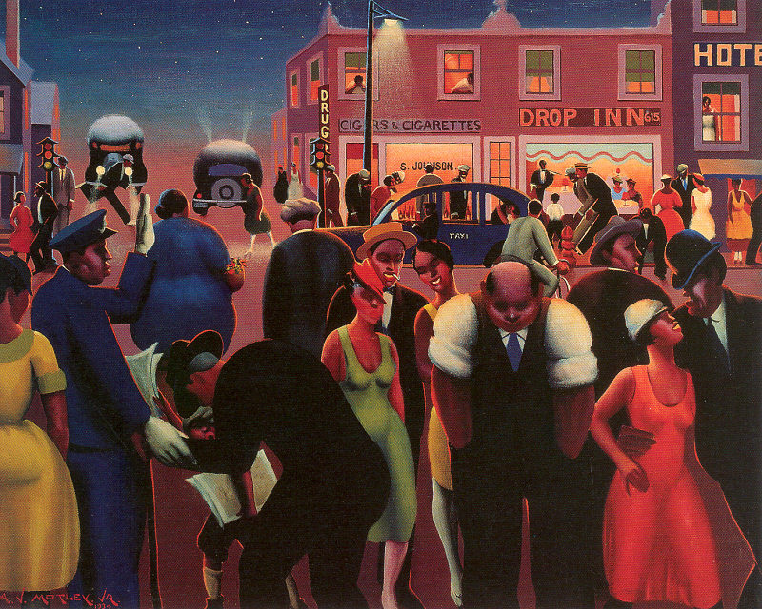
Harlem
By Langston Hughes
Interpreting imagery

Slide 2
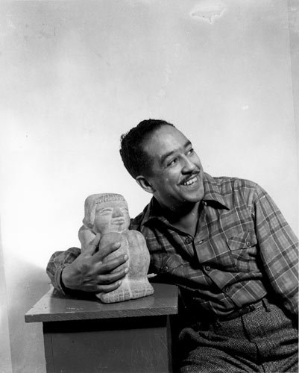
Langston Hughes
Historical Background
‘Harlem’ was written in 1951
Addresses the limitations on the access to the American Dream for African Americans

Slide 3
Learning Objectives:
Understand the literal meanings of imagery
Analyze and interpret the effects of imagery on a piece of writing
Distinguish between paraphrasing and interpretation
Use textual evidence to support a claim, interpreting its effects

Slide 4
Harlem by Langston Hughes
What happens to a dream deferred?
Does it dry up
like a raisin in the sun?
Or fester like a sore—
And then run?
Does it stink like rotten meat?
Or crust and sugar over—
like a syrupy sweet?
Maybe it just sags
like a heavy load.
Or does it explode?
How does the author use imagery to convey the sense of longing in the poem?

Slide 5
Paraphrase:
Retell in your own words
What happens to a dream deferred?
Does it dry up
like a raisin in the sun?
Or fester like a sore—
And then run?
Does it stink like rotten meat?
Or crust and sugar over—
like a syrupy sweet?
Maybe it just sags
like a heavy load.
Or does it explode?
What is the literal meaning behind each use of imagery?
Use your foldable to paraphrase each use of imagery.

Slide 6
With a partner, paraphrase each line of imagery
What happens to a dream deferred?
Does it dry up
like a raisin in the sun?
Or fester like a sore—
And then run?
Does it stink like rotten meat?
Or crust and sugar over—
like a syrupy sweet?
Maybe it just sags
like a heavy load.
Or does it explode?
What happens when a goal is put off indefinitely?
Does it wither and shrink?
Does it rot as an open sour and drip pus and blood?
Will it spoil and give off a bad smell?
Does it get stale like a dessert?
Does it bend from its own weight?
Or does it burst?

Slide 7
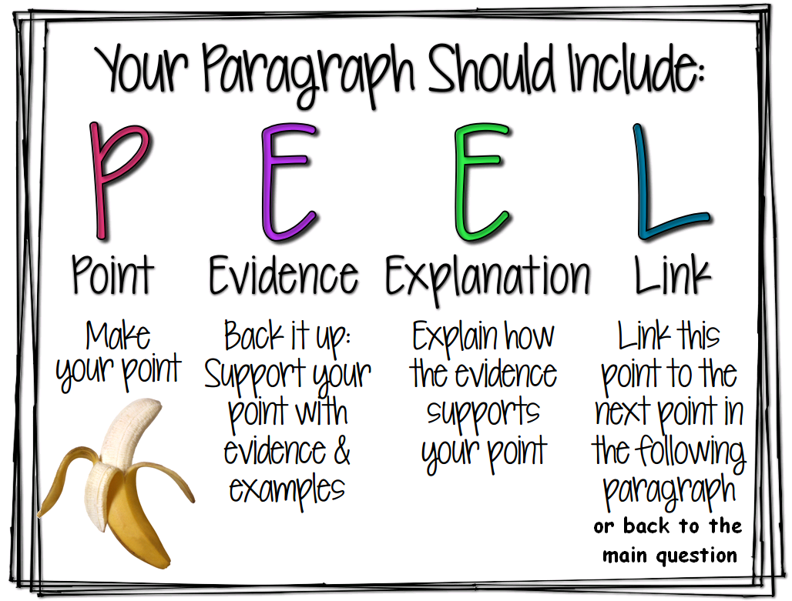
Using and interpreting textual evidence
Now that you understand the literal meaning of the poem:
You’ve got plenty of evidence!
But how do we explain and link?

Slide 8
interpret:
Analyze and draw a conclusion
What happens to a dream deferred?
Does it dry up
like a raisin in the sun?
Or fester like a sore—
And then run?
Does it stink like rotten meat?
Or crust and sugar over—
like a syrupy sweet?
Maybe it just sags
like a heavy load.
Or does it explode?
What is the author actually trying to convey with each use of imagery?
What is the message the author intends to communicate?
Use your foldable to interpret each use of imagery.

Slide 9
With a partner, interpret the meaning behind the imagery.
What happens to a dream deferred?
Does it dry up
like a raisin in the sun?
Or fester like a sore—
And then run?
Does it stink like rotten meat?
Or crust and sugar over—
like a syrupy sweet?
Maybe it just sags
like a heavy load.
Or does it explode?
Are goals and dreams really achievable in our current society? What happens if the answer is no?
Raisins come from juicy grapes. Does the dream wither and slowly die?
Will the dream just remain a sickly version of itself that never heals, that just slowly seeps pain?
Rotten meat is harmful garbage that must be thrown away for for health reasons.
Sweet treats become stale when left out, neglected, contrasting a sweet promise of a dream with the bitterness of lost dreams.
The burden of the unfulfilled dream weighs on the dreamer over time, and the effects can be physically felt.
Explode has two connotations: Dangerous and celebratory. Which will it be?

Slide 10
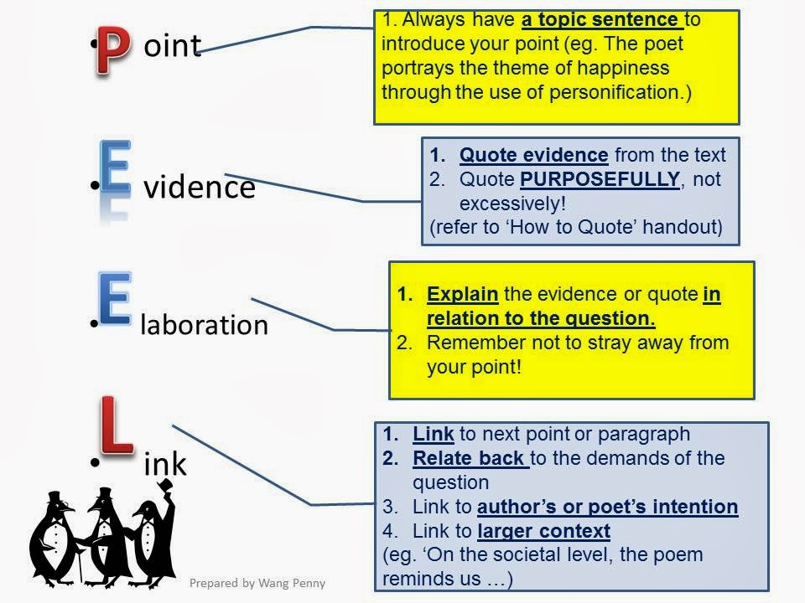
How does the author use imagery to convey the sense of longing in the poem?
Use your interpretations to answer the question using P.E.E.L.

Slide 11
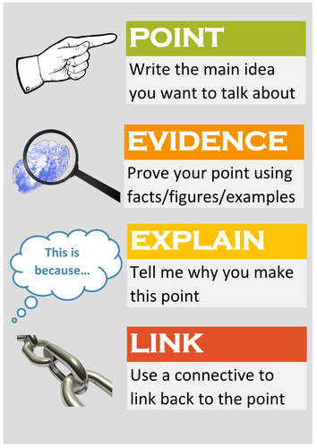
Explaining your textual evidence:
In the poem Harlem, Langston Hughes uses imagery to convey a theme of longing for unfulfilled dreams. He asks, “Does it sag like a heavy load?” This means that an unfulfilled dream can can bend under it’s own weight. We can therefore see the physical effects of a dream that is neglected over time.
Which explanation is more effective?
COMPARE
In the poem Harlem, Langston Hughes uses imagery to convey a theme of longing for unfulfilled dreams. He asks, “Does it sag like a heavy load?” This means that an unfulfilled dream weighs on the dreamer over time, and its effects can be phycically felt. We can therefore see the physical effects of a dream that is neglected over time.

Slide 12
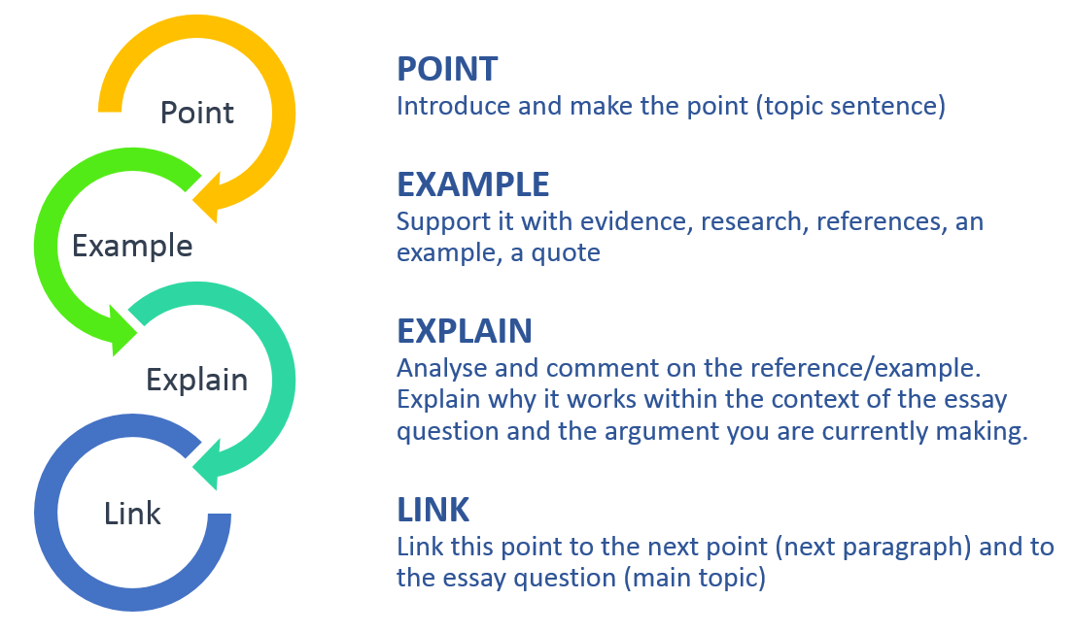
Compare your paraphrasing to your interpretations. Which are more effective?
In the poem Harlem, Langston Hughes uses imagery to convey a theme of longing for unfulfilled dreams. He asks about the dream, “Does it explode?” This means that eventually the dream could burst. The reader must question if a neglected dream will eventually explode.
COMPARE
In the poem Harlem, Langston Hughes uses imagery to convey a theme of longing for unfulfilled dreams. He asks about the dream, “Does it explode?” This question has two connotations: both dangerous and celebratory. The reader must explore the possible outcomes of long neglected dreams, how they have the potential to be victorious or violent.
How does paraphrasing limit your ability to analyze the poem?

