Slide 1

Question Words and Sentence Starters
What is the question and how do you answer?

Slide 2

How do you know what the question is asking you to do?
Look for the verb in the question.
That’s what you need to do.
The following verbs can be big clues:
  Summarize
  Paraphrase
  Interpret
  Distinguish
  Analyze
  Compare
  Contrast
  Infer

Slide 3
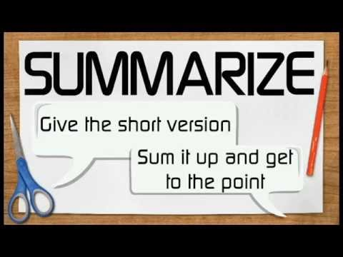
Summarize or Paraphrase:
Retell in your own words
Signal Words:
summarize
paraphrase
explain
in you own words
Sentence Starters:
Essentially,
In summary,
In other words,
To sum up,
As shown above,
In short,
On the whole,

Slide 4

Compare and Contrast:
Explain what is the same and what is different
Sentence Starters:
Similarly,
Likewise,
Correspondingly,
Comparatively,
Moreover,
However,
By contrast,
Nevertheless,
Conversely,
On the contrary,
Signal Words:
compare
contrast
measure
weigh
distinguish
differentiate

Slide 5

Analyze:
Study closely
Signal Words:
analyze
determine
evaluate
interpret
investigate
study
examine
Sentence Starters:
The fact that __________ shows that
Based on ________, it can be concluded that
Considering ________, we can conclude
The evidence suggests that

Slide 6

Infer:
Make an educated guess based on information present
Signal Words:
imply
infer
convey
draw an inference
investigate
study
examine
Sentence Starters:
We can infer that
Consequently,
Therefore,
Subsequently,
For this reason,
Thus,
If…then

