Slide 1
There Will come soft rains
By Ray Bradbury

Slide 2
Learning Objectives
Recognize uses of personification and interpret their effects on the meaning of the text
Analyze text structure: How does the format and arrangement of a text contribute to the overall meaning
Identify and interpret extended metaphor

Slide 3
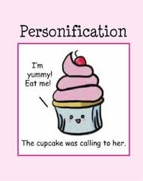
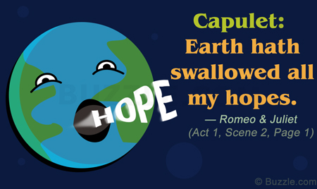
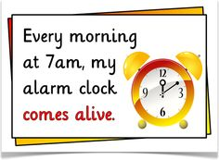

personification
Giving human qualities to non-human things
Reminder: Personification is a kind of metaphor

Slide 4

Dictionary race!

Slide 5
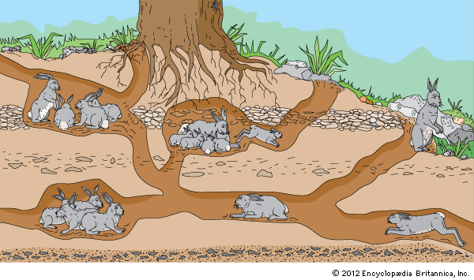
1. warren
Network or rabbit holes

Slide 6
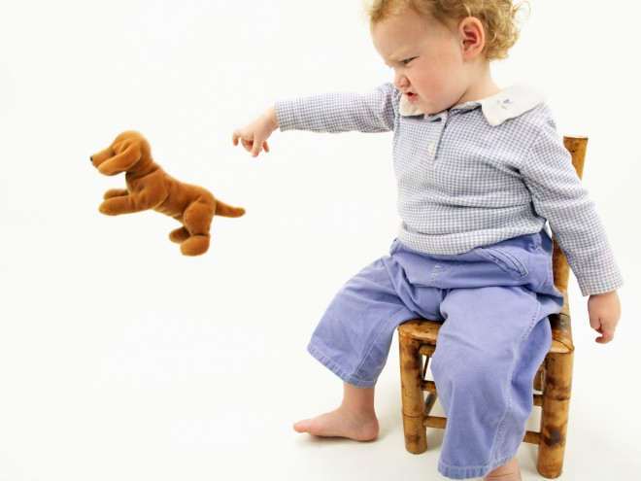
2. Pelt (v)
Throw very hard

Slide 7
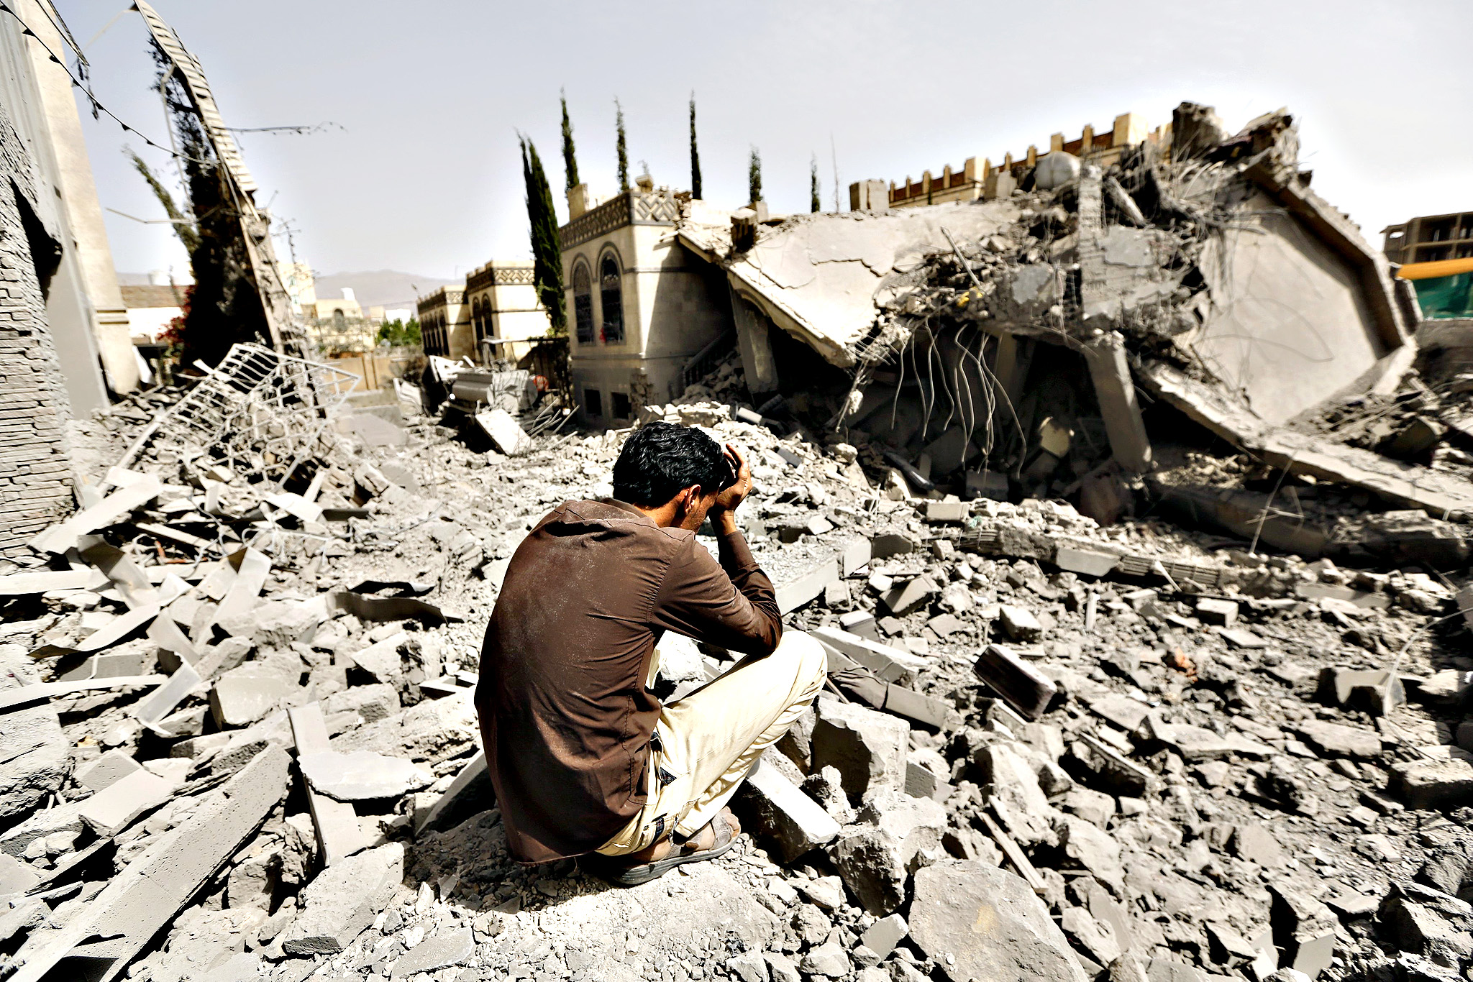
3. rubble
Broken bits as a result of destruction

Slide 8

4. silhouette
outline

Slide 9

5. preoccupation
Worry, busy thought

Slide 10
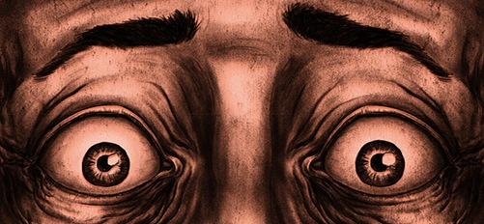
6. paranoia
Thinking everyone is out to get you

Slide 11
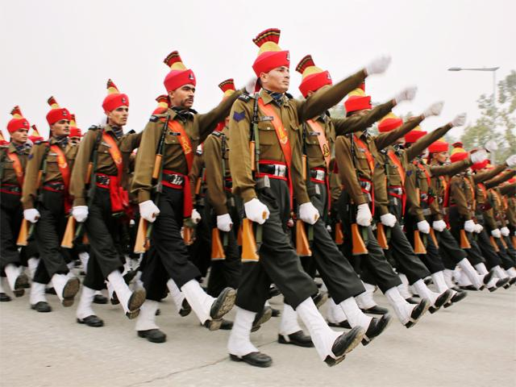
7. regiment
Military unit

Slide 12
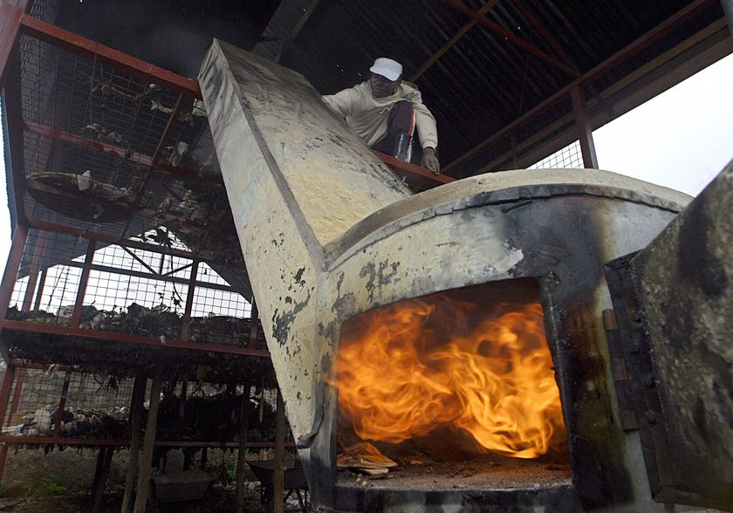
8. Incinerator
Big furnace for burning trash

Slide 13
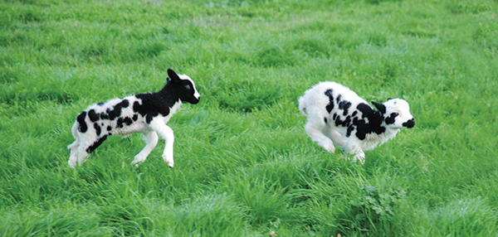
9. cavort
Jump, prance, dance about

Slide 14
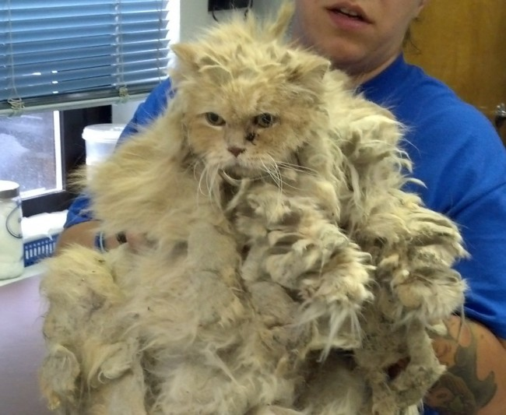
11. matted
Covered In dense, tangled mass

Slide 15

12. parched
Dry, thirsty

Slide 16
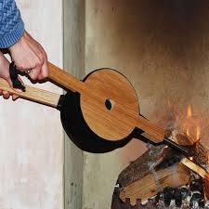
13. bellows
Lungs, device for blowing air

Slide 17

14. manipulate
use or manage skillfully

Slide 18

15. tremulous
nervous, trembling

Slide 19
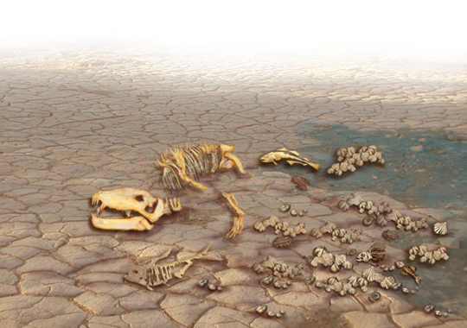
16. perish
die

Slide 20
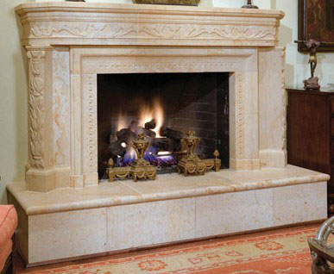
17. hearth
fireplace

Slide 21

18. bough
branch of a tree

Slide 22
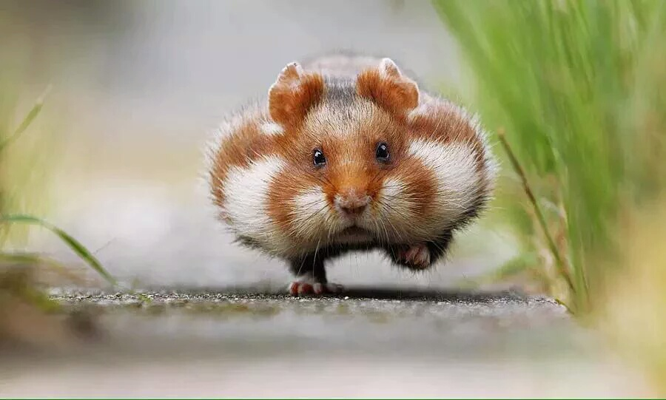
19. scurry
move quickly (especially like a small animal)

Slide 23

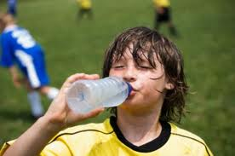
20. quench
satisfy (a thirst or fire)

Slide 24
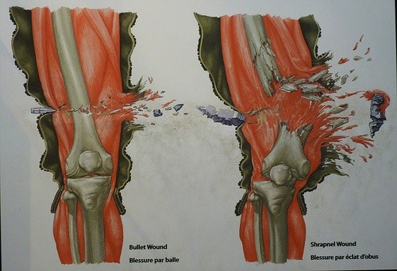
21. shrapnel
projectile that explodes before hitting target

Slide 25
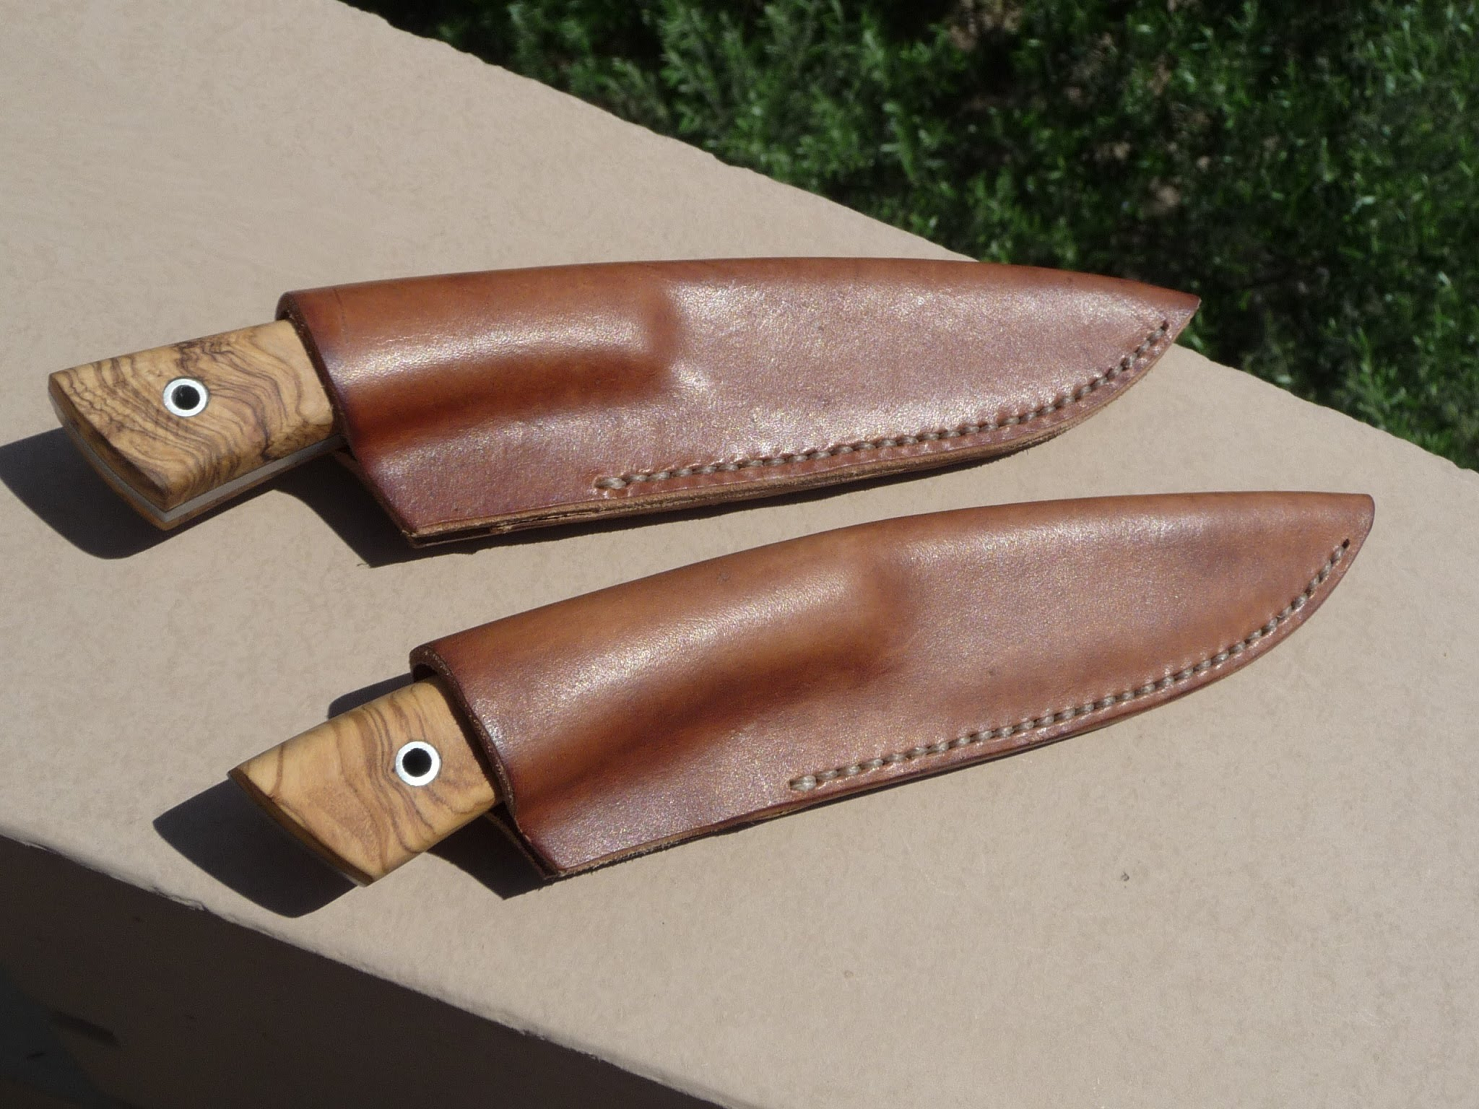
22. sheath
protective casing

Slide 26
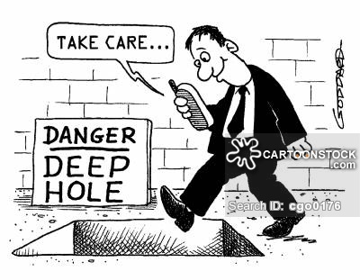
23. oblivious
unaware

Slide 27

24. sublime
elevated in thought, supreme

Slide 28

25. disregard
pay no attention to, neglect

Slide 29

Choose 5 vocabulary Words:
Create your own examples of personification using 5 different vocabulary words.

Slide 30
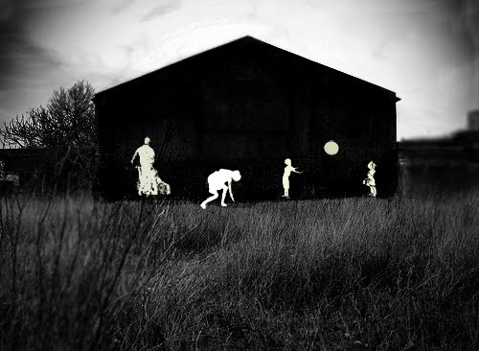
As you read:
Consider the structure of the text as your read:
  How and why does the author change from chronological to descriptive narration?
Highlight or underline examples of personification as you read.

Slide 31
Interpret personification
Personification | Textual Evidence | Interpretation
Example 1:
Example 2:
Example 3:
Example 4:
Example 5:
Extended Metaphor:

Slide 32
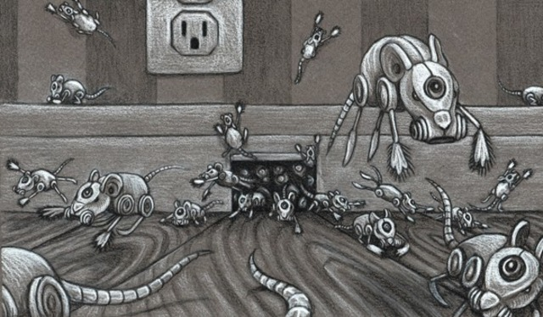
Interpret the extended metaphor:
In two paragraphs: Is the house alive?
Evaluate how Bradbury uses personification to describe the house.
What commentary is the author trying to make about the difference between machines and humankind?
CONSIDER:

