Slide 1
Sympathy and
Caged Bird
Paul Laurence Dunbar and Maya Angelou

Slide 2
Learning Objectives
Review understanding of literary terms and how they contribute meaning to a poem
Determine the meaning of words and phrases as they are used in the text
Determine the theme or central idea of a text and analyze in detail its development over the course of two texts
Understand the importance of historical context to a poem’s meaning

Slide 3
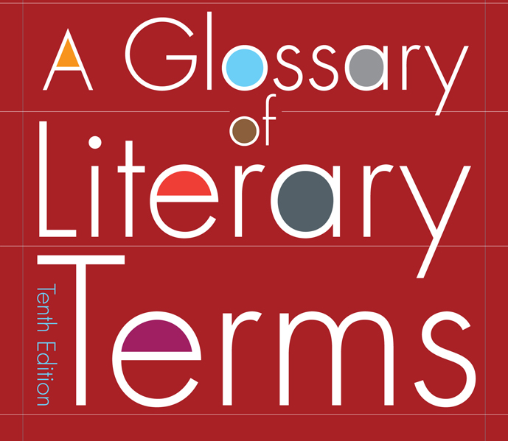
Literary Terms to Know:
Theme
Imagery
Personification
Allusion
Symbolism
Tone
Let’s review!

Slide 4
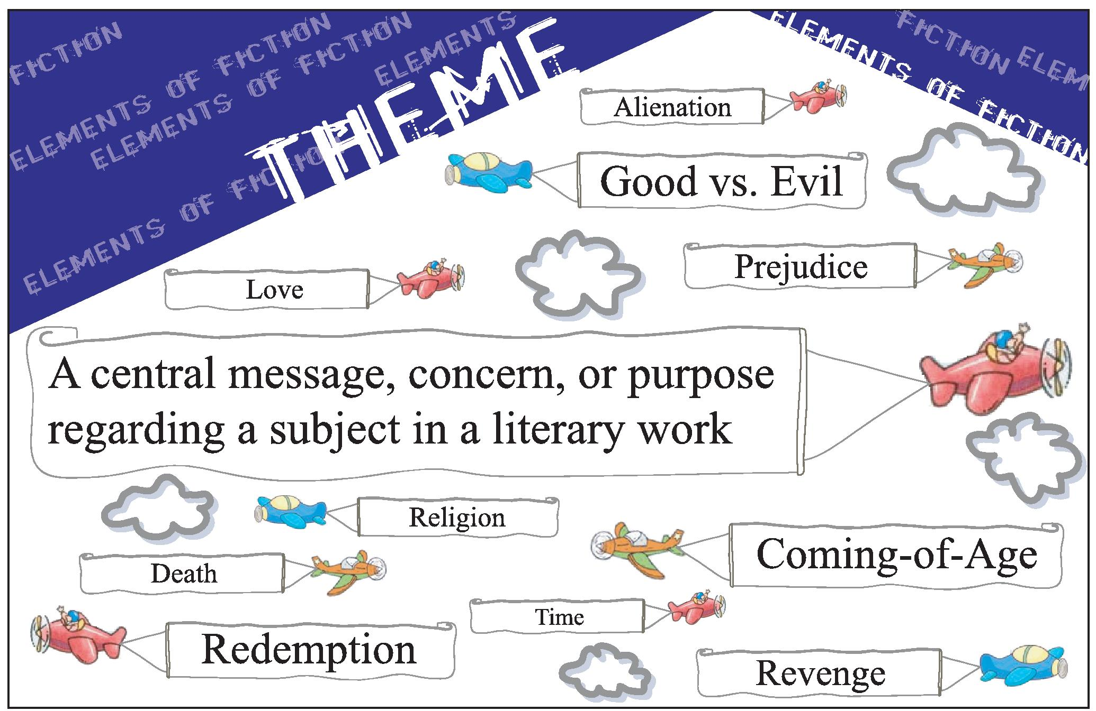
Theme
The big idea in a text
Usually universal for human experience
Can you think of any examples?

Slide 5
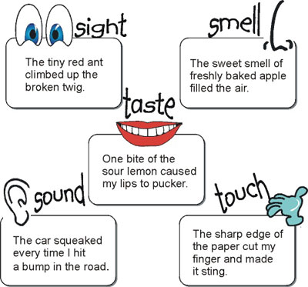
Imagery
The use of language to stir up a picture or a sensation of a person, a place, a thing, an experience, or a feeling

Slide 6
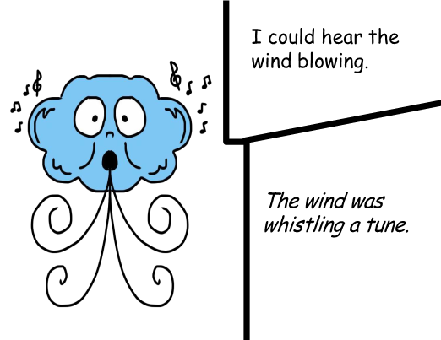
Personification
Applying human characteristics to non-human things
Example: “The wind was whistling.”
NOT personification
personification

Slide 7
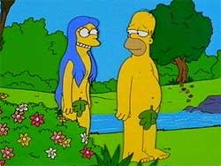
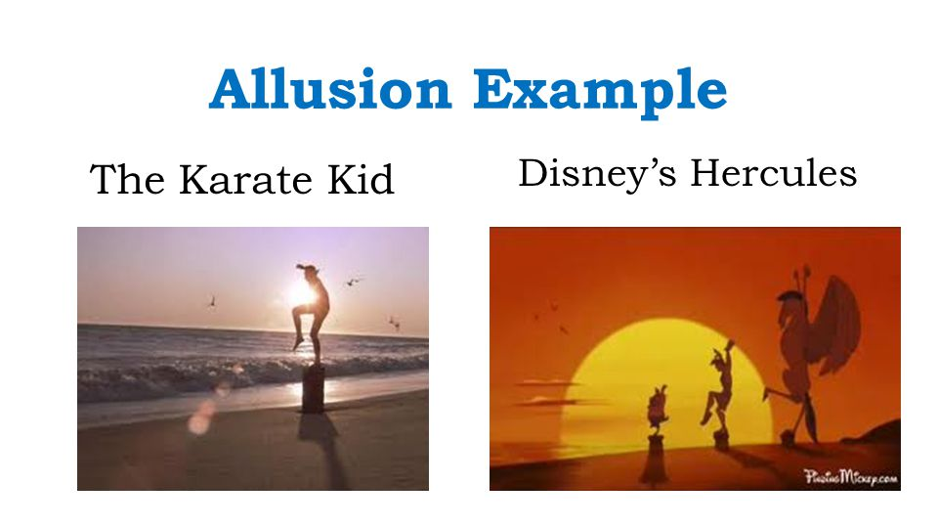
Allusion
A reference to another work of art, historical event, person, etc.

Slide 8




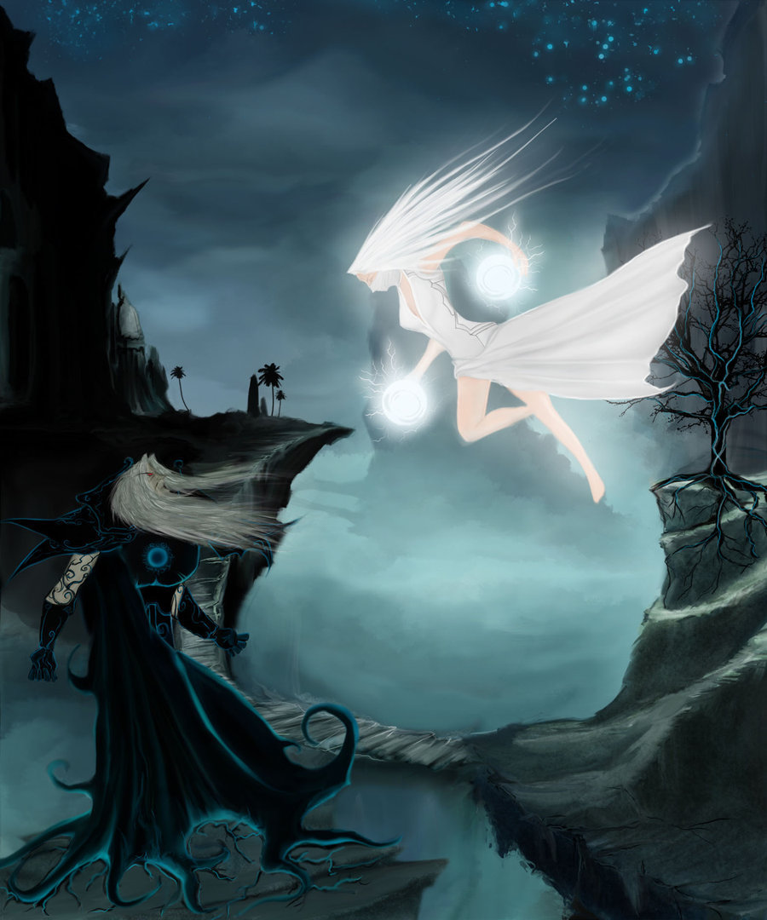
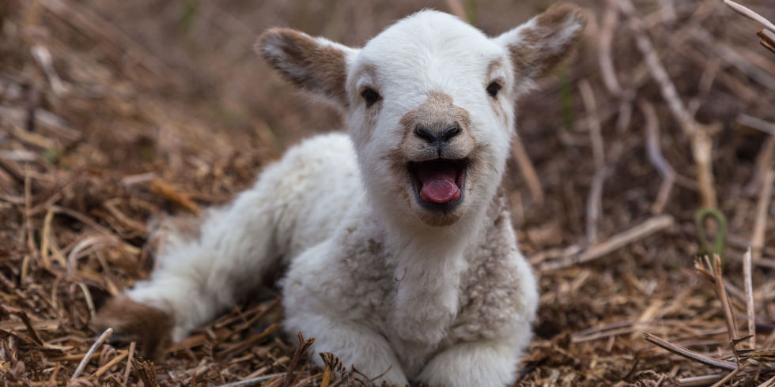
symbolism
Object, person, or situation has another meaning other than its literal meaning
love
Foreshadowing/doom
The end/death
Can you identify these common symbols in literature?
Light vs dark
Royalty/power/authority
innocence
Good vs evil

Slide 9
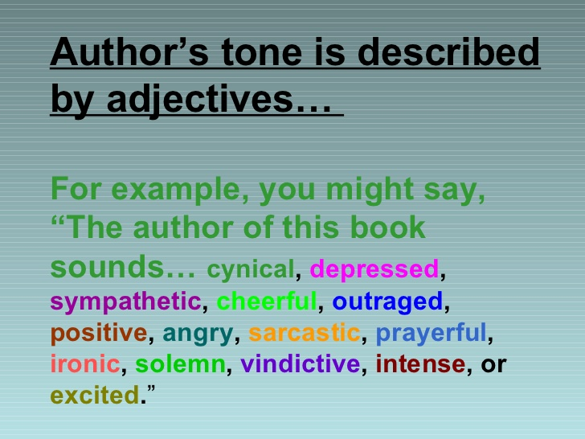

Tone
The attitude or feeling expressed in the text

Slide 10
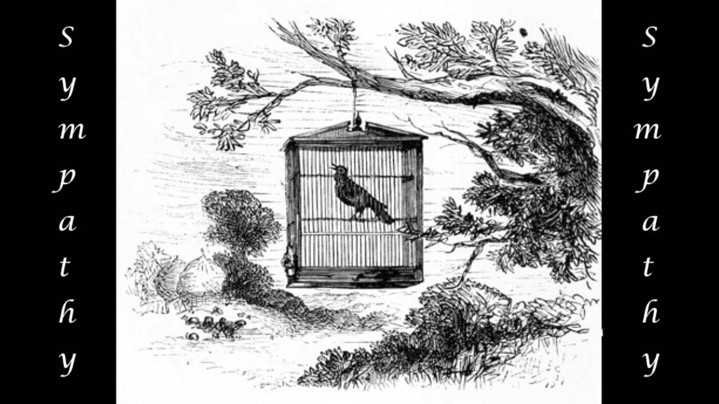
Sympathy by Paul Laurence Dunbar

Slide 11
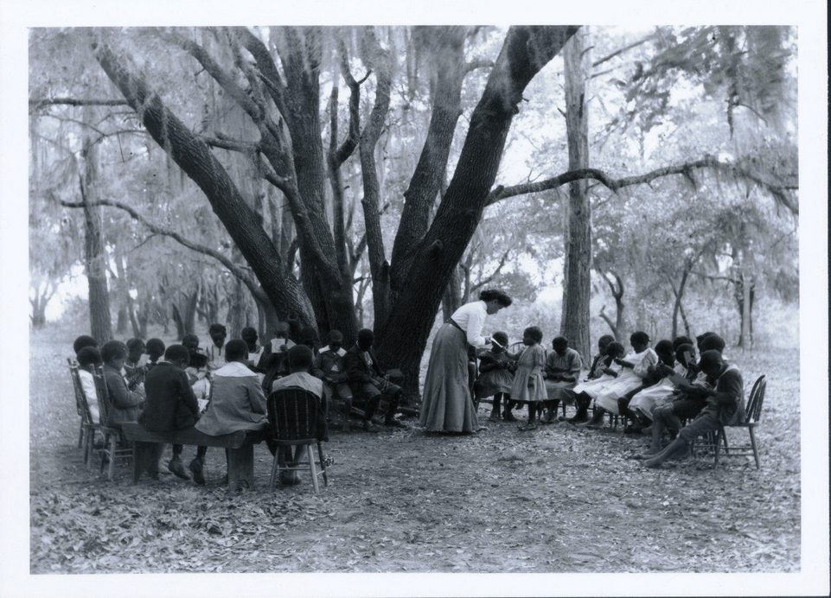
Historical Context
Despite the end to slavery, African Americans did not experience equality and had limited opportunities across the United States, especially in the south.

Slide 12
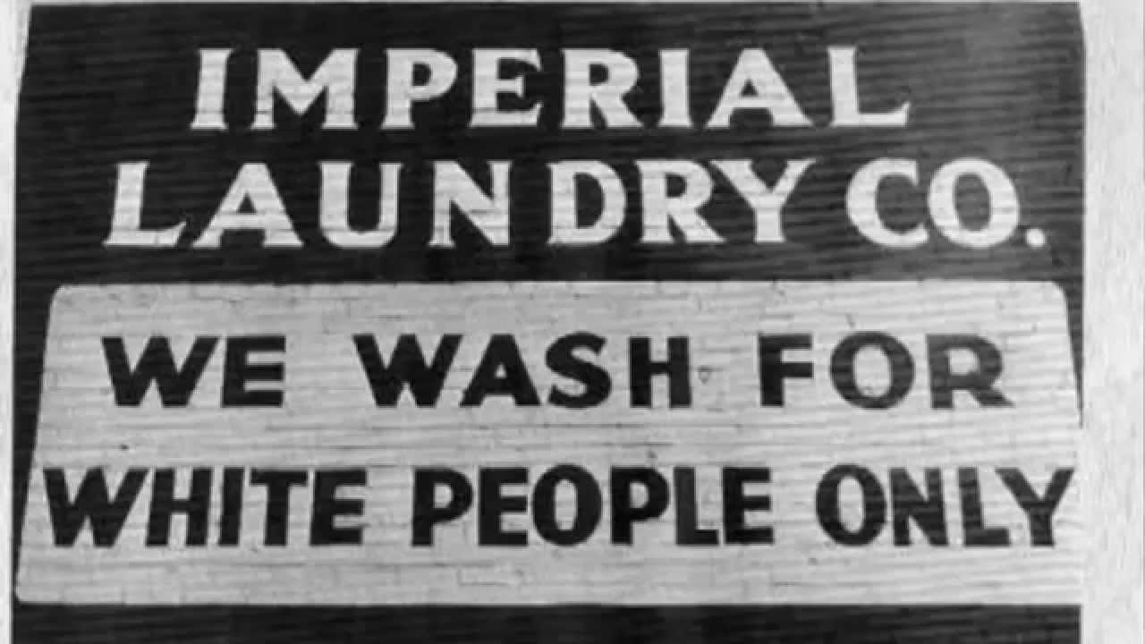
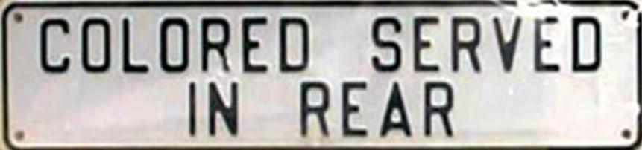
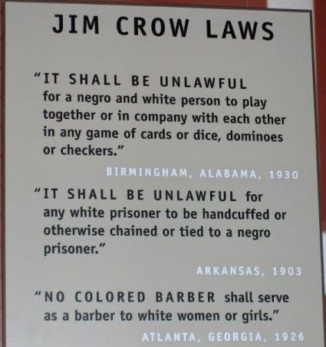
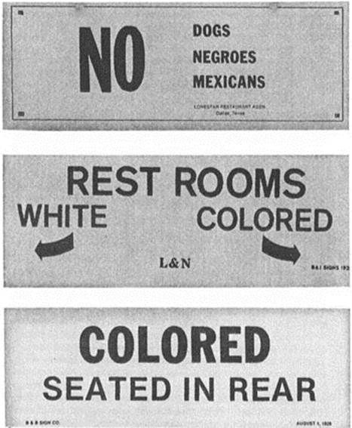

Jim Crow Laws
Enacted 1896

Slide 13
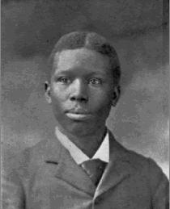
Paul Laurence Dunbar
1872-1906
Dayton, Ohio
One of the first African American poets to gain national recognition
Parents were freed slaves
Their stories of plantation life served as inspiration for much of his writing

Slide 14
Pre-Reading Discussion:
  Think-Pair-Share
What can you infer about the poem based on the title and what you know about the author?

Slide 15
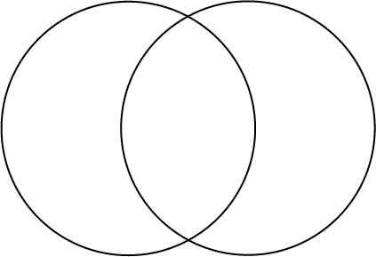
Sympathy vs Empathy
Em=within
Sym=with/together with
Have to do with feelings and experiences of another
Greek roots:
Pathos=feeling/suffering
Ability to imagine oneself in the situation of another
Pity of feeling sorry for another’s misfortune

Slide 16
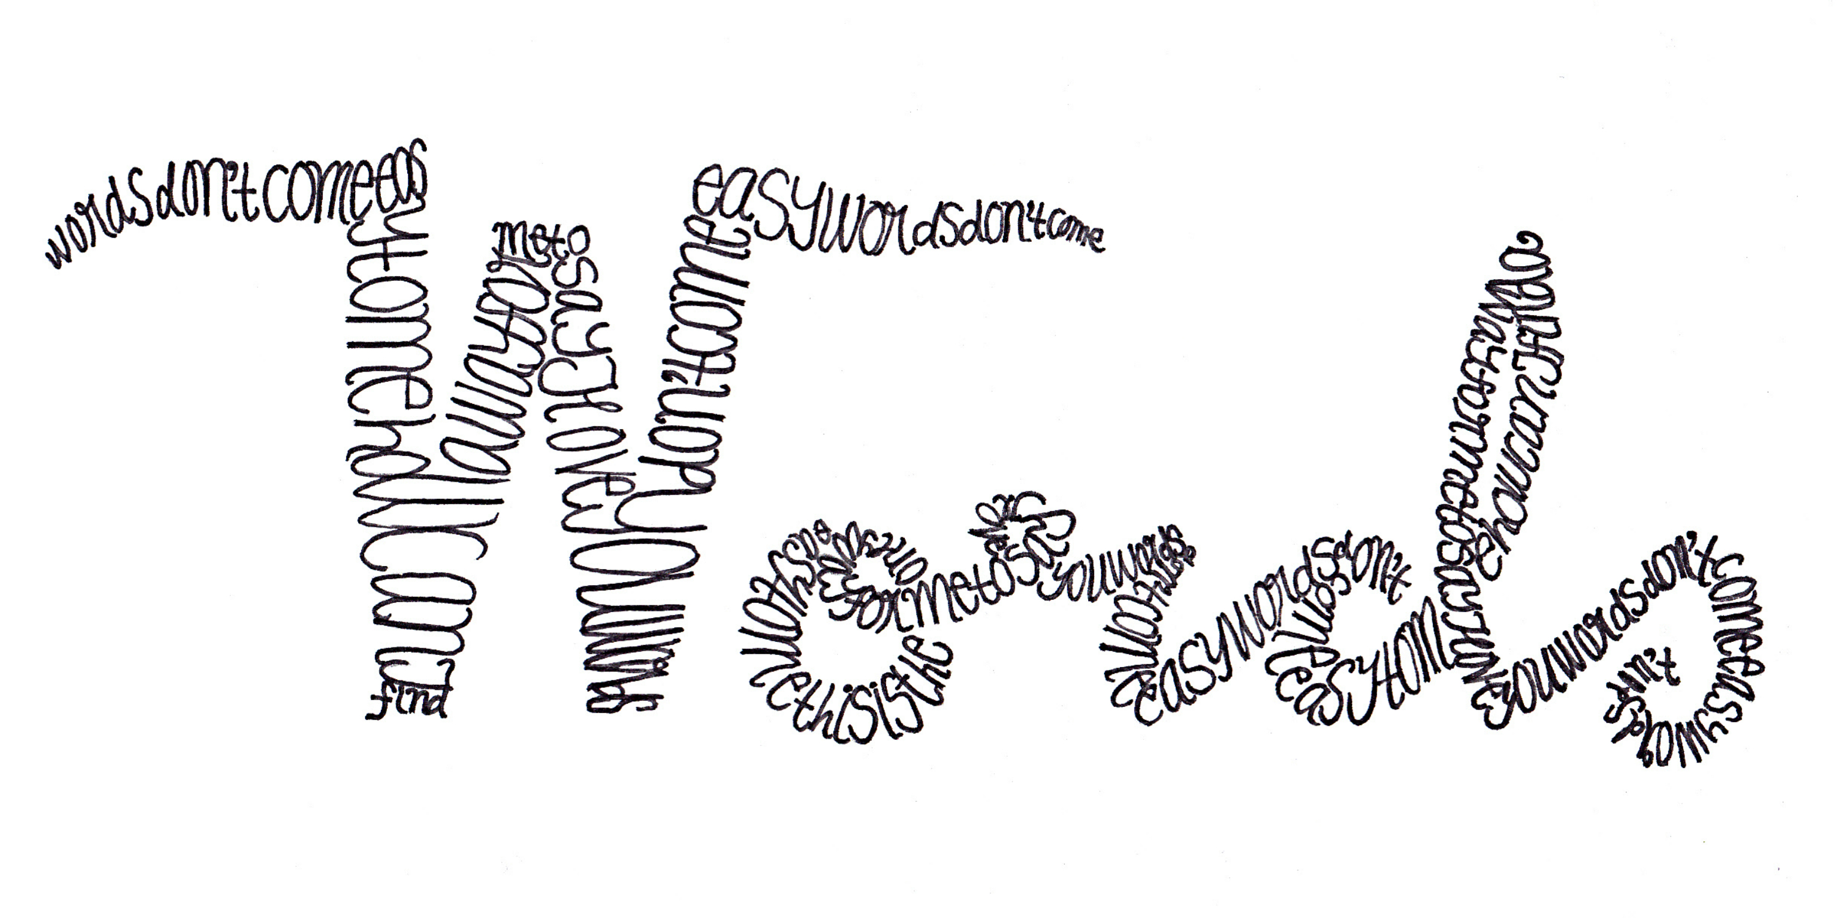
Use a Dictionary to look up the words in the word bank

Slide 17

Let’s Read!

Slide 18

As you Read:
Identify language from the text that you find particularly vivid.
What literary devices is Dunbar using? (**Hint: We discussed a few at the beginning of this lesson, but readers can always find more!)

Slide 19
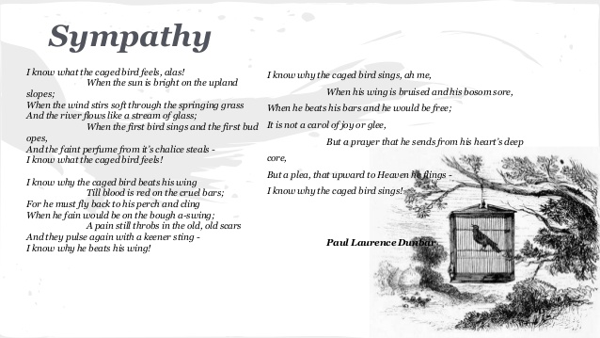
Post Reading Discussion
Why is the use of imagery so effective for this poem?
What images do you find the most powerful?
What big idea(s) are being communicated by imagery in the poem?

Slide 20

Writing Response
What is the theme of Sympathy?
  How do the different literary devices help to reveal the theme to the reader?
  What language does Dunbar use that is particularly powerful?

Slide 21
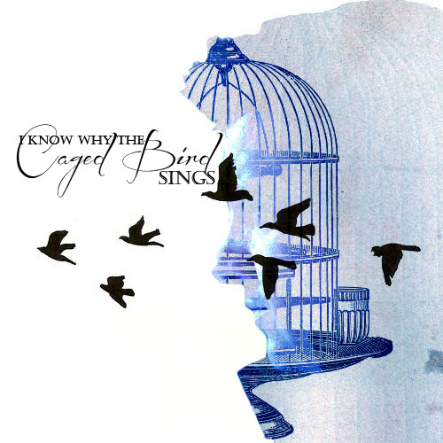
Caged Bird by Maya Angelou

Slide 22
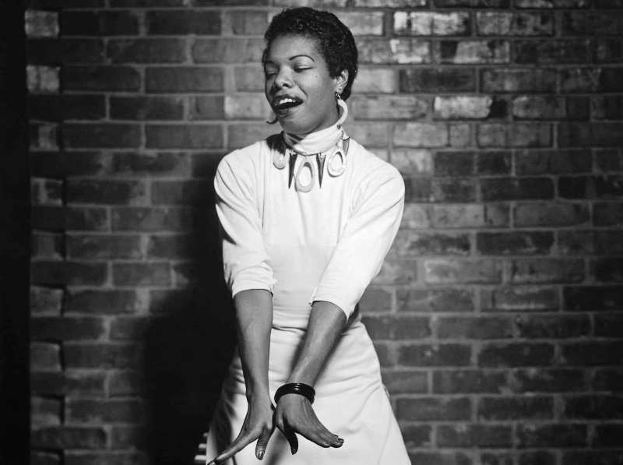
Maya Angelou
1928-2014
Born in St. Louis, MO
Career highlights include: author, poet, historian, songwriter, playwright, dancer, stage and screen producer, director, performer, singer, and civil rights activist

Slide 23

Pre-Reading Discussion
What is the significance of Angelou making an allusion to Dunbar’s poem, Empathy? Why borrow from another poet?

Slide 24
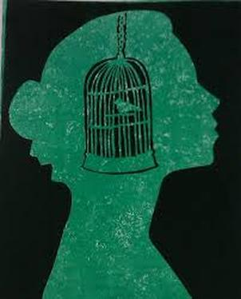
As you read
Compare and contrast the birds in the first stanza and the second two stanzas.
What examples of imagery strike you as very effective? Why?
What verbs does Angelou use that create a vivid depiction of each bird?
How can you interpret the phrase, “clipped wings”?

Slide 25
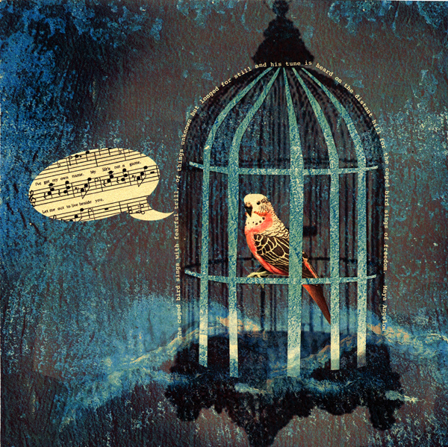
Writing Response: option a
The symbolism of the two birds is very apparent throughout the poem.
How does Maya Angelou develop the idea of the caged bird throughout the poem?
(**Hint: consider structure as well as language.)
Provide at least 2 examples of textual evidence

Slide 26
Written response: option b
Compare and contrast the tone of each poem.
(**Hint: The feelings of the caged bird in each poem are quite different.)
Provide at least 2 examples of textual evidence

